Slide 1
Patentable Subject Matter
Don Cameron
Bereskin & Parr LLP
May 2023

Slide 2
Patents: The Bargain
Public:
gets use of invention after patent expires
Inventor/Owner:
gets limited monopoly for limited period of time

Slide 3
Patents: The Document
Disclosure
(Description):
“How to” manual
Claims:
What you cannot do.

Slide 4
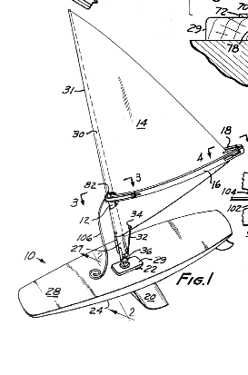
Anatomy of a Patent
The Sailboard Patent

Slide 5

“Hierarchy of claims”

Slide 6
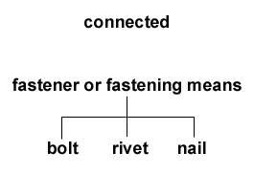
“Hierarchy of claims”

Slide 7
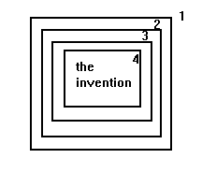
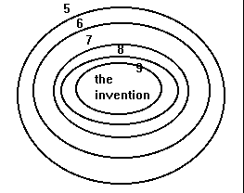
Claims as “nested fences”

Slide 8
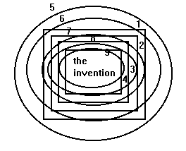
Claims as “nested fences”

Slide 9
One Invention – Many descriptions:
BOUNCE:
A dryer added fabric softener sheet
A method of reducing static cling by commingling clothes with a treated substrate

Slide 10
The Patent Act
Some general features

Slide 11
Two requirements
a concept and
an implementation: a way of putting the concept into practical form.

Slide 12
Other indicia of patentability
Is there a change of state of matter?
Is there a vendible product?
Combinations not aggregations

Slide 13
The Patent Act
The 3 criteria

Slide 14
What’s patentable: Patent Act s. 2
“invention” means any new and useful
art,
process,
machine,
manufacture or
composition of matter,
or any new and useful improvement in any art, process, machine, manufacture or composition of matter.”

Slide 15
What’s patentable: Patent Act s. 2
“invention” means any new and useful
art,
process,
machine,
manufacture or
composition of matter,
or any new and useful improvement in any art, process, machine, manufacture or composition of matter.”

Slide 16
Prerequisites
  new
  useful
  inventive (non-obvious)

Slide 17
New (Novelty)
  never been done, used, written about before
  publicly

Slide 18
Useful (Utility)
  it works
  it achieves the promise

Slide 19
Non-Obvious
  any idiot would not have thought of it

Slide 20
Inventive/Obvious
  a person of ordinary skill in the area
  with no inventive abilities
  would have been led to the solution
  directly and without difficulty.

Slide 21
Inventiveness proven
smart person says:
    “I wouldn’t have thought of that”

Slide 22
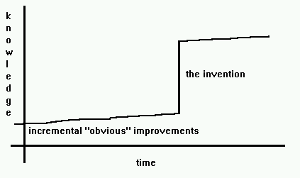
The Inventive Step

Slide 23
The Patent Act
The categories

Slide 24
What’s patentable: Patent Act s. 2
“invention” means any new and useful
art,
process,
machine,
manufacture or
composition of matter,
or any new and useful improvement in any art, process, machine, manufacture or composition of matter.”

Slide 25
What’s not patentable: Prohibited Subject Matter
Patent Act s. 27(3):
  "No patent shall issue for any mere scientific principle or abstract theorem.“
E=mc² isn’t patentable;
nuclear powered pacemakers are patentable

Slide 26
US Patent Act
35 U.S.C. 101:
Whoever invents or discovers any new and useful process, machine, manufacture, or composition of matter, or any new and useful improvement thereof, may obtain a patent therefor, subject to the conditions and requirements of this title.

Slide 27
European Patent Convention: Article 52
1) European patents shall be granted for any inventions, in all fields of technology, provided that they are new, involve an inventive step and are susceptible of industrial application.
(2) The following in particular shall not be regarded as inventions within the meaning of paragraph 1:
  (a) discoveries, scientific theories and mathematical methods;
  (b) aesthetic creations;
  (c) schemes, rules and methods for performing mental acts, playing games or doing business, and programs for computers;
  (d) presentations of information.
(3) Paragraph 2 shall exclude the patentability of the subject-matter or activities referred to therein only to the extent to which a European patent application or European patent relates to such subject-matter or activities as such.

Slide 28
GATT/TRIPS
Make patents available for “any inventions … in all fields of technology” (Article 27(1))
Can’t discriminate against technologies (except biotech)

Slide 29
Art
What it is:
Practical application
Application of skill and knowledge
Commercially useful result or effect
What it isn’t:
A disembodied idea

Slide 30

Art (Lawson)
an act or series of acts
performed by some physical agent
upon some physical object and
producing in such object some change either of
  character or
  of condition
a mode, or method or manner of accomplishing a certain result

Slide 31
Art (Amazon)
Something with a physical existence; or
Something that manifests a discernible effect or change
“Physicality” requirement isn’t met merely by a practical application

Slide 32
Process
use of a method or the performance of an operation
to produce a result

Slide 33
Machine
the embodiment in mechanism of any function or mode of operation designed to accomplish a particular effect

Slide 34
Manufacture
In 1799, "manufacture " was defined as "something made by the hands of man”

Slide 35
Composition of Matter
chemical compounds or mechanical mixtures
More to follow re Harvard Mouse case

Slide 36
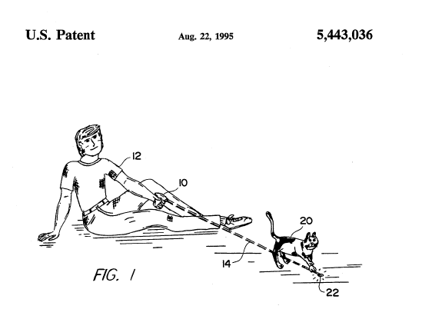
This is patentable?

Slide 37
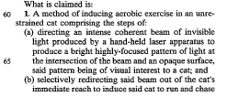
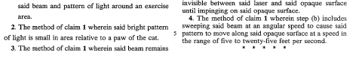

Slide 38
Thank You
Presenter
E-mail
Bereskin & Parr LLP

