Slide 1
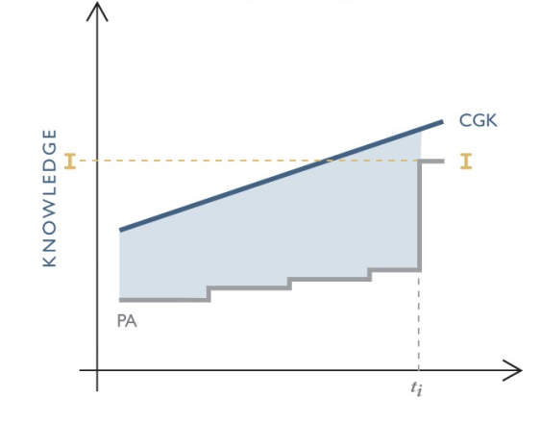

Obviousness
Don Cameron
May 30, 2023
Donald M. Cameron

Slide 2
Would any idiot have thought of that?
Beloit Canada Ltd. v. Valmet Oy (1986), 8 C.P.R. (3d) 289 (F.C.A. per Hugessen J.A.) at p. 294:
    “The classical touchstone for obviousness is the technician skilled in the art but having no scintilla of inventiveness or imagination; a paragon of deduction and dexterity, wholly devoid of intuition; a triumph of the left hemisphere over the right. The question to be asked is whether this mythical creature (the man in the Clapman omnibus of patent law) would, in the light of the state of the art and common general knowledge as at the claimed date of invention, have come directly and without difficulty to the solution taught by the patent. It is a very difficult test to satisfy.”

Slide 3
How to increase production 25%
Gelatin capsules
Four fingers ------→ 5 fingers

Slide 4
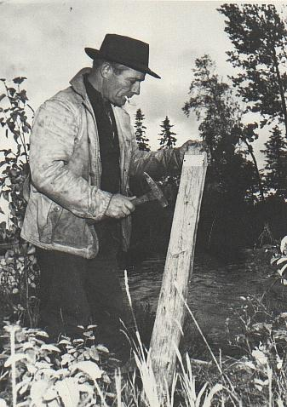
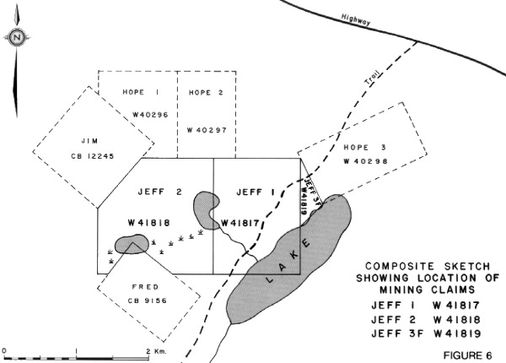
Staking a Claim
"By his claims the inventor puts fences around the fields of his monopoly and warns the public against trespassing on his property. His fences must be clearly placed in order to give the necessary warning and he must not fence in any property that is not his own. The terms of a claim must be free from avoidable ambiguity or obscurity and must not be flexible; they must be clear and precise so that the public will be able to know not only where it must not trespass by where it may safely go. If a claim does not satisfy these requirements it cannot stand... The inventor may make his claims as narrow as he pleases within the limits of his invention but he must not make them too broad. He must not claim what he has not invented for thereby he would be fencing off property which does not belong to him. It follows that a claim must fail if, in addition to claiming what is new and useful, it also claims something that is old or something that is useless.“
Minerals Separation North American Corp. v. Noranda Mines, Ltd., (1947), 12 C.P.R. 99 (Ex.Ct. per Thorson P.) at p. 146.

Slide 5

The sunspot analogy
Key:
  Black “umbra”: what’s old
  Dark aura “penumbra”: what’s obvious
  Yellow: what’s inventive

Slide 6
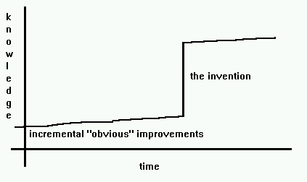
The “Inventive Step”

Slide 7

Obviousness

Slide 8
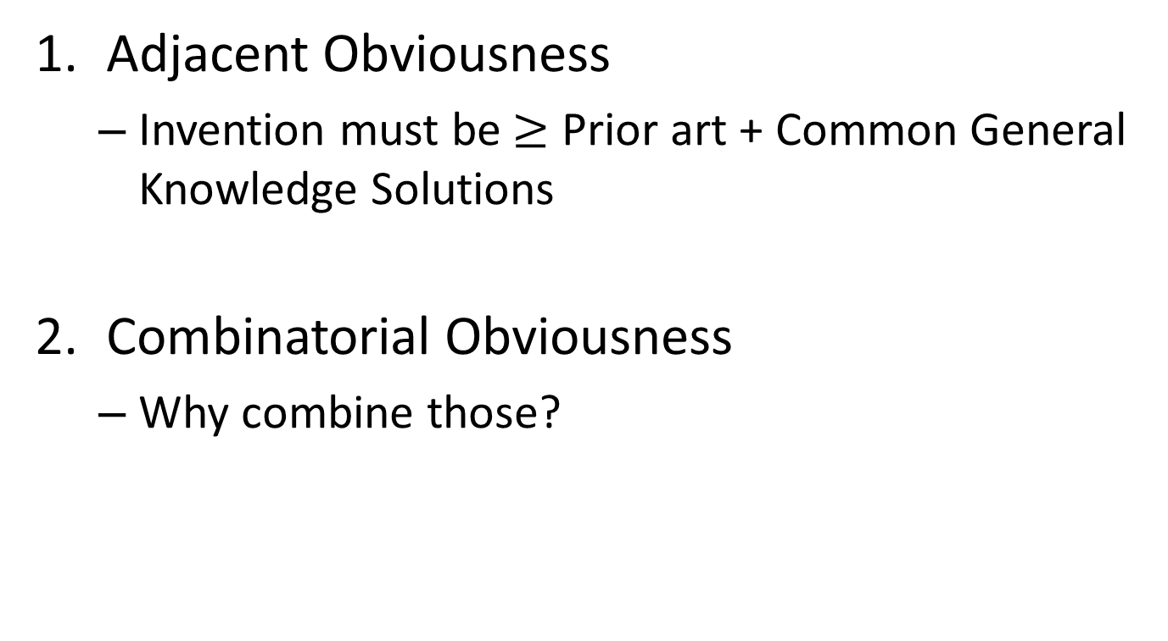
At least Two Species of the Genus “Obvious”
Adjacent Obviousness
  Invention must be$≥$ Prior art + Common General Knowledge Solutions
Combinatorial Obviousness
  Why combine those?

Slide 9

Combinatorial Obviousness
Many elements
S. 28.3 of the Patent Act contemplates “information disclosed…in such a manner that the information became available to the public”.

Slide 10



Combinatorial Obviousness
Selected elements

Slide 11
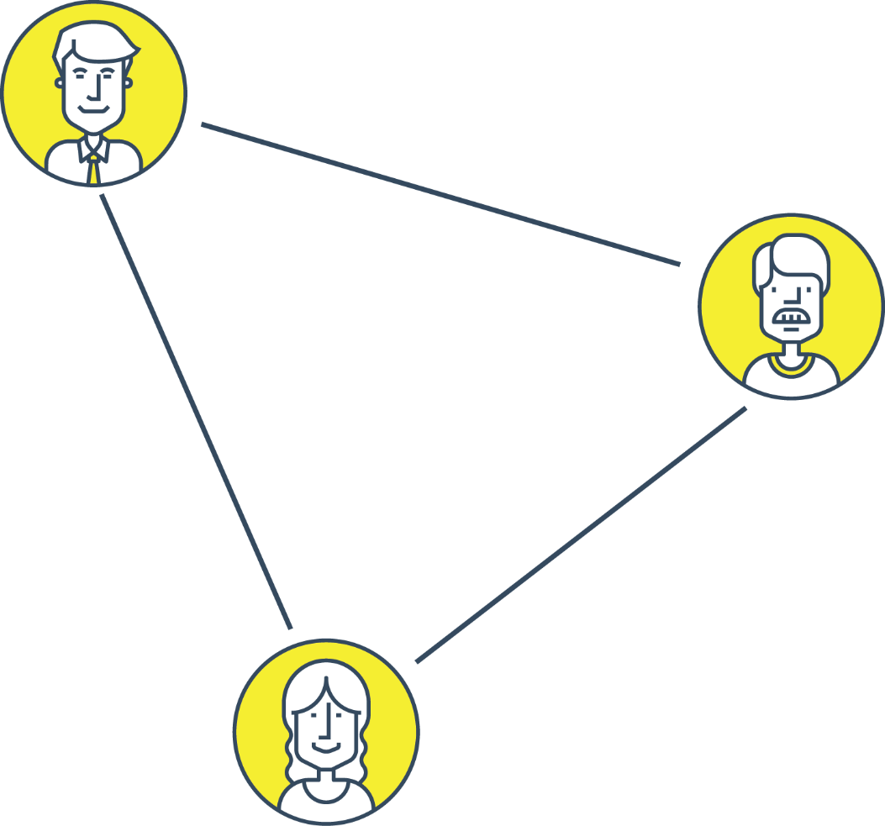
Combinatorial Obviousness
Choose those elements
But why THEM?

Slide 12
Pollard Bank Note
[194] A related consideration is that monopolies are associated in the public mind with higher prices, and a patent monopoly should be purchased with the hard coinage of new, ingenious, useful and unobvious disclosures: Apotex Inc v Wellcome Foundation Ltd, 2002 SCC 77 at para 37. Accordingly, in order to obtain a valid patent, it is not enough for a skilled person simply to make an obvious change to what is known in the art. This principle should apply to any information that was available to the public, even if it would not have been located in a diligent search. For example, should a skilled person be able to obtain a valid patent by simply searching a dusty corner of a public library for a document that describes a forgotten invention and making an obvious change to it? The fact that a prior art reference would not have been located in a diligent search may be more relevant where the obviousness allegation combines two references, neither of which is part of the common general knowledge. In that event, it would be necessary for the party alleging obviousness to explain how a skilled person having one of the references would have been led directly and without difficulty to combine it with the other to arrive at the impugned invention.

Slide 13
All Prior Art is Available
Some old law:
  Can only use what would have been found as the result of a “diligent search”
New law (finally):
  Hospira Healthcare Corporation v. Kennedy Trust for Rheumatology Research, 2020 FCA 30 (Nadon, Rivoalen, Locke JJA.).
    the state of the art for the purpose of an obviousness attack can include all relevant prior art, not just that which would be reasonably discoverable
I ask: But why THAT prior art? Any motivation to use them out of all the others?

Slide 14
“Worth a Try”
Old UK law:
  If something was merely worth a try (investing in research to do it) then it was obvious.
  A very low threshold
  All UK inventions were obvious
Generics kept trying in Canada
Hoescht v. Halocarbon

Slide 15
Hoescht v. Halocarbon
“On this point, the Federal Court of Appeal reached a different conclusion [from the trial judge], Jackett C.J. saying (at p. 471):
“The learned trial judge appears to have proceeded upon the assumption that the requirement of “inventive ingenuity”, is satisfied unless the “state of the art” at the time of the alleged invention was such that it would have been obvious to any skilled chemist “that he would successfully produce isohalothane (assuming the monomer used here and hydrogen bromide) in the ‘liquid phase’.” (The italics are mine.) I do not think that the learned trial judge’s assumption is correct as a universal rule. I would not hazard a definition of what is involved in the requirement of “inventive ingenuity: but, as it seems to me, the requirement of “inventive ingenuity”, is not met in the circumstances of the claim in question where the “state of the art” points to a process and all the alleged inventor has done is ascertain whether or not the process will work successfully.”
In my view this statement of the requirement of inventive ingenuity puts it much too high. Very few inventions are unexpected discoveries. Practically all research work is done by looking in directions where the “state of the art” points. On that basis and with hindsight, it could be said in most cases that there was no inventive ingenuity in the new development because everyone would then see how the previous accomplishments pointed the way. The discovery of penicillin was, of course, a major development, a great invention. After that, a number of workers went looking for other antibiotics methodically testing whole families of various microorganisms other than penicillum noatum. This research work was rewarded by the discoveries a number of antibiotics such as chloromycetin obtained from streptomyces venezuelae as mentioned in Laboratoire Pentagone v. Parke, Davis & Co. [1968] R.C.S. 307, tetracycline as mentioned in American Cyanamid Co. v. Berk Pharmaceuticals Ltd. [1976] R.P.C. 231 where Whitford J. said (at p. 257):
“A patient searcher is as much entitled to the benefits of a monopoly as someone who hits upon an invention by some lucky chance or inspiration.”

Slide 16
Hoescht, cont’d
I cannot imagine patents obtained for antibiotics and for various processes for their production being successfully challenged on the basis that the discovery of penicillin pointed the way and there was no inventive ingenuity in the search for other antibiotics and in the testing and the development processes. In my view the true doctrine was clearly stated in Pope Appliance Corporation v. Spanish River Pulp and Paper Mills [1929] A.C. 269, where Viscount Dunedin said (at p. 280-1):
“… After all, what is invention? It is finding out something which has not been found out by other people. This Pope in the present patent did. He found out that the paper would so stick, and the practical problem was solved. The learned judges below say that all this might have been done by anyone who experimented with “doctors” and air blasts already known. That is that some one else might have hit upon the invention. There are many instances in various branches of science of independent investigators making the same discovery. That does not prevent the one who first applies and gets a patent from having a good patent, …”
The same result will be obtained by putting, as the trial judge did (at p. 274), the “Cripps question” as to what Viscount Simon said in Martin and Biro Swan Ld. V. H. Millwood Ld. [1956] R.P.C. 125, at pp. 133-4:
“… Your Lordships at least have the opportunity of affirming that the law on this matter is as stated by Jenkins, L.J. in Allmanna Svenska Elektriska A/B v. Burntisland Ship Building Coy. Ld. (1952) 69 R.P.C. 63, and that the proper question to ask is that which was formulated by Sir Stafford Cripps as counsel in Sharp & Dohme Inc. v. Boots Pure Drug Coy. Ld. (1928) 45 R.P.C. 153 at p. 163:
“Was it obvious to any skilled chemist in the state of chemical knowledge existing at the date of the patent that he could manufacture valuable therapeutic agents by making the higher resorcinols by the use of the condensation and reduction processes described. If the answer is ‘No’ then the patent is valid, if ‘Yes’ the patent is invalid.

Slide 17
2007 USA KSR decision
Rejected CAFC’s restrictive TSM test
  Teaching
  Suggestion
  Motivation
“Consider everything” approach, including “obvious to try”:
  “The same constricted analysis led the Court of Appeals to conclude, in error, that a patent claim cannot be proved obvious merely by showing that the combination of elements was “obvious to try”. ... When there is a design need or market pressure to solve a problem and there are a finite number of identified, predictable solutions, a person of ordinary skill has good reason to pursue the known options within his or her technical grasp. If this leads to the anticipated success, it is likely the product not of innovation but of ordinary skill and common sense. In that instance the fact that a combination was obvious to try might show that it was obvious under §103.”
Notes:
Meanwhile the United States, in 2007 the Supreme Court issued its decision in the KSR case.
The principal issue in that case was whether the Court of Appeal of the Federal Circuit had been too rigorous in its application of the Teaching, Suggestion and Motivation requirement in determining obviousness.
The Supreme Court took the approach that when determining obviousness it should consider many factors, including whether the invention was “obvious to try”, but only under particular circumstances. Its articulation of the circumstances is interesting. The court said:
“When there is a design need or market pressure to solve a problem and there are a finite number of identified, predictable solutions, a person of ordinary skill has good reason to pursue the known options within his or her technical grasp. If this leads to the anticipated success, it is likely the product not of innovation but of ordinary skill and common sense. In that instance the fact that a combination was obvious to try might show that it was obvious …”
What the US Supreme Court seems to be saying here is that where there are a number of predictable solutions available, it makes sense for an ordinary skill worker to pursue them. If you know something will work, it is obvious to try them and that might make it obvious under patent law.

Slide 18
“Worth a try” test gets buried
“Mere possible inclusion of something within a research programme on the basis you will find out more and something might turn up is not enough. If it were otherwise there would be few inventions that were patentable. The only research which would be worthwhile (because of the prospect of protection) would be into areas totally devoid of prospect. The “obvious to try” test really only works where it is more or less self-evident that what is being tested ought to work.”
    Saint-Gobain PAM SA v. Fusion Provida Ltd., [2005] EWCA Civ 177 at para. 35 (per Lord Jacob).

Slide 19
Weird facts make weird law

Slide 20
Obviousness – the Sanofi approach (Windsurfing redux)
  (1) (a) Identify the notional “person skilled in the art”;
  (b) Identify the relevant common general knowledge of that person;
  (2) Identify the inventive concept of the claim in question or, if that cannot readily be done, construe it;
  (3) Identify what, if any, differences exist between the matter cited as forming part of the “state of the art” and the inventive concept of the claim or the claim as construed;
  Viewed without any knowledge of the alleged invention as claimed, do those differences constitute steps which would have been obvious to the person skilled in the art or do they require any degree of invention?
Notes:
Justice Rothstein adopted the test for obviousness articulated in the UK Windsurfing decision.
The second step is an interesting one:
Identify the inventive concept of the claim in question or, if that cannot readily be done, construe it;
In the Sanofi case, the claim simply claimed the salt of the right-handed enantiomer. The claim never said that this compound was better than those that were described in the genus patent. It simply claimed the compound. So the claim in the selection patent didn’t spell out the invention so as to differentiate it from the genus patent. If you just read the claim, it didn’t tell you what was the invention. So Rothstein had to look elsewhere.
The disclosure of the selection patent said that the right handed enantiomer had greater efficacy and fewer side effects than the compounds of the genus patent. Therefore, in order to differentiate the invention of the selection patent from the genus patent, Justice Rothstein had to find that “inventive concept” elsewhere than in the claims.
To me, this looks like the court is resurrecting the “pith and substance” of the invention or the “spirit of the invention” that Justice Binnie tried put to death in the Free World and Whirlpool cases. Thanks to the Sanofi decision, in order to determine whether an invention was obvious, you have to determine what is this “inventive concept” or, if that’s too hard, construe the claim.
Step four is also interesting in that Justice Rothstein clearly focuses on the steps that someone would have had to have taken from the prior art to the invention in question. He asks whether those steps would’ve been obvious or required any degree of invention. Presumably if they required any degree of invention, the result would not have been obvious.

Slide 21
“Obvious to try” test
– for cases involving experimentation
“Obvious to try” test
  Could be part of step #4 in cases “where advances are won by experimentation”
Rothstein’s Questions:
  (1) Is it more or less self-evident that what is being tried ought to work? Are there a finite number of identified predictable solutions known to persons skilled in the art?
  (2) What is the extent, nature and amount of effort required to achieve the invention? Are routine trials carried out or is the experimentation prolonged and arduous, such that the trials would not be considered routine? The path followed by the inventor(s) is worth examining.
  (3) Is there a motive provided in the prior art to find the solution the patent addresses?
Notes:
Justice Rothstein said that for cases that involve experimentation, the “obvious to try” test could be part of step four.
He said that the “obvious to try” test had three parts:
Is it more or less self-evident that what is being tried ought to work?
That is language from the UK Saint-Gobain case.
Are there a finite number of identified predictable solutions known to persons skilled in the art?
That is from the US KSR case.
He then looked to the effort required to achieve the invention and used the effort required by the actual inventors as a yardstick.
What is the extent, nature and amount of effort required to achieve the invention? Are routine trials carried out or is the experimentation prolonged and arduous, such that the trials would not be considered routine?
Here Rothstein seems to be redefining the term “routine” as that which is not “prolonged and arduous.” Does that mean that if trial and error experiments are routine in the field, that they aren’t routine if there are lots of them?
Lastly, he includes a motive test reminiscent of the American teaching, suggestion and motivation test.
Is there a motive provided in the prior art to find the solution the patent addresses?
I think a better motive test would have been “did the prior art suggest that you combine these references”.

Slide 22
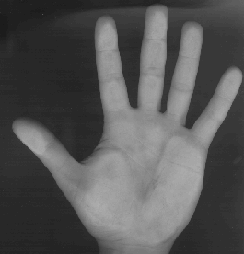
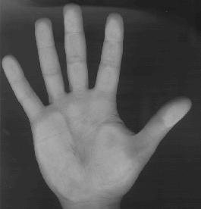
1. Prior art: the racemate
(isomers: 2 enantiomers)
1. separate:
left hand (levo) right hand (dextro)
2. separate &
analyze:
side effects activity
3. make it a salt bisulfate salt the best
clopidogrel bisulfate (Plavix)
Notes:
More nomenclature: An mixture of equal parts of two enantiomers is called a racemate.
In the Sanofi case, the patent owner owned a prior art patent that covered over 250,000 possible different compounds. Their utility was to inhibit platelet aggregation. When platelets aggregate, they can form clots which can cause heart attacks and strokes. We’ll refer to this first patent as the “genus” patent.
The genus patent referred to 21 examples of this group of compounds that had been made and tested. Two of these compounds formed a particular racemate. The racemate showed some promise as a pharmaceutical. It worked to inhibit platelet aggregation but it had some negative side effects.
Somebody then said, “I wonder what would happen if I separated the racemate into its two enantiomers”. Methods for separating racemates were known. Once they were separated, experiments revealed that the right-handed enantiomer had all the efficacy and the left-handed enantiomer had all of the side effects. Not surprisingly, they decided to go forward with the right handed enantiomer. In order to make that compound into a pharmaceutical, it needed to be turned into a salt. Experiments revealed that the bisulfate salt was the best. A second patent, that we’ll call the selection patent, covered this bisulfate salt of the right-handed enantionmer.
The drug was marketed as PLAVIX. It was a great commercial success. In 2004, it had worldwide sales of $5.2 billion US for Sanofi and Bristol-Myers.

Slide 23
Two Monopolies
The genus patent covered >250,000 compounds
In a selection patent, the inventors choose one of the claimed compounds on the basis of its “special advantage” over the racemate and the other isomer (the levo-rotatory isomer)
Clopidogrel:
  better therapeutic index,
  less toxicity and
  better tolerance – of the selected compound
A selection patent is a second monopoly over a compound already claimed in a genus patent.

Slide 24
Don’t trip on the “inventive step”
UK “Windsurfing/Pozzoli” approach was based on UK statute
Our “New Act” has specific language:
“28.3 The subject-matter defined by a claim in an application for a patent in Canada must be subject-matter that would not have been obvious on the claim date to a person skilled in the art or science to which it pertains, having regard to
  (a) information disclosed more than one year before the filing date by the applicant, or by a person who obtained knowledge, directly or indirectly, from the applicant in such a manner that the information became available to the public in Canada or elsewhere; and
  (b in such a manner that the i) information disclosed before the claim date by a person not mentioned in paragraph (a) became available to the public in Canada or elsewhere.”

Slide 25
Windsurfing approach redux for New Act
1.[Identify the common general knowledge]
2. Identify the invention of the claim in question or, if that cannot readily be done, construe it;
3. Identify what, if any, differences exist between the matter cited as forming part of the “state of the art” and the invention of the claim as construed;
4. Viewed without any knowledge of the alleged invention as claimed, would the invention as claimed have been obvious on the claim date to a person skilled in the art or science to which it pertains, having regard to the information referred to in s. 28.3(a) and (b)?

Slide 26
What’s the invention/inventive concept?
Servier (FCA)
  Approved what Snider did: look to the claims
  Adopted Angiotech v. Conor:
    “… the invention is the product specified in a claim and the patentee is entitled to have the question of obviousness determined by reference to his claim and not to some vague paraphrase based upon the extent of his disclosure in the description.”

Slide 27
2020 “Obvious to Try” Update
Amgen Inc. v. Pfizer Canada ULC,
  2020 FC 522 (Justice Southcott),
  aff’d 2020 FCA 188 (Stratas, Gleason, Laskin JJA.).
Was there a motive to try such that the decision to try would have been obvious? If yes, then:
  Was it more or less self-evident that what was being tried ought to work?
  without undue effort.
If “No” to both questions, it may be non-obvious.

Slide 28
Old considerations still apply
Sharlow J.A. in levofloxacin infringement case:
The invention
The hypothetical skilled person referred to in the Beloit quotation
The body of knowledge of the person of ordinary skill in the art
The climate in the relevant field at the time the alleged invention was made
The motivation in existence at the time the alleged invention to solve a recognized problem
The time and effort involved in the invention
Secondary factors:
Commercial success
Meritorious awards

Slide 29
Proving Non-Obviousness
The expert who didn’t make the invention.

Slide 30
Conclusions
An obvious truth:
  a predictable solution may be obvious; but
  an unpredictable outcome cannot be an obvious solution.

