Slide 1
Key Aspects of IP License Agreements
Donald M. Cameron
Revised by Noel Courage
for UofT Law – March 2022

Slide 2
Agenda
IP Rights
Skeleton of a License Agreement
License Grant & Consideration
Licensor & Licensee Obligations
Common Clauses
Questions

Slide 3
What is Intellectual Property?
It’s not the right to do something
It’s the right to exclude others
Legal monopoly
Limited in time
Limited in territory
“License to litigate”

Slide 4
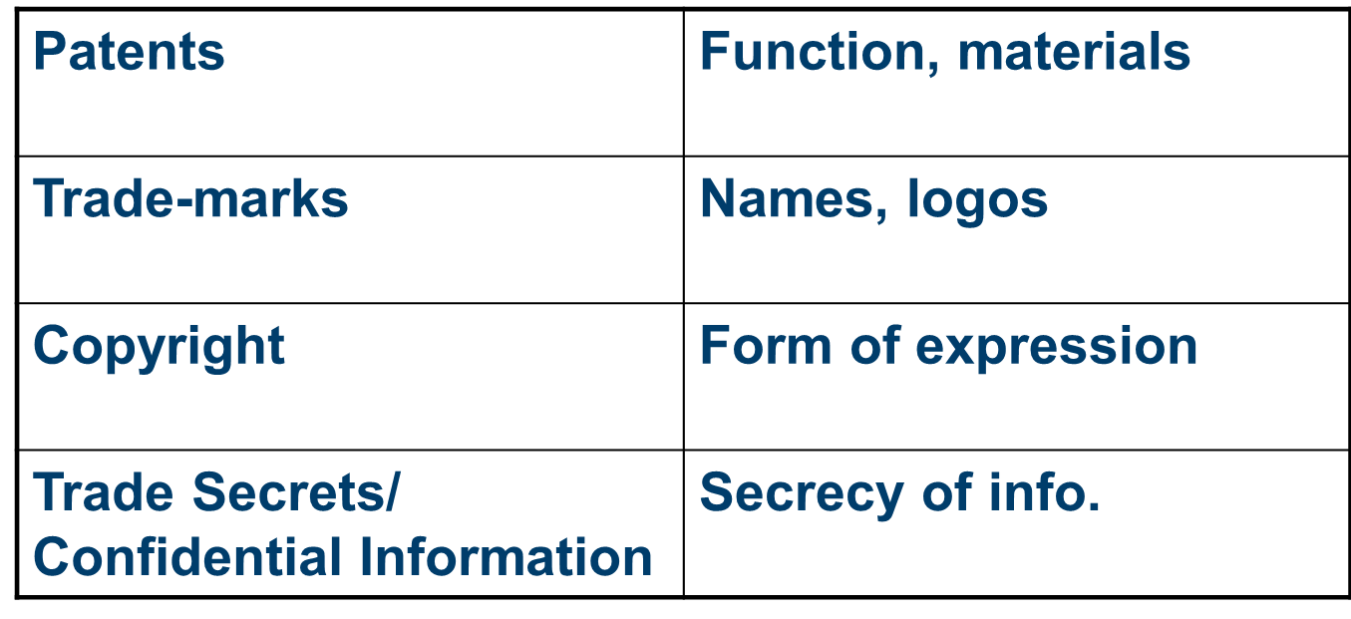
The Legal Cubby-holes

Slide 5
IP Assets
Buy (assignment of ownership)
Sell
License
Use as security for a loan

Slide 6

Overview of Basic Licensing
Permission to do what you would not
otherwise have the right to do

Slide 7
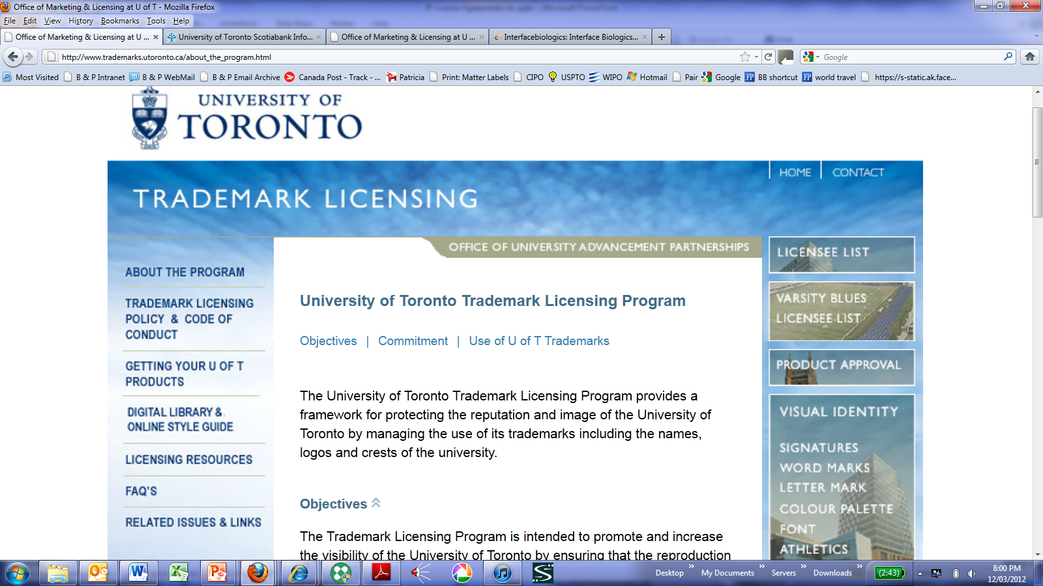
Licensing Out

Slide 8
Licensing Out - Complex
UofT – Schering
Alzheimer’s gene
  Largest Industry – University biotech deal to that date

Slide 9
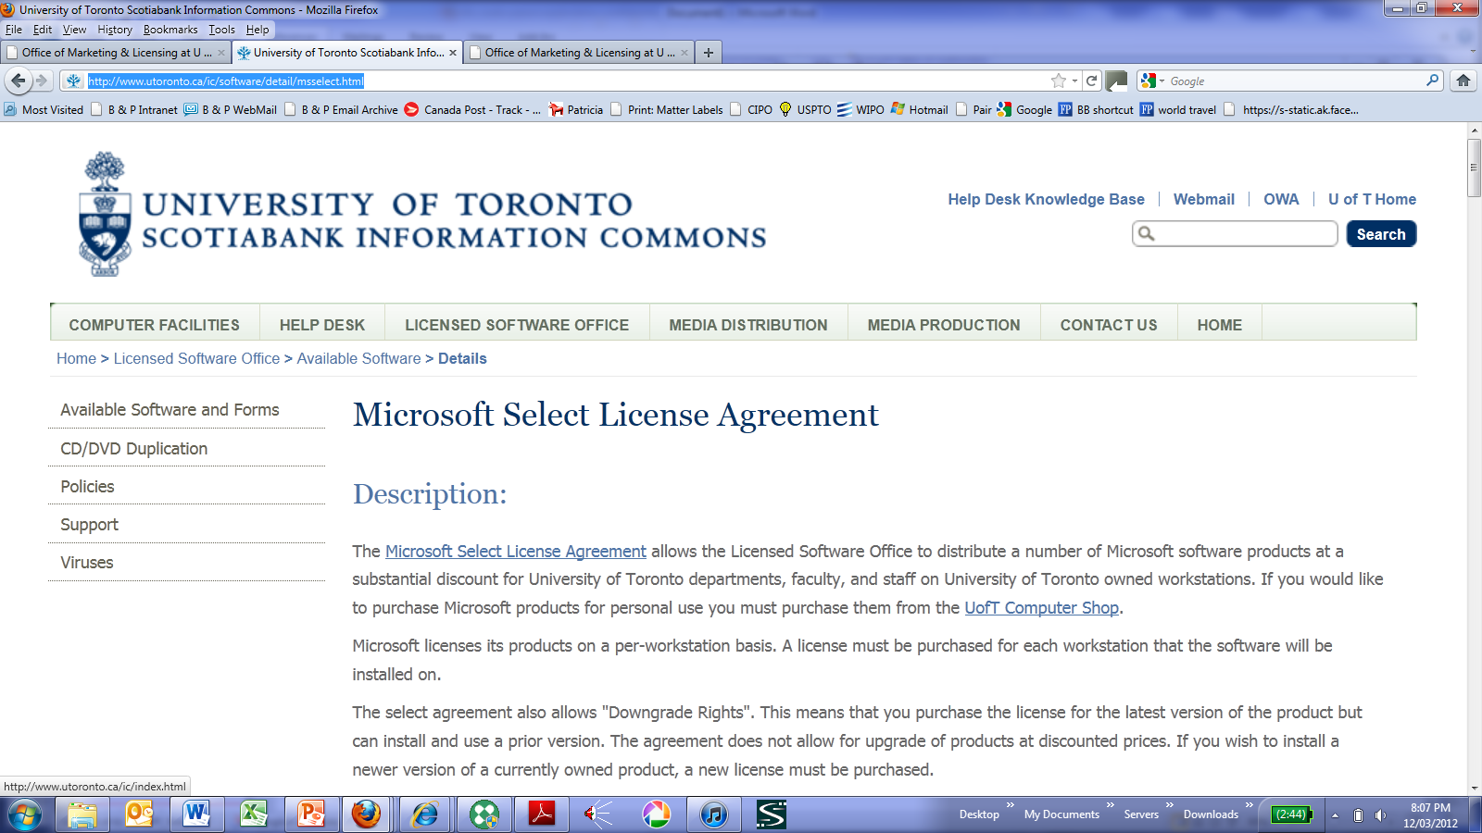
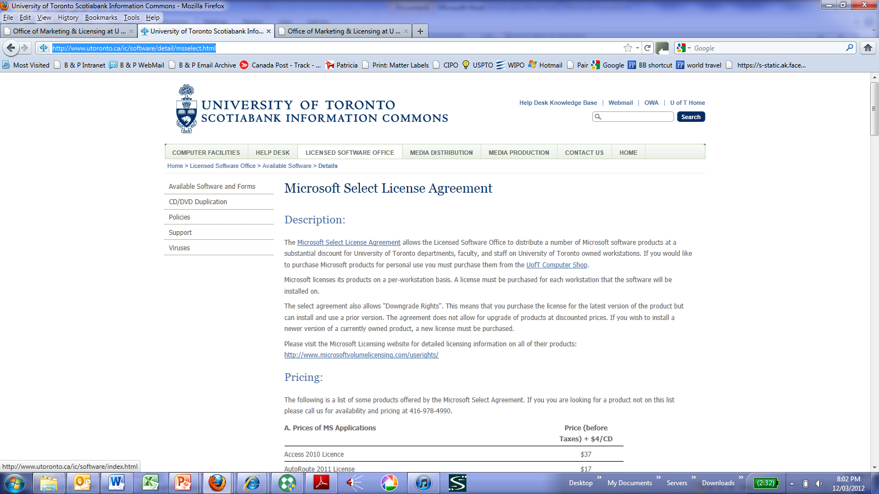
Licensing In

Slide 10
No license at all
IP infringement
Counterfeit

Slide 11
Licensed use becomes unlicensed
Visibility Corp. sues for copyright infringement re software.
Visibility had previously granted a software license to the defendants’ parent company
defendants were merged but continued to use the software, now without a license.
License agreements prohibited transfers of the software without Visibility’s consent.
Visibility Corp. v. Hudson Prods. Corp., 10- 12279-RGS (D. Mass. Dec. 30, 2010)

Slide 12
You’ve got licenses
Facebook
Sharing Your Content and Information
You own all of the content and information you post on Facebook, and you can control how it is shared through your privacy and application settings. In addition: For content that is covered by intellectual property rights, like photos and videos (IP content), you specifically give us the following permission, subject to your privacy and application settings: you grant us a non-exclusive, transferable, sub-licensable, royalty-free, worldwide license to use any IP content that you post on or in connection with Facebook (IP License).

Slide 13
Skeleton of a License Agreement
The Big Question:
WHO GETS WHAT?

Slide 14
Skeleton of a License Agreement
Three building blocks License Skeleton
  Who: The Parties
  Gets: The Grant
  What: The Definitions
Licensor
Licensee
Definitions
The Grant

Slide 15
IP License Agreement - WHO
Who has the right to grant the license?
  Ownership of the intellectual property?
  Licensed to sublicense the intellectual property?
Warranty of licensor’s ownership?

Slide 16
Many different relationships between licensor and licensee
  Licensee may be ‘customer’
  License may be business arrangement between affiliates

Slide 17
Federal Court Docket: A-486-10
BETWEEN:
BRISTOL-MYERS SQUIBB COMPANY (Patent Owner) and
BRISTOL-MYERS SQUIBB CANADA CO. (Licensee)
Appellants
and
APOTEX INC.
                Respondent

Slide 18
IP License Agreement - WHO
Who is the Licensee?
  The company?
  >> 1 machine, 1 location
  >> site license
  >> corporate wide
  Subsidiaries and affiliates?

Slide 19
Main body of license
Recitals
Definitions
Listing of terms and conditions

Slide 20
Clear Drafting is Essential

Slide 21
The case of the million-dollar comma

Slide 22
Clear Drafting is Essential
The comma case - 14 page contract:
Rogers’ five-year, renewable agrt to attach cable lines across Bell Aliant utility poles in the Maritimes. $9.60 access fee per pole. Bell Aliant terminated. Price raised. Approx $1m cost differential at stake.
Agreement “shall continue in force for a period of five years from the date it is made, and thereafter for successive five year terms, unless and until terminated by one year prior notice in writing by either party.”
Rogers loses initially, wins on appeal b/c of unambiguous French version of contract. (Telecom Decision CRTC 2007-75)

Slide 23
2156775 Ontario Inc. v. Just Energy, 2014 ONSC 3276 (CanLII)
Enforceability of clause triggering arbitration was in dispute.
Plaintiff alleges agreement void due to lack of signing authority, misrepresentation. Defendant tried to force arbitration. Clause:
“Customer may contact Just Energy with regard to a concern or dispute under this Agreement… such a dispute will be referred to and finally resolved by binding arbitration…”
Clause only applied to disputes “under” the agreement?
Covers disputes pertaining to the validity of the agreement?
Narrow wording - defendant could not enforce the clause.
To enforce clause in validity situation, would need to use broader wording, such as, “in relation to” or “in connection with.”

Slide 24
IP License Agreements - WHAT
WHAT DOES THE LICENSEE GET?
What IP rights are being granted?
  copyright, trade secrets, patents, know-how
  if trade secrets, include confidentiality provisions

Slide 25
IP License Agreements - WHAT
WHAT DOES THE LICENSOR GET?
$$$$
  License fees
  Royalties
  Cross-licenses

Slide 26
License Grant – the Asset
What it Protects
Patents Function or Composition
Trademarks Brand Names and Logos
Copyright The Form of Information
Trade Secrets / The Secrecy of an idea
Confidential Info

Slide 27
License Grant
Licensor hereby grants License Skeleton
to Licensee
a nontransferable,
nonexclusive right and
license to use
the Licensed Patents
In the Territory, solely
for the purpose of
manufacturing and
selling the Licensed Products
Licensor
Licensee
Definitions
The Grant

Slide 28
License Grant
What is the Licensee allowed to do?
  Patents: make, use, sell
  Trade-marks: use
  Copyright: copy, publish, translate, perform, modify, create derivative works
  Trade Secrets: make, use, sell product made with trade secret

Slide 29
License Grant – all or part of asset?
What is the Licensee allowed to do?
  Exclusive: only the Licensee
  Sole: only the Licensee and the Licensor
  Non-exclusive: multiple Licensees

Slide 30
License Grant
What is the Licensee allowed to do?
Territory: use the Licensed Trade-marks to promote, sell and distribute products in Canada and the United States
Field: use the Licensed Patents to develop a therapeutic product to treat diabetes
Sublicense: modify the source code of the Licensed Software to create the Integrated Software and sublicense the object code of the Integrated Software to end-users

Slide 31
License Grant
What is the Licensee not allowed to do?
  non-competition
  no reverse engineering
  no misuse of confidential information
  sublicense
  use outside scope of grant
  Query: which of the above are also prohibited by common law or IP rts?

Slide 32
Consideration
How much is the license worth?
$$ -----------------------------------→$$$$
Non-Exclusive ---------------------→Exclusive
Small Territory --------------------→ Large Territory
Narrow Field -----------------------→Broad Field
“Use” --------------------------------→ “Exploit”
Technological ----------------------→ Technological
Convenience Breakthrough

Slide 33
Consideration
License Fees (Fixed)
  Initial or Upfront
  Annual
  Milestone

Slide 34
Consideration
Royalties (Fixed or Variable)
  5$ per widget sold
  5% of “Revenue” per widget sold
    “Net Revenue”

Slide 35
Consideration
Minimum Sales Commitment
  Tied to exclusivity
  Quotas per Territory, Product line or Total
Maximum Royalties Payable
  Cap on Amount (aggregate of royalty payments)
  Cap on Time (duration of royalty payments)
  “Stacks” (total percentage of 3d party royalties)

Slide 36
Consideration
Reports
  May be tied to payment of royalties
  Periodic reports (monthly, quarterly, annual)
  Certified?
  use outside scope of grant
Audits
  Should be conducted regularly

Slide 37
Maximizing royalty revenue
Issue more licenses
  more licensees/sublicensees, new fields, new territories etc.
More volume of sales under license
  marketing/advertising, incentives to licensees
Higher royalty per sale under license
Verify royalty payments

Slide 38
Headlines: more licenses and more licensed products = $$
CryptoLogic Reports Profit and Revenue Growth …
DUBLIN, IRELAND--(Marketwire) - CryptoLogic …a developer of branded online betting games and Internet casino software….
Branded Games revenue increased 25% to $6.9 million (prior year: $5.5 million), accounting for approximately 25% of total revenues (prior year: 21%). In Q4, revenue from this segment increased to $1.9 million (Q3 prior year: $1.4 million).
The increase in Branded Games revenue is primarily due to the increased number of revenue producing games through an increased number of licensees and games per licensee.

Slide 39
Consideration
Other Consideration
  Cross-license
  Shares/ Stock/ Equity
  Joint Venture arrangements

Slide 40
BREAK!

Slide 41
Obligations
Bhasin v. Hrynew (2014 SCC 71)
  good faith contractual performance is a general organizing principle of the common law of contract.
  the contracting parties must act honestly in the performance of contractual obligations.
  failure to abide by this duty can be considered a breach of contract.

Slide 42
Obligations - Licensor
What does the Licensor have to do?
  Deliver the Intellectual Property
  Modify/Improve the Intellectual Property
  Enforce the Intellectual Property
  Defend against claims of Infringement

Slide 43
Obligations - Licensor
Deliver the Intellectual Property
  Disclose Know-How
  Train Licensee Personnel
  Support and Maintenance
  Disclose/Deliver Improvements and Modifications

Slide 44
Obligations - Licensor
Improvements – a development in the field of the licensed intellectual property that enhances one of the following:
  Usability
  Functionality
  Efficiency
  Performance

Slide 45
Obligations - Licensor
Improvements can be deemed included in license grant
  No additional payment required
  May extend life of payment terms
License may be offered a right of first refusal
  Allows Licensor to negotiate additional $$$
  Improvement may not be usable without base technology

Slide 46
Obligations - Licensor
Enforcement
  Prosecute and maintain registrations
  Take action against infringers
  Keep other licensees “in line”
  Defend against challenges to the validity of the intellectual property

Slide 47
Obligations - Licensor
Infringement Claims
  IP litigation can be VERY expensive and VERY risky
  Licensor may not want to bear the risk – will factor into overall value of license
  Consultation, cooperation typically required
  Get settlement approval by licensee, divide litigation proceeds

Slide 48
Obligations – Licensee
What does the Licensee have to do?
  “Work” the Invention
  Maintain Quality Standards
  Disclose and Deliver Improvements
  Indemnification/ Insurance
  Safeguard Confidential Information, Non-Compete, Non-Solicit

Slide 49
Obligations – Licensee
“Working” the Invention
  Tied to exclusivity
  May incorporate “quotas”
  Covenant to use “commercially reasonable” efforts to promote, distribute and sell products

Slide 50
Obligations – Licensee
Quality Standards
  Critical in trade-mark licenses
  Licensor entitled to inspect samples and audit
  Good practice to provide Licensee with specifications for mark use (e.g. dimensions, colours) and legends

Slide 51
Obligations – Licensee
Improvements
  These are “Licensee” improvements
  Licensor may require disclosure, and a license back
  Beware of “blocking” patents

Slide 52
Obligations – Licensee
Indemnification and Insurance
  Flip side to infringement indemnity
  Product liability concerns
  Indemnity limited by Licensee’s activities (i.e., is the Licensee manufacturing?)
  In trade-mark licenses, product liability can be damaging to goodwill in owner’s mark

Slide 53
Common Clauses
Assignment of Licence
Term and Termination
Conflict Resolution

Slide 54
Common Clauses
Assignment
  Usually require consent to assign or in the event of a change of control
  May wish to withhold if assigned to a competitor
  Guarantee from original licensee?

Slide 55
Common Clauses
Term
  Term may be dependent on intellectual property rights

Slide 56
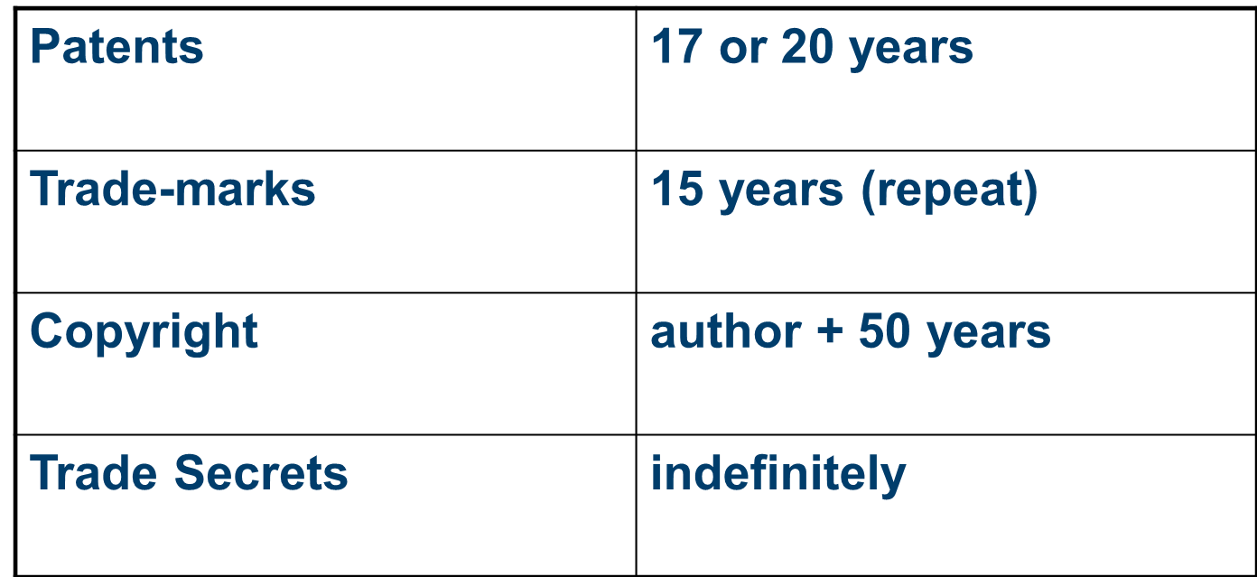
IP Expiry

Slide 57
Contract term re expiry
Gerhard Reichert and a co-inventor created the window insulator called "Super Spacer"
Lauren Intl bought Super Spacer patents and patents for 2 other potl products.
Lauren agreed to pay Reichert and his co-inventor a royalty of 1% each on gross sales under the patents. Reichert earned > $2 million in royalties.
Lauren International, Inc. v. Reichert, [2008] ONCA 382, affirming [2007] CanLII 44351

Slide 58
Contract term re expiry
The patents for the Super Spacer and the other two products were filed in different countries on different dates and had different expiry dates.
The Super Spacer patents expired on dates between 2006-2008, while the patents for the other products expired as late as 2011.
patent royalty payments were, "ending on the expiry of the Principals' Patent Rights."

Slide 59
Common Clauses
Termination
  No matter how friendly the parties are, conflicts may arise – employees depart, market conditions change, etc.
  Better to plan ahead, while the parties are still on good terms

Slide 60
Common Clauses
Termination
  By Licensor:
    Failure of Licensee to pay royalties
    Breach of Confidential Information
    Failure to exploit
  By Licensee
    Invalidity of Patents
    Infringement Claim

Slide 61
Assignments

Slide 62
Assignments
IP – exclusive rights (monopoly)
  eg. patent: exclusive right to make, use, sell
Assignable in whole or part

Slide 63
Co-ownership
More complex rules
Can’t stop co-owner from using invention
Ability of co-owner to assign or license?

Slide 64
Co-ownership
Can assign entire ownership rights
Licensing co-ownership interest without consent of other co-owner?
Forget v. Specialty Tools of Canada Inc.
(1995), 62 C.P.R. (3d) 537 (B.C.C.A.), aff’g (1993), 48 C.P.R.(3d) 323 (B.C.S.C.).

Slide 65
Georgina and Daniel Forget coowned patent for a scissor-type tube-cutter
Daniel licensed the cutter --- Specialty Tools of Canada Inc. – right to manufacture and sell in Canada
Georgina was cut out of the action

Slide 66
Co-owner can assign entire interest in a patent to a third party without the consent or an obligation to account to the other co-owner.
Cannot dilute the rights of the other co-owner.
Co-owner cannot grant a valid license without consent: license not valid - would dilute the rights of the other co-owners. Patent infringement by licensee.

Slide 67
Best practice to avoid dispute
Co-owners should make their own agreement governing commercialization

Slide 68
Thank You
Noel Courage
ncourage@bereskinparr.com
t: @noel_ip

