Slide 1
Patent Infringement
Donald M. Cameron
2021
Donald M. Cameron

Slide 2
What is infringement?
“any act that interferes with the full enjoyment of the monopoly granted to the patentee”
s. 42: “… the exclusive right, privilege and liberty of making, constructing and using the invention and selling it to others to be used …”

Slide 3
Have the essential elements of the claim been taken/used?
What do the words and phrases in the claim mean?
Are the essential ones there?
Purposive construction:
  Sometimes read down the claim
  Whirlpool: “vanes” meant “rigid vanes” and did not include “flexible vanes”

Slide 4
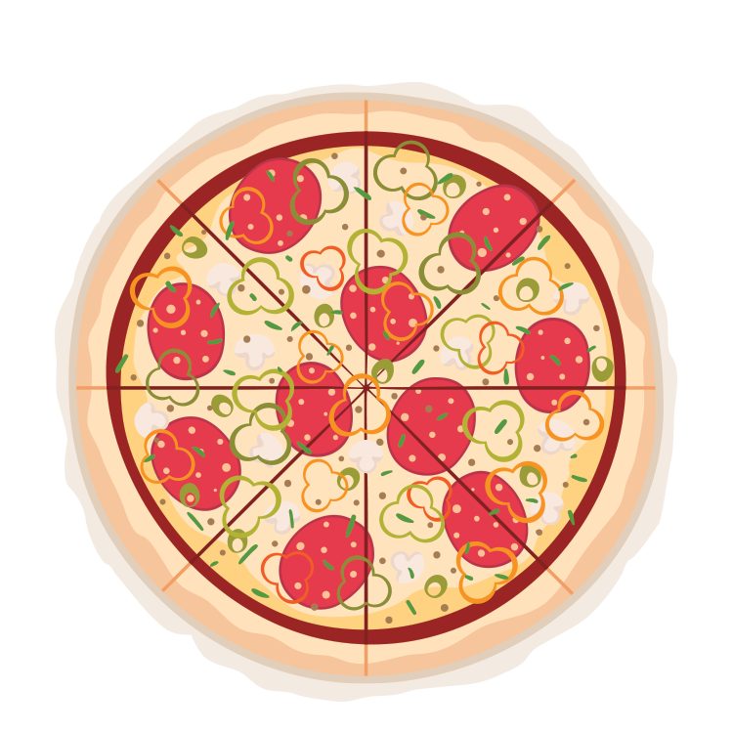
CANADA
Imagine an 8 slice pizza
(or a claim with 8 elements)
1. Construe the claims: Determine what are the essential elements

Slide 5
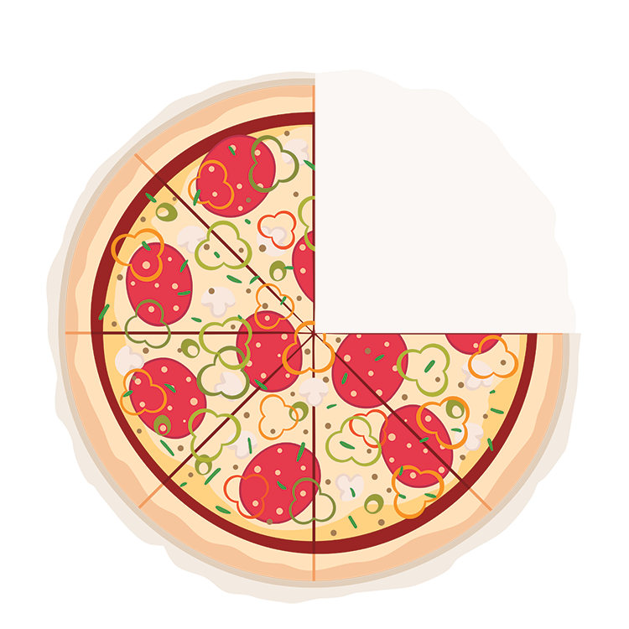
CANADA
2. If there are 6 essential elements, have all 6 been taken? If so, there’s infringement.
(Don’t worry about the non-essential elements – they don’t matter)
NON-
ESSENTIAL

Slide 6
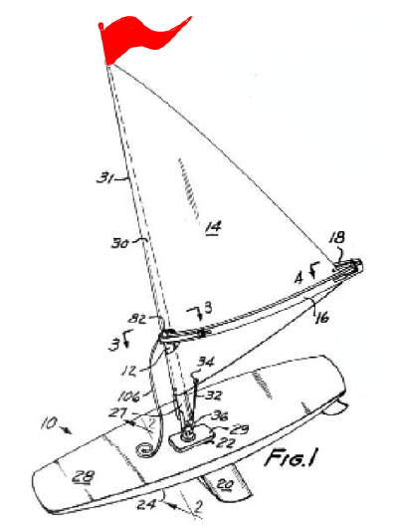
What’s an essential element?
It’s essential if changing it changes the way the invention works.
It’s essential if the inventor meant it to be essential.

Slide 7
Recap – claim construction the set up
Who:
  Person (or team) of ordinary skill in the art to whom the patent is directed
What
  The claim terms “where the shoe pinches”
When
  At the date of publication (for patent applications filed after October 1989)

Slide 8
Recap
Read the patent as a whole, and construe the claims in the context of the patent.
If the disclosure expressly defines certain terms to have certain meanings, use those definitions when interpreting the claims.
The relevant date for construing the patent claims is either:
  The date of issuance of the patent, for patents applied for before October 1, 1989; or
  the date of publication of the patent application, for patents applied for on or after October 1, 1989
Read the patent as if you were the person to whom it was addressed. Except for terms expressly defined in the patent, give the terms in the claim the ordinary meaning they would have had to such person as of the relevant date.

Slide 9
Apply the “principles” from Free World
Essential & Non-Essential
The claims language will, on a purposive construction, show that some elements of the claimed invention are essential while others are non-essential. The identification of elements as essential or non-essential is made:
(iii) having regard to whether or not it was obvious to the skilled reader at the time the patent was published that a variant of a particular element would not make a difference to the way in which the invention works; or
(iv) according to the intent of the inventor, expressed or inferred from the claims, that a particular element is essential irrespective of its practical effect;
“Adhere to the language”
(Invention limited to what has been claimed)
(a) The Patent Act promotes adherence to the language of the claims.
(b) Adherence to the language of the claims in turn promotes both fairness and predictability.
(d) The language of the claims thus construed defines the monopoly. There is no recourse to such vague notions as the “spirit of the invention” to expand it further.

Slide 10
To apply Free World
Think “Cameron”:
To determine whether a claim element is essential or not, ask:
  Was it obvious to the skilled reader at the time the patent was published that a variant of a particular element would not make a difference to the way in which the invention works? If modifying or omitting the element changes the way the invention works, and that was obvious at the relevant date, then the element is essential; or
  According to the intent of the inventor, expressed or inferred from the claims, was a particular element essential irrespective of its practical effect? If the element appears to have been intended to be essential, then the element is essential.
If the claim element was not found to be essential under either Q1 or Q2, then the element is non-essential.

Slide 11
But use Improver
Does the variant have a material effect upon the way the invention works? If yes, then the variant is outside the claim. If no?
Would this (i.e. that the variant had no material effect) have been obvious at the date of publication of the patent to a reader of the patent skilled in the art? If no, the variant is outside the claim. If yes?
Would the reader skilled in the art nevertheless have understood from the language of the claim that the patentee intended that strict compliance with the primary meaning was an essential requirement of the invention? If yes, then the variant is outside the claim.
  (In other words, is the patentee using the term in a special way, different from the “normal” meaning?)

Slide 12
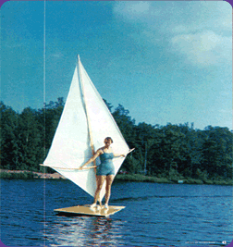
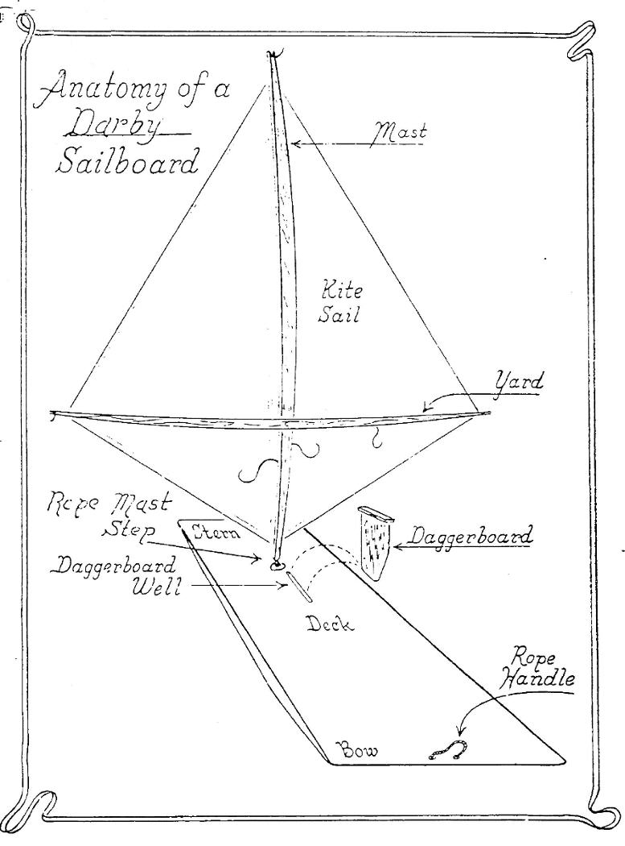
Windsurfing v. Trilantic

Slide 13
Windsurfing v. Trilantic
1. Wind-propelled apparatus comprising body means adapted to support a user and wind-propulsion means pivotally associated with said body means and adapted to receive wind for motive power for said apparatus, said propulsion means comprising a mast, a joint for mounting said mast on said body means, a sail and means for extending said sail laterally from said mast, the position of said propulsion means being controllable by said user, said propulsion means being substantially free from pivotal restraint in the absence of said user, said joint having a plurality of axes of rotation whereby said sail free falls along any of a plurality of vertical planes upon release by said user.
4. The apparatus of Claim 1 wherein said sail extending means comprises a boom laterally disposed of said mast to hold said sail taut and adapted to provide a hand-hold for said user.
10. The apparatus of Claim 4, wherein said boom comprises a pair of boom members arcuately connected athwart said mast and securing said sail therebetween.

Slide 14
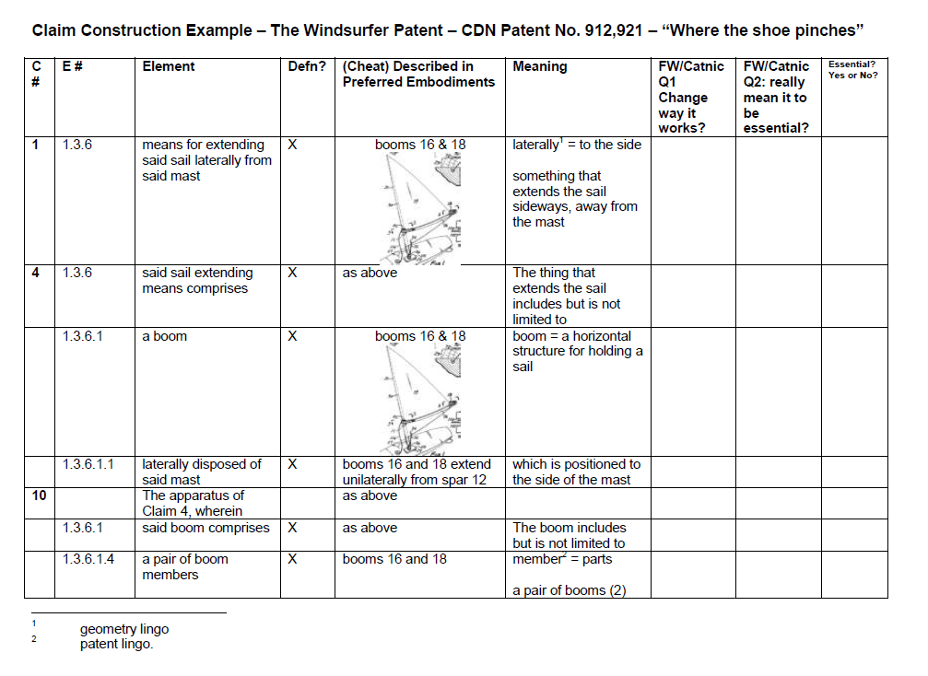
Does Darby Infringe?

Slide 15
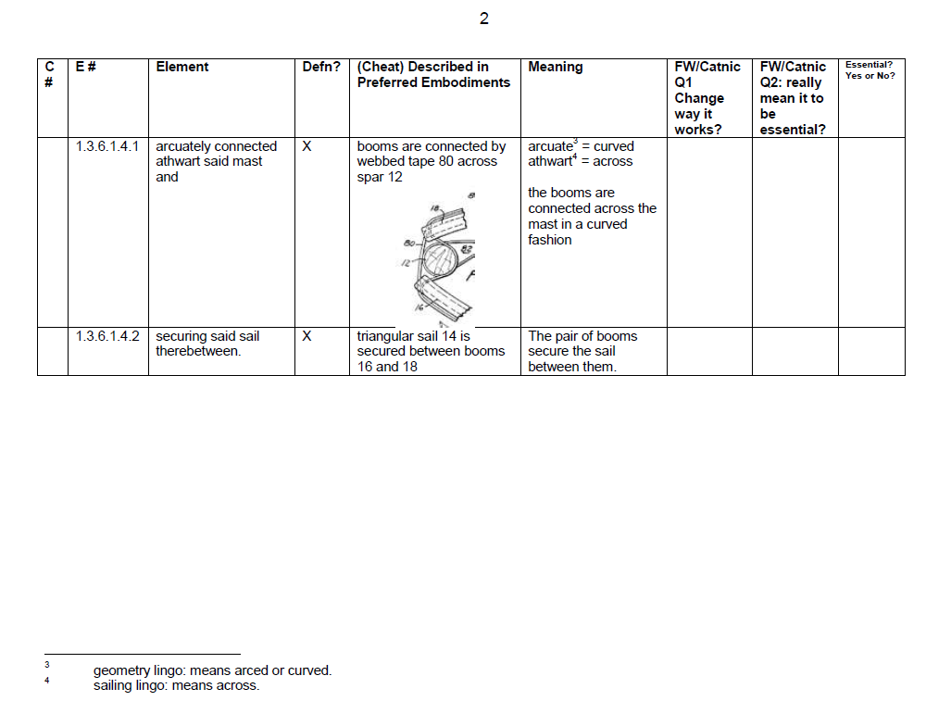
Does Darby Infringe?

Slide 16
Territorial limits to patents
Infringement in Canada:
  Made used or sold… in Canada Domco
Infringement in USA
  Method claims must be practised in USA (no inf)
  System infringes if control and benefit is in USA
    NTP v. RIM

Slide 17
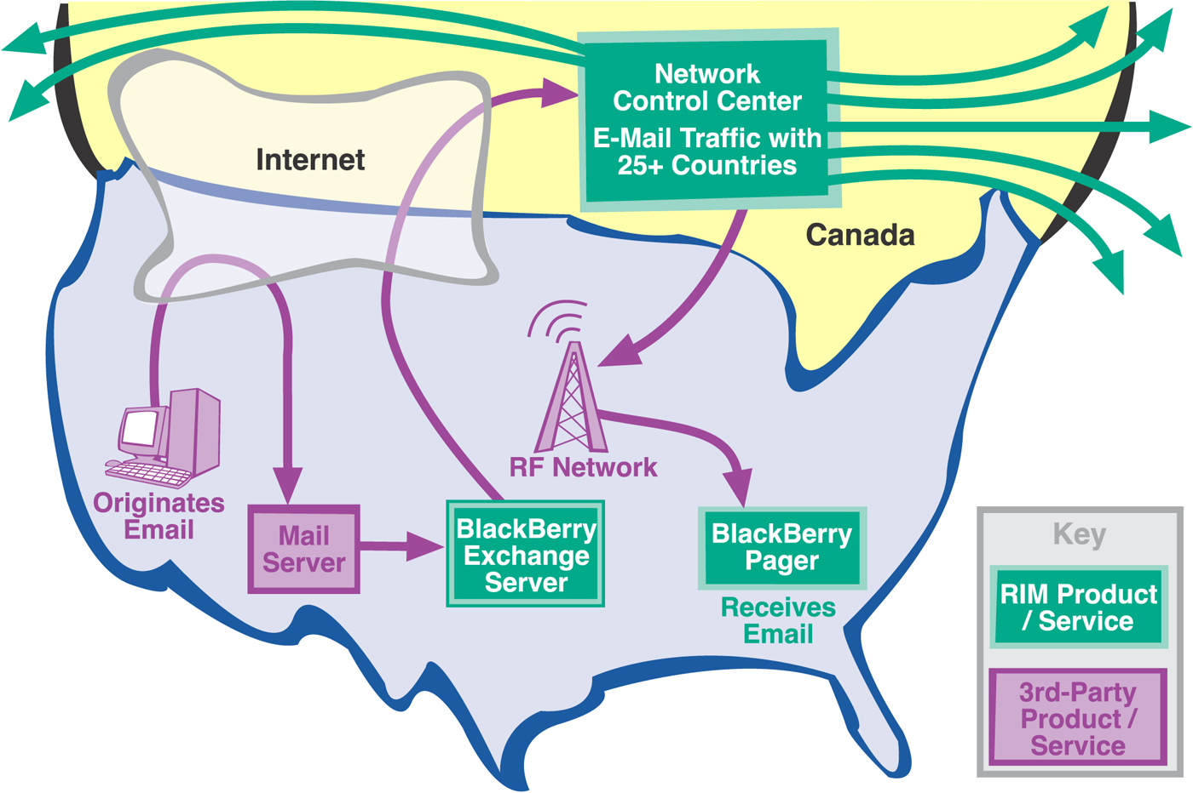

Slide 18
Who sues who?
Plaintiff(s)
  Patentee (must be a party) and legal representative
  And all persons claiming under the patentee
    Includes licensees
    May include customers
Defendants
  Makers, users, sellers
  Directors or officers

Slide 19
Making and constructing
Making just parts is OK
Making part when you’re licensed to make all isn’t OK
Making something for patented use outside Canada isn’t OK (Allied Signal)
Using patented process abroad to make something, makes that thing infringing when imported into Canada
Repairing is OK; rebuilding is not

Slide 20
Presumptions
S. 55.1: New process to make a new product, presumption is that the product was made by the patented process

Slide 21
Using
“utilize with a view to production or advantage”
(commercial benefit belongs to the patentee)
Possession creates presumption of intended use
Schmeiser used the gene or cell; he could have sprayed (“stand-by” use, like a fire extinguisher)
Use of a product of a patented process (whether or not product is patented)

Slide 22
Selling
Must be in Canada
Anywhere along the chain is infringing

Slide 23
Importation
For what purpose?
  Resale – actionable
  Research – not actionable
  Transhipment – who knows?
Importation of a product made offshore by a patented process is infringement
  Onus of proof on defendant to show foreign supplier does not use the patented process
  May apply to product made abroad by infringing product.

Slide 24
Importation cont’d
Saccharin doctrine
  Where the patented product is an intermediate used to make the imported product, and it’s of some importance and not merely incidental, importation is an infringement

Slide 25
Inducing and Procuring Infringement
“She made me do it”
Person who knowingly, for his/her own ends and benefits, induces or procures infringement
Stop the instigator – too hard to go after all the infringers
Vendor of kits

Slide 26
“Indirect infringement” – what’s needed
“direct” infringement (threatened or happened)
Defendant caused the direct infringer to do “it”
Defendant knew such influence would result in the infringing actions

Slide 27
Common Design
(divided infringement)
  Was there was a common design between the parties to do acts which, if the patent is upheld, amounted to infringement; and
  Did the defendant act in furtherance of that design.
    Unilever Plc v. Gillette (UK) Limited, [1989] R.P.C. 583 at 608-609.

Slide 28
Defences/Exceptions to Infringement
Gillette defence: Hobson’s choice
  If claims broad – include prior art & invalid
  If claims narrow – no infringement
Experimental use
  To improve
  To test
  s. 55.2: for regulatory approval
Prior acquired goods (s. 56)
  Prior to the claim date

Slide 29
US Approach
Doctrine of Equivalents
An equivalent has the same:
  Function
  Way
  Result
[See also Actavis v. Eli Lilly in UK where protection > claim scope]

Slide 30
USA
CANADA

Slide 31

USA
CANADA
EQUIVALENT
All elements test: are all elements or their equivalents present?
Each element can be expanded by doctrine of equivalents: performs the same function in the same way to achieve the same result

Slide 32
USA
CANADA
EQUIVALENT
NON-
ESSENTIAL
All elements
Each element can be expanded by doctrine of equivalents
All essential elements
No D.O.E.

