Slide 1
On Creativity
Don Cameron
2022
Donald M. Cameron

Slide 2
Ideas
If trade secrets and inventions come from Ideas …
Where do Ideas come from?

Slide 3
How Scientists think/create

Slide 4
The Scientific Method
Hypothesis
Make an Experiment
Observe
Conclude

Slide 5
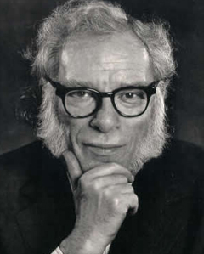
Isaac Asimov
“The most exciting phrase to hear in science, the one that heralds the most discoveries, is not "Eureka!" (I found it!) but 'That's funny...”

Slide 6
The Scientific Method
Observe
Conclude
Hypothesis
Make an Experiment

Slide 7
Cameron’s Spin on
The Scientific Meethod
Hypothesis
Conclusion
Experiment
Observation

Slide 8
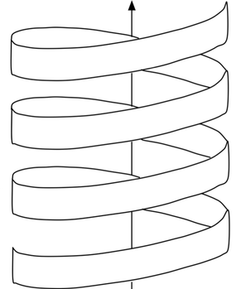
The Cameron – de la Herrán model
exp
conclude
observe
hypo
The “Scientific Method” spiral:
repeating the 4 steps every loop
increasing knowledge at every cycle
exp
conclude
observe
hypo
exp
conclude
observe
hypo
conclude
observe

Slide 9
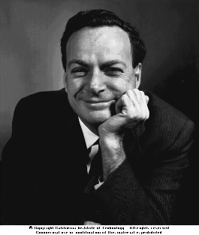
Richard Feynman
Imagination in Science
So many of his witnesses observed the utter freedom of his flights of thought, yet when Feynman talked about his own methods he emphasized not freedom but constraints. The kind of imagination that takes blank paper, blank staves, or a blank canvas and fills it with something wholly new, wholly free -- that, Feynman contended, was not the scientist's imagination. Nor could one measure imagination as certain psychologists try to do, by displaying a picture and asking what will happen next. For Feynman the essence of the scientific imagination was a powerful and almost painful rule. What scientists create must match reality. It must match what is already known. Scientific creativity, he said, is imagination in a straitjacket. 'The whole question of imagination in science is often misunderstood by people in other disciplines,' he said. 'They overlook the fact that whatever we are allowed to imagine in science must be consistent with everything else we know...'

Slide 10

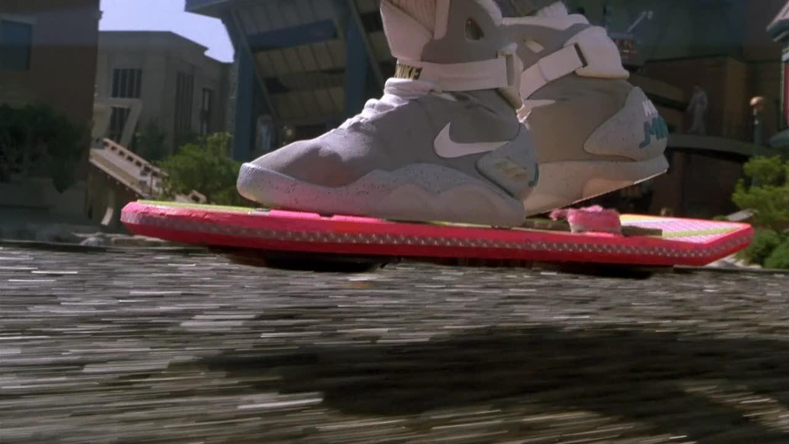
The Hoverboard
Not immediately possible
Not a invention
Notes:
For an invention, you need an idea and a way to carry it out.

Slide 11
The “Immediately Possible”
What’s known?
What’s immediately possible?
What’s obvious improvement over what’s known?
What’s Inventive?
  More than obvious
  But still, only what’s possible
what’s
known
Notes:
An invention has to be “doable”.
You need “current technology” to be available in order to make the invention.
“Current technology” changes over time.

Slide 12
How to be creative

Slide 13
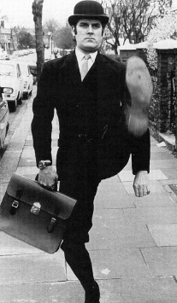
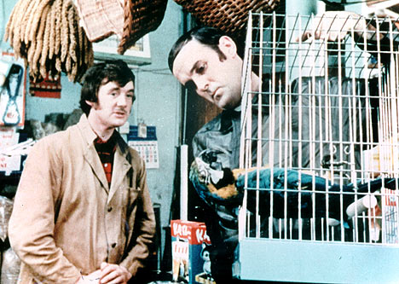
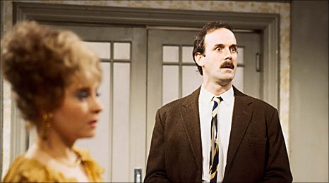
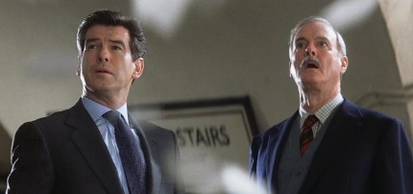
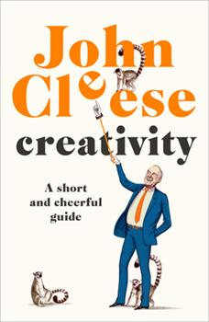
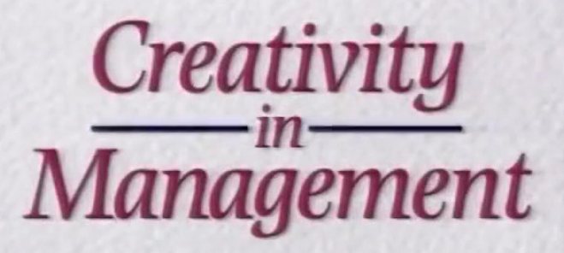
Video #1: John Cleese
of:
Monty Python
Fawlty Towers
A Fish Called Wanda
“Q” in some James Bond movie
1991: Creativity in Management
https://www.youtube.com/watch?v=Pb5oIIPO62g
transcript: https://jamesclear.com/great-speeches/creativity-in-management-by-john-cleese
2020: book

Slide 14
per John Cleese:
Space (an oasis of time)
Time to create the oasis (about 90 minutes)
Alone or play with others (brainstorming)
Enter the Open Mode (anything goes)
  Use the Closed Mode later to critique and execute
Use your deadline as an endpoint: use all the time available.

Slide 15
Video #2: Richard Feynman
One of the best ever:
  Physicists &
  physics teacher
Post WW2 – depressed:
  Help designed the bomb
  Figured world would soon end
  His wife had died of TB
  Physics wasn’t fun anymore ... until he made it so.
BBC – The Fantastic Mr. Feynman
https://www.youtube.com/watch?v=H9fjhQMsDW4
13:05 – 15:32 & 18:07-19:01

Slide 16
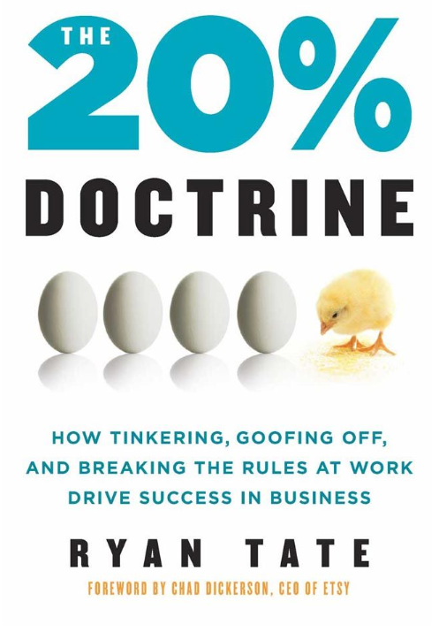
3M – “play time”

Slide 17
Brainstorming – playing with ideas
Play with friends
No idea is stupid
  “Intermediate impossibles” might lead to the “good” idea
Choose the best ideas to try out/refine

Slide 18
More Tips
Use sleep
  My best ideas come between 3 and 5 AM
  Sleep clears the brain to make room for new ideas
  Naps work, I’m told
Leave the problem on simmer on your brain’s back stove element
Read Widely
  The more you know, the more possible combinations you can make

Slide 19
Be Curious – Learn about lots of things
“Creativity is just connecting things. When you ask creative people how they did something, they feel a little guilty because they didn’t really do it, they just saw something. It seemed obvious to them after a while. That’s because they were able to connect experiences they’ve had and synthesize new things. And the reason they were able to do that was that they’ve had more experiences or they have thought more about their experiences than other people. Unfortunately, that’s too rare a commodity. A lot of people in our industry haven’t had very diverse experiences. They don’t have enough dots to connect, and they end up with very linear solutions, without a broad perspective on the problem. The broader one’s understanding of the human experience, the better designs we will have.”
Steve Jobs, Wired, February, 1996, quoted in “I, Steve: Steve Jobs in His Own Words”, edited by George Beahm

Slide 20
Don’t do it the old way do it the way others don’t

Slide 21
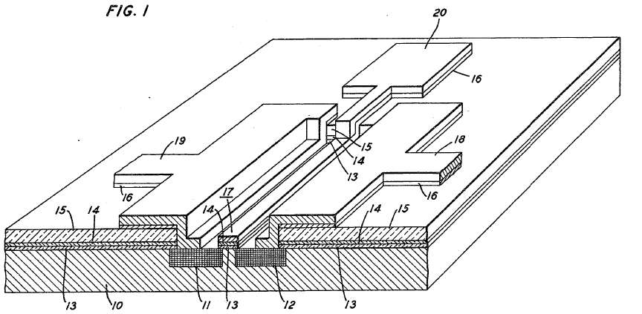
The silicon gate transistor
The most common human-made object in the world

Slide 22
The transistor
The object is to connect the wells at will by putting a charge on the gate to open the substrate to allow current to flow
Off/on = 0/1

Slide 23
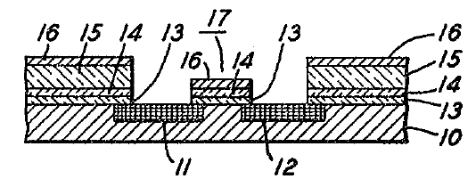
The problem: aligning the gate wrt the wells

Slide 24
The old way: build the wells, align the gate

Slide 25
The problem: aligning the gate

Slide 26
The new way: build the gate; the well align themselves

Slide 27
Inventiveness/Obviousness
Inventions are “inventive’
More that what the average skilled person would do
If something is obvious, it’s not inventive.
You can’t get a patent if it’s an obvious improvement.

Slide 28
The closing door problem
The Prior Art:
circa 1958
My bedroom door would swing shut because of the hinges
Solution: put a book in front of the door – it stops closing!
The classroom door:
Has a piston/spring to make it close
The room is stuffy – let’s keep the door open
We try one book – the door keeps swinging shut
What’s the obvious solution?

Slide 29
The closing door problem
The “brute force” engineering method:
  If it breaks, it’s too small. So make it bigger, thicker.
So what’s an obvious way to keep the classroom door open, if one book doesn’t work?

Slide 30
Hugesson J.A. in Beloit – Would any idiot have come up with it, directly and without difficulty?
"The test for obviousness is not to ask what competent inventors did or would have done to solve the problem. Inventors are by definition inventive.”
The (Sir Stafford) Cripps Question:
"The classical touchstone for obviousness is the technician skilled in the art but having no scintilla of inventiveness or imagination; a paragon of deduction and dexterity, wholly devoid of intuition; a triumph of the left hemisphere over the right. The question to be asked is whether this mythical creature (the man in the Clapham omnibus of patent law) would, in the light of the state of the art and of common general knowledge as at the claimed date of invention, have come directly and without difficulty to the solution taught by the patent.”
Notes:
Justice Hugesson in the Beloit case rephrased the Cripps question: Would a non-inventive skilled worker be led directly and without difficulty to the solution taught by the patent?

Slide 31
On Creativity
Don Cameron
2022
Donald M. Cameron

