Slide 1
Patent Claim Construction:
What does the claim mean?
Donald M. Cameron
July 27, 2022

Slide 2
“… talk about the words”
“It is a long time since I have attended a gathering of the scientiﬁc world–a world in which I am at home — one in which men deal with realities and where truth is, in fact, the goal. For the past ten years I have been in exile from this world and an explorer in another — a world where men substitute words for realities and then talk about the words. Truth in that world seems merely to be the avowed object. Now I undertook to reconcile the objects of these two worlds and for a time I believed that could be accomplished. Perhaps I still believe it–or perhaps it is all a dream.”
    Edwin Howard Armstrong, inventor of regeneration and FM radio, in an address to the annual convention of the Institute of Radio Engineers, Philadelphia, U.S.A., May 29, 1934 quoted by Tom Lewis in “Empire of the Air, The Men Who Made Radio”; Edward Burlingame Books, 1991, referring to his losses in the hands of the U.S. judicial system.

Slide 3
It shouldn’t be this difficult
If the patent is addressed to a “person skilled in the art” of the patent …
What would the claim mean to that person?

Slide 4
The Question for the Court
What does the claim mean?
  to the person skilled in the art,
  as of the date the patent was published?
Lord Hoffman (Kirin-Amgen):
  “… what would a person skilled in the art have understood the patentee to have used the language of the claim to mean?”

Slide 5
It’s the Gateway Question
Before infringement
  Have all the essential elements been taken?
Before anticipation
  Does the 1 piece of prior art disclose and enable the essential elements?
Before obviousness
  Was it obvious to combine things to get the essential elements?

Slide 6
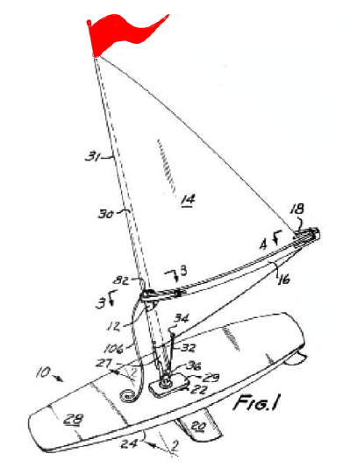
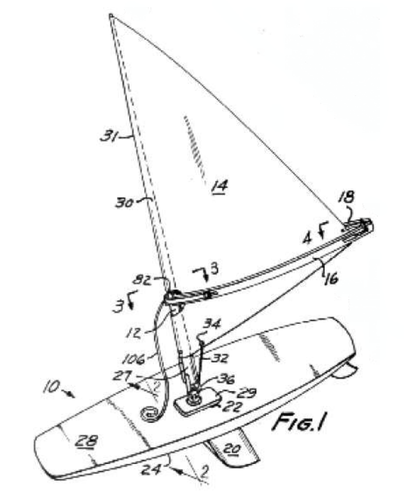
“But that’s soooo close.”
Imagine the Patent claims:
And the Defendant does this:
Wind propelled apparatus comprising:
Body means;
Wind propulsion means comprising a mast, boom & sail;
Universal joint connecting mast and body means; and
Red flag on top of mast (to see which way the wind is blowing)
Should this be infringing?

Slide 7
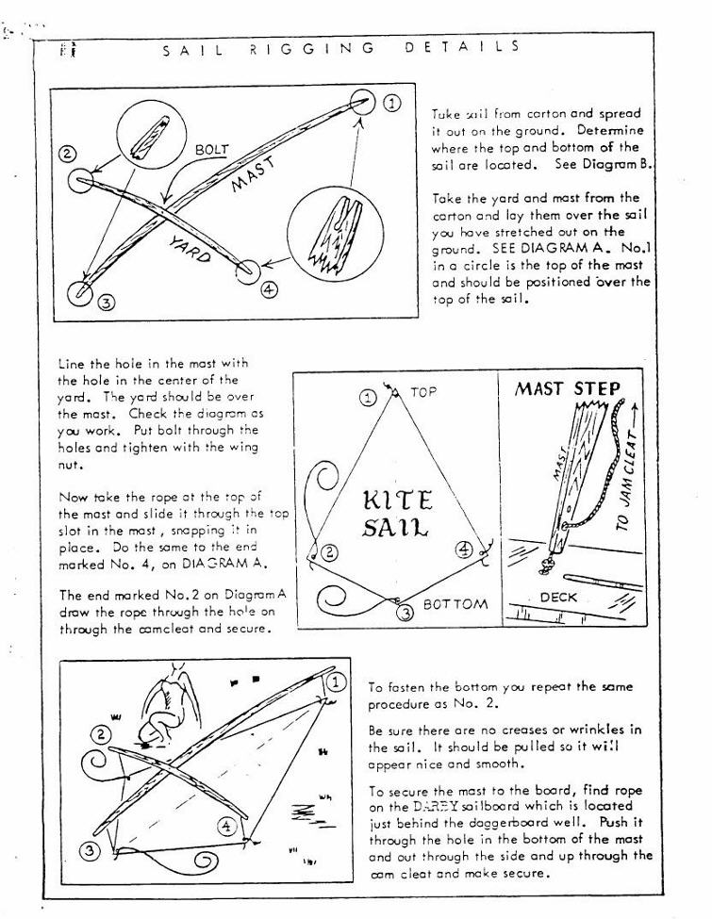
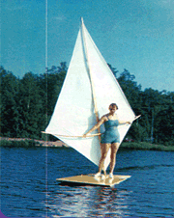
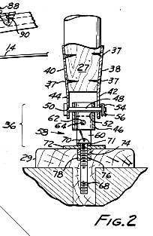
“But that’s soooo close.”
Imagine the Patent claims:
And the Defendant does this:
Wind propelled apparatus comprising:
Body means;
Wind propulsion means comprising a mast, boom & sail;
Universal joint connecting mast and body means.
Should this be infringing?

Slide 8
What do you want the answer to be?

Slide 9
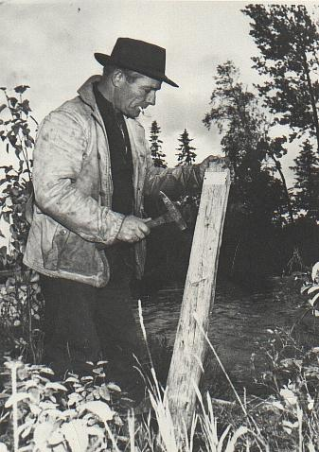
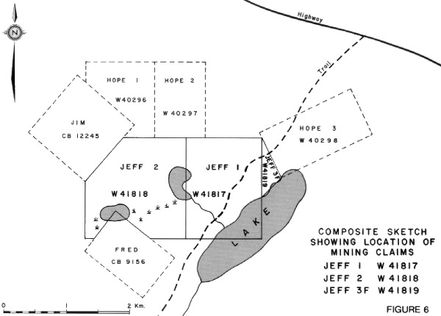
Staking a Claim
"By his claims the inventor puts fences around the fields of his monopoly and warns the public against trespassing on his property. His fences must be clearly placed in order to give the necessary warning and he must not fence in any property that is not his own. The terms of a claim must be free from avoidable ambiguity or obscurity and must not be flexible; they must be clear and precise so that the public will be able to know not only where it must not trespass by where it may safely go. If a claim does not satisfy these requirements it cannot stand... The inventor may make his claims as narrow as he pleases within the limits of his invention but he must not make them too broad. He must not claim what he has not invented for thereby he would be fencing off property which does not belong to him. It follows that a claim must fail if, in addition to claiming what is new and useful, it also claims something that is old or something that is useless.“
Minerals Separation North American Corp. v. Noranda Mines, Ltd., (1947), 12 C.P.R. 99 (Ex.Ct. per Thorson P.) at p. 146.

Slide 10
Am I infringing?
Are you inside or outside the fence?
I dunno, where’s the boundary of the fence?
Where do you want it to be?
  “S/he who controls the definitions, controls the debate.”

Slide 11
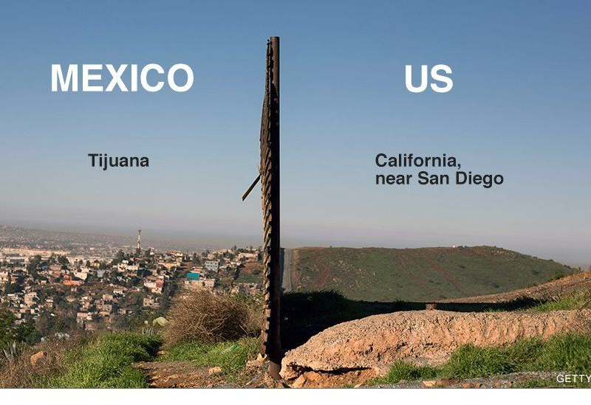
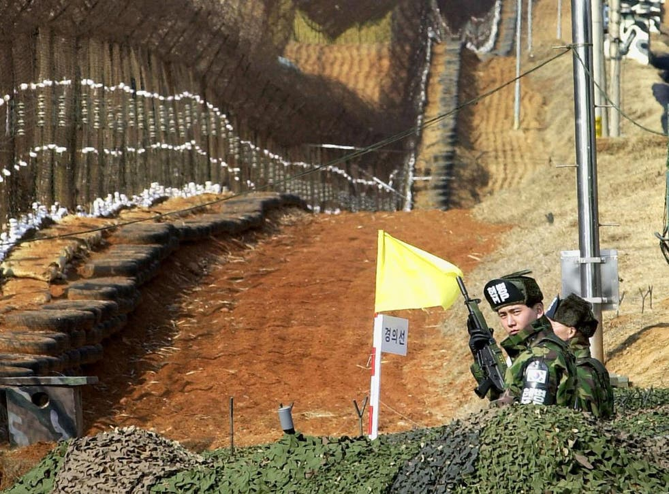
Claim Boundary: Clear or Fuzzy?
Hard: Wall
Fuzzy: Fence + Land Mines
North/South Korea DMZ
Notes:
There’s a fence, but there’s additional danger outside the fence that you can’t see

Slide 12
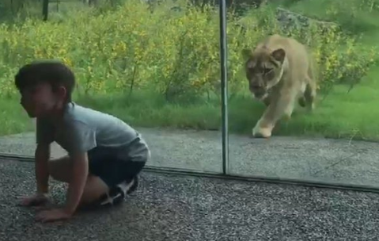

Claim Boundary: Clear or Fuzzy?
Hard: Glass Wall
Fuzzy: Bars tiger can reach through
Get as close to the boundary as you want
Don’t even think about getting close.
Notes:
There’s a fence, but there’s additional danger outside the fence that you can’t see

Slide 13
Claim Boundary: Clear or Fuzzy?
Hard Edge
Fuzzy Edge
Wall
Literal/All Elements
  The words define the border
  You chose the words
  You’re stuck with those words
For Public:
  Predictability
For Courts:
  Bright line – no flexibility
Bars + Claws
#1 Substantial/Essential
  You can’t take most of it
  You can’t take the most important/essential parts
For Public:
  No certainty
For Courts:
  flexibility (for equities)

Slide 14
It’s a question for the Judge
Like interpreting a statute …
Like interpreting a contract …
… It’s a “question of law”
(Don says: But it’s really:
  95% fact [What would the claim mean to the person skilled in the art?]; and
  5% “law” [Is there something in the patent that makes it different than how a skilled reader would read it?])
[SCOTUS: Teva v. Sandoz 2015: defer on fact finding]

Slide 15
Historically,
2 very different approaches
Strict, limiting construction
Wiggle room
Claim what you want; you don’t get what you don’t claim.
You said it, you meant it
“literal infringement”
Don’t take the substance of the invention
Infringing the “pith and marrow”
Probably driven by equity:
  The inventor could have claimed more, but didn’t (claimed too narrow to catch the infringer).

Slide 16
Split Personality
Invention limited to what’s claimed
“defining distinctly and in explicit terms”
Literal infringement
Well defined “fence”
Pith and substance
The “spirit” of the invention
Pith and marrow
Can modify or omit non-essential elements and still infringe
Notes:
So we have this split personality in the caselaw: the doctrine of infringing the pith and substance that effectively allows for the rewriting of the claim into essential and non-essential elements
And the other – a more strict construction – requires each and every element to be present in order for there to be infringement.

Slide 17
USA: literal doctrine of equivalents
Body means
Wind propulsion means
U-joint
Red flag
Body means
Wind propulsion means
U-joint
Red flag
Rope joint
Blue flag ag
Weather vane
All elements test: are all elements or their equivalents present?
Each element can be expanded by doctrine of equivalents:
  performs the same function
  in the same way
  to achieve the same result

Slide 18
Taking the substance of the invention

Slide 19
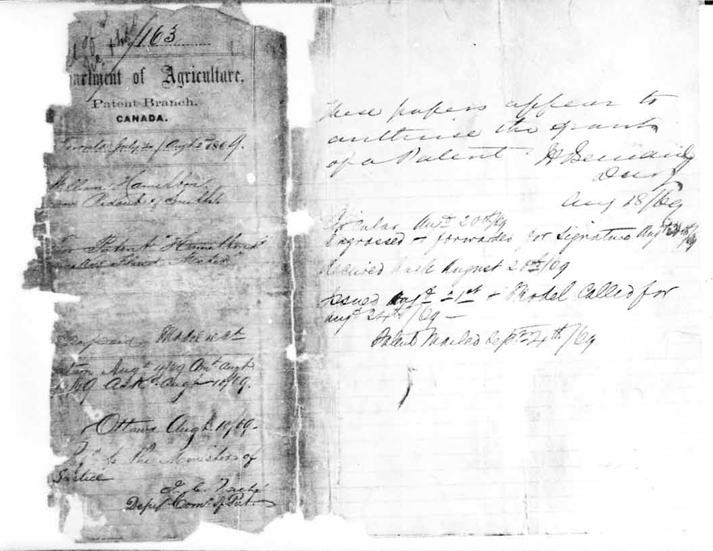
In the beginning … Canadian Patent No. 1
Notes:
This is a reproduction of Canadian Patent No. 1 for “A Machine for Measuring Liquids” granted by the Patents Branch of the Ministry of Agriculture in 1869.

Slide 20
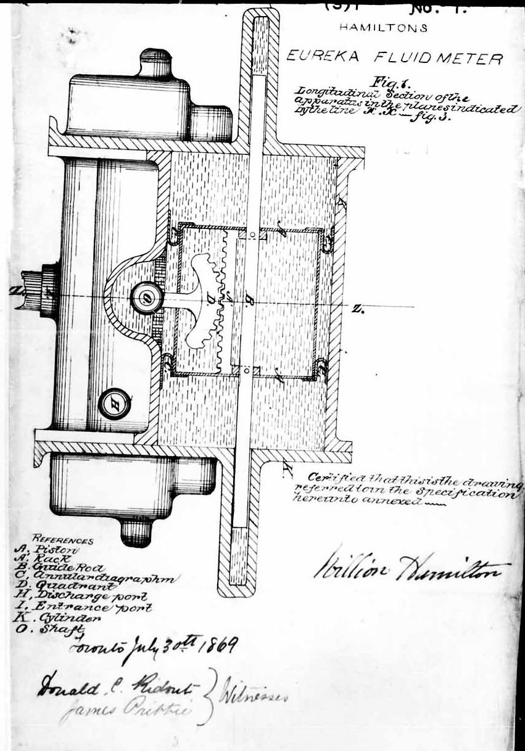
Notes:
Mr. Hamilton’s Eureka Fluid Meter

Slide 21
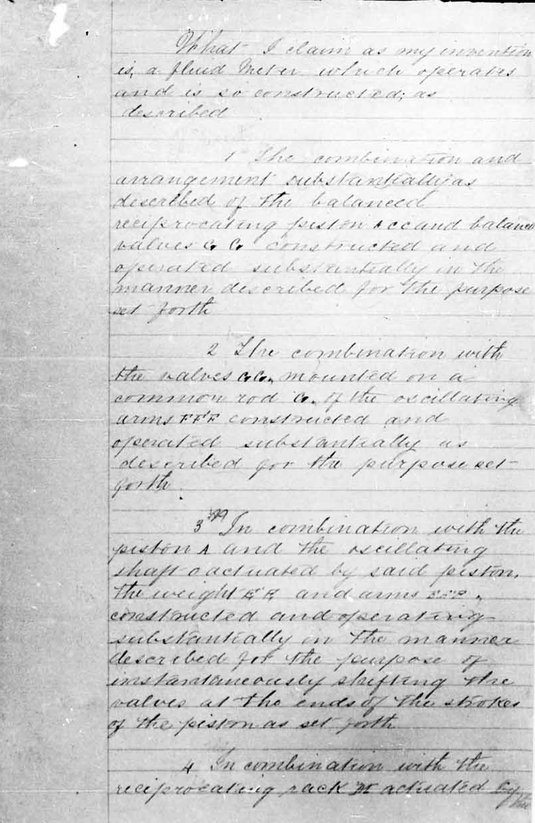
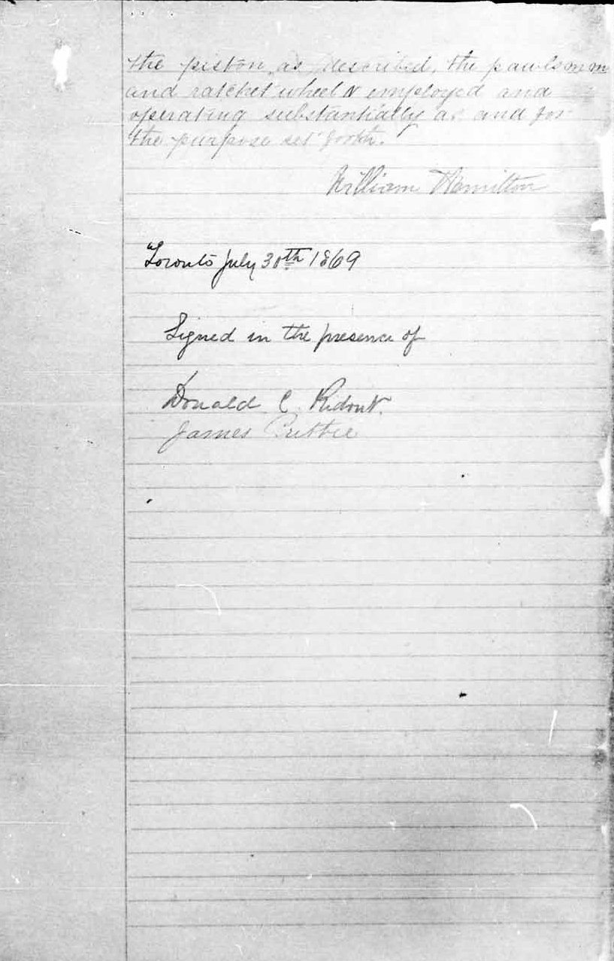
The combination and arrangement as described of the balanced reciprocating piston and balance valves constructed and operated substantially in the manner described for the purpose set forth.
Notes:
Mr. Hamilton’s patent ended with 4 claims.
Claim1:
What I claim as my invention is a fluid meter which operates and is so constructed as described.
The combination and arrangement as described of the balanced reciprocating piston and balance valves constructed and operated substantially in the manner described for the purpose set forth.
Not terribly illuminating
More or less saying I hereby claim what I’ve shown you.
The case law developed to protect inventors from having someone take the idea behind the specific embodiment of the invention described in the patent. To the Court, it did not seem fair that someone could make minor modifications what the inventor had disclosed and escape liability for infringement.
It sounds like the ghost of the Courts of Equity intervening.

Slide 22
Taking the substance of the invention
There "may be an essence or substance of the invention underlying the mere accident of form; and that invention, like every other invention, may be pirated by a theft in a disguised or mutilated form, and it will be in every case a question of fact whether the alleged piracy is the same in substance and effect, or is a substantially new or different combination".
James L.G. in Clark-vs-Adie, [1873] L.R. 10 Ch. 667
There "may be an essence or substance of the invention underlying the mere accident of form…”
Notes:
In 1873, Justice James described it this way:
There "may be an essence or substance of the invention underlying the mere accident of form; and that invention, like every other invention, may be pirated by a theft in a disguised or mutilated form, and it will be in every case a question of fact whether the alleged piracy is the same in substance and effect, or is a substantially new or different combination"

Slide 23
Taking the substance of the invention
There "may be an essence or substance of the invention underlying the mere accident of form; and that invention, like every other invention, may be pirated by a theft in a disguised or mutilated form, and it will be in every case a question of fact whether the alleged piracy is the same in substance and effect, or is a substantially new or different combination".
James L.G. in Clark-vs-Adie, [1873] L.R. 10 Ch. 667
"pith and marrow of the invention”
Lord Cairns Clark-vs-Adie, [1877] 2 App. Cas. 315, at 320
Notes:
By the time this case reached the House of Lords, this form of infringement was called taking the “pith and marrow” of the invention.

Slide 24
R.C.A. Photophone Ld. v. Gaumont-British Picture Corporation Ltd. and British Acoustic Films, Ld. (1936), 53 R.P.C. 167 per Romer J. at 197
“The principle is, indeed, no more than a particular application of the more general principle that a person who takes what in the familiar, though oddly mixed metaphor is called the pith and marrow of the invention is an infringer. If he takes the pith and marrow of the invention he commits an infringement even though he omits an unessential part. So, too, he commits an infringement if, instead of omitting an unessential part, he substitutes for that part a mechanical equivalent.”
Notes:
And another line of cases which continued the “pith and substance” approach well described in the RCA Photophone case:
... a person who takes what in the familiar, though oddly mixed metaphor is called the pith and marrow of the invention is an infringer. If he takes the pith and marrow of the invention he commits an infringement even though he omits an unessential part. So, too, he commits an infringement if, instead of omitting an unessential part, he substitutes for that part a mechanical equivalent.

Slide 25
Smith Incubator Co. v. Seiling
[1936] S.C.R. 251 per Rinfret J. at p. 260
“It is sufficient if the infringer has borrowed the substance or spirit of the invention as it can be ascertained from the claims, except in details which could be varied without detriment to the successful working of it."
Notes:
Even our Supreme Court recognized taking the substance or spirit of the invention:
“It is sufficient if the infringer has borrowed the substance or spirit of the invention as it can be ascertained from the claims, except in details which could be varied without detriment to the successful working of it."
A prime example is McPhar and Sharpe.

Slide 26
C. Ven Der Lely N.V. v. Bamfords Ltd.
[1963] R.P.C. 61 at 75 (H.L.) per Lord Reid
“Copying an invention by taking its "pith and marrow" without textual infringement of the patent is an old and familiar abuse which the law has never been powerless to prevent. It may be that in doing so, there is some illogicality, but our law has always preferred good sense to strict logic.”
Notes:
This contradiction was noticed a long time ago

Slide 27
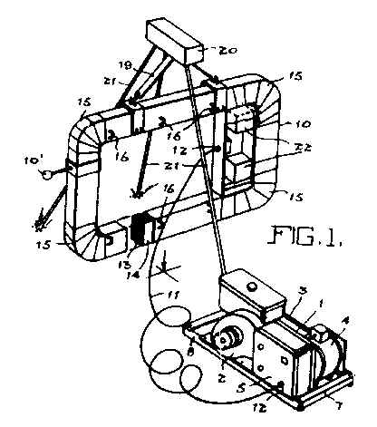
McPhar v. Sharpe
Means to suspend said transmitting coil to hang vertically and orientable in azimuth

Slide 28
McPhar Co. v. Sharpe Instruments
[1956-60] Ex. C.R. 467, at p. 525, (1960), 21 Fox Pat. C. 1 at p. 55.
"Thus it is established law that if a person takes the substance of an invention he is guilty of infringement and it does not matter whether he omits a feature that is not essential to it or substitutes an equivalent for it." [emphasis added.]

Slide 29
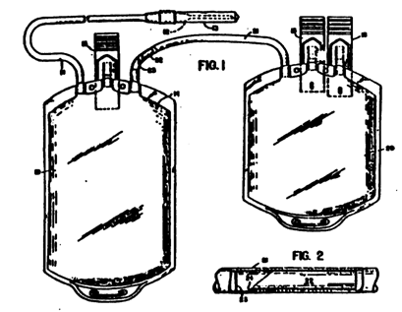
Cutter v. Baxter Travenol
(1983) 68 C.P.R. (2d 179
1. In parenteral fluid administration equipment a donor tube having needle means at one end and communicating with a flexible, collapsible, hemo-repellant blood container at the other end, a length of resilient tubing connecting said container to a second flexible, collapsible container to form a unitary system, a removable, transverse membrane positively closing said connecting tubing to the flow of fluid between said containers and a free moving membrane-removing, hollow cannula located wholly within said tubing, the cannula being completely unattached to said tubing and any part of said system, said cannula being proportioned to readily fit in and move within said tubing so that the cannula can be externally manipulated to remove said membrane without opening said tubing, said cannula being further manipulatable substantially out of said tubing into one of said containers.

Slide 30
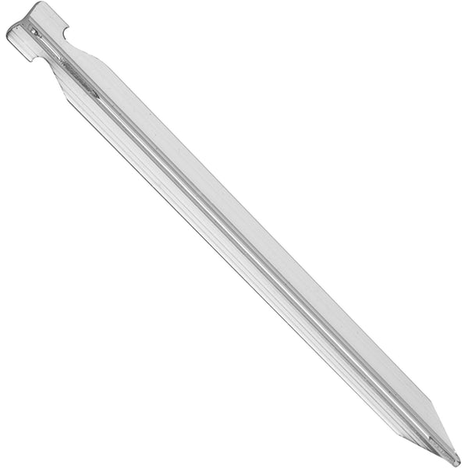
Cutter “a vaned spike”
tent peg from mec.ca

Slide 31
Cutter v. Baxter Travenol
At pp.198-199
"It seems to me to be plain that the Cutter spike is, as found by the learned trial judge, the functional equivalent of the cannula referred to in claims 1, 2 and 4. Both are operated by the technician in the same way. Both rupture the membrane and establish a channel or channels through which blood or its components or anticoagulants can flow. Both do it in the same way. The evidence shows that the cannula ruptures the membrane by causing a transverse slit which permits the blood to flow around the outside wall of the cannula as well as through its lumen.
Moreover, both devices are in the tube and are unattached.
Further, in my view, the precise structure or configuration of the device to be used to rupture the membrane and establish a flow channel is not an essential element of the invention. As I see it, it would not matter whether a cannula or a vaned spike or a device of some other sort, such as, for example, a device of the like proportions with a semicircular cross section, were used or whether it would cut out in whole or in part or merely rupture the membrane. The substance of the invention, its "pith and marrow", would be taken so long as the rupturing device had the essential elements of being in the tube and being unattached. I think therefore that the substance of the invention has been taken and that all the claims of the patent were infringed by the Cutter device."

Slide 32
Strict reading: distinctly claim

Slide 33
Statutory requirement for claims
U.S.A. 1836
  the inventor “shall particularly specify and point out the part, improvement, or combination, which he claims as his own invention or discovery.”
U.S.A. 1870
  the inventor “..shall particularly point out and distinctly claim the part, improvement, or combination which he claims as his invention or discovery
U.K. 1883
Notes:
Meanwhile, Patent Acts around the world were being amended to require patents to end with claims

Slide 34
Patent Act s. 27(4):
"The specification must end with a claim or claims defining distinctly and in explicit terms the subject-matter of the invention for which an exclusive privilege or property is claimed."
defining distinctly and in explicit terms
Notes:
By 1923 the Canadian Patent Act was phrased much in the same way as it is today:
"The specification must end with a claim or claims defining distinctly and in explicit terms the subject-matter of the invention for which an exclusive privilege or property is claimed.
define distinctly and in explicit terms
But with this statutory requirement, it’s as if the case law didn’t notice it.
Two lines of case law developed:
One that more strictly construed the claims, to limit the scope of infringement to what had been claimed.

Slide 35
EMI Ltd. et al v. Lissen, Ltd. et al
(1939), 56 R.P.C. 23 at p. 39 per Lord Russell of Killowen
  “The function of the claims is to define clearly and with precision the monopoly claimed, so that others may know the exact boundaries of the area within which they will be trespassers. Their primary object is to limit and not to extend the monopoly. What is not claimed is disclaimed. The claims must undoubtedly be read as part of the entire document, and not as a separate document; but the forbidden field must be found in the language of the claims and not elsewhere. It is not permissible, in my opinion, by reference to some language used in the earlier part of the specification to change a claim which by its own language is a claim for one subject-matter into a claim for another and a different subject-matter, which is what you do when you alter the boundaries of the forbidden territory. A patentee who describes an invention in the body of a specification obtains no monopoly unless it is claimed in the claims. As Lord Cairns said, there is no such thing as infringement of the equity of a patent (Dudgeon v. Thomson, L.R. 3 App. Cas. 34)." [emphasis added]
Notes:
The EMI v. Lissen case is an excellent example:
"The function of the claims is to define clearly and with precision the monopoly claimed, so that others may know the exact boundaries of the area within which they will be trespassers. Their primary object is to limit and not to extend the monopoly. What is not claimed is disclaimed. The claims must undoubtedly be read as part of the entire document, and not as a separate document; but the forbidden field must be found in the language of the claims and not elsewhere. It is not permissible, in my opinion, by reference to some language used in the earlier part of the specification to change a claim which by its own language is a claim for one subject-matter into a claim for another and a different subject-matter, which is what you do when you alter the boundaries of the forbidden territory. A patentee who describes an invention in the body of a specification obtains no monopoly unless it is claimed in the claims. As Lord Cairns said, there is no such thing as infringement of the equity of a patent

Slide 36
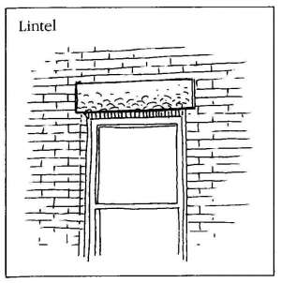
Taking the Substance 2.0
Notes:
Lintels are made of stone or wood. They go across a window or door opening to support the weight of the bricks above the window.

Slide 37
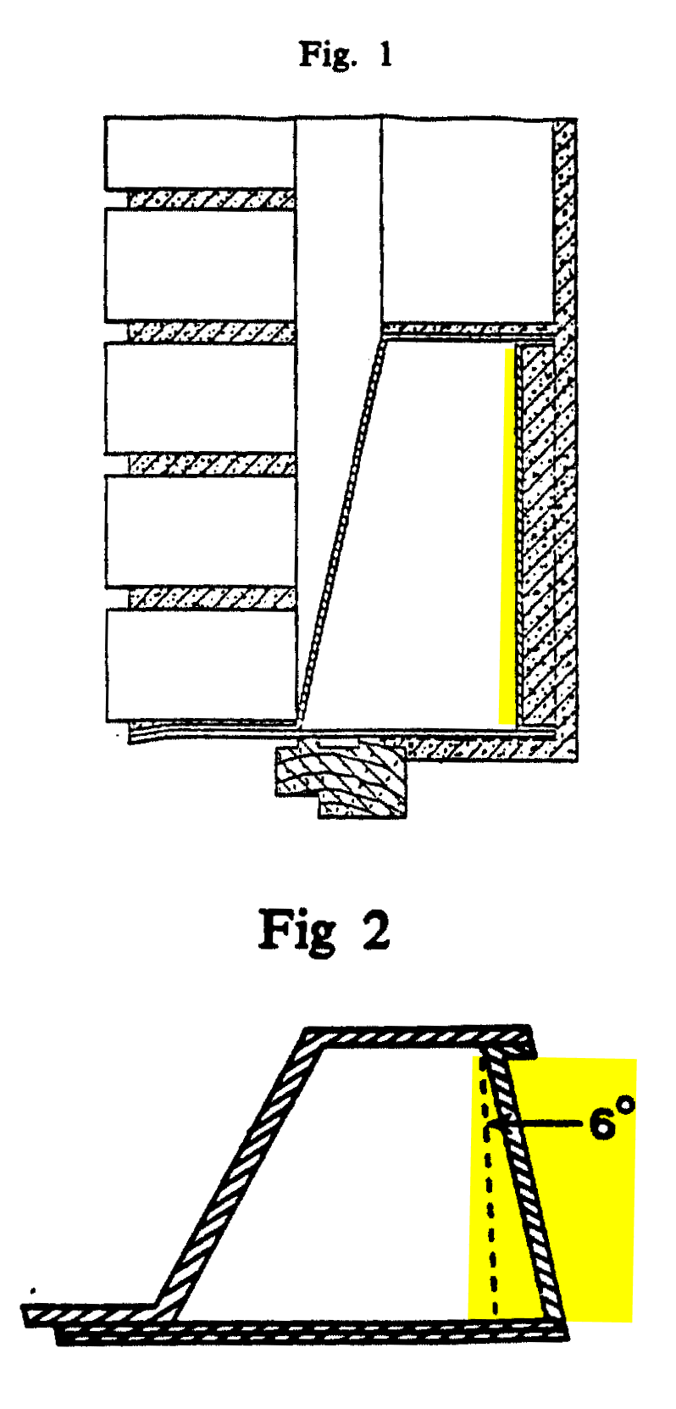
Catnic
having a rear wall member "extending vertically"

Slide 38
Catnic
Notes:
In the Catnic case, the lintel was made of metal, shaped on end view like a box with a slanted left side and a right side that was described as having a rear wall “extending vertically”. It’s shaded in yellow on the slide.
Attempting to avoid infringement, the defendant Hill made its box beam lintel with the rear wall sloped 6 degrees off vertical. It’s exaggerated in this diagram. If it was drawn to scale, you could hardly see it. If you look at your wrist watch when the second hand is at one second – that’s six degrees.
Having the rear wall at this angle made the Hill lintel about 1% weaker.

Slide 39
“purposive construction”
fair
asking “What were the parties or drafter trying to achieve?”
sometimes “making sense out of nonsense”
avoiding the absurd interpretation

Slide 40
Pfizer v. Novopharm per Blanchard J.
Purposive: what did they mean?
"As a preliminary matter, it is noted that claim 23 erroneously refers to an "antimicrobial" infection. Both parties accept that the intended reference in claim 23 is to a "microbial" infection. It is agreed that the error is of no consequence to the within application.”
Notes:
The parties and the judge understood what the author was saying, recognizing a typo and interpreting the words to make sense out of what would otherwise be nonsense.
Making sense out of the patent.
In Catnic, Lord Diplock determined that the was a variant from what was claimed, and set out his own phrasing of a test to decide whether the variant should be considered to be within the claim language in any event.

Slide 41
Catnic
The question in each case is: whether persons with practical knowledge and experience of the kind of work in which the invention was intended to be used, would understand that strict compliance with a particular descriptive word or phrase appearing in a claim was intended by the patentee to be an essential requirement of the invention so that any variant would fall outside the monopoly claimed, even though it could have no material effect upon the way the invention worked.
The question, of course, does not arise where the variant would in fact have a material effect upon the way the invention worked. Nor does it arise unless at the date of publication of the specification it would be obvious to the informed reader that this was so. Where it is not obvious, in the light of then-existing knowledge, the reader is entitled to assume that the patentee thought at the time of the specification that he had good reason for limiting his monopoly so strictly and had intended to do so, even though subsequent work by him or others in the field of the invention might show the limitation to have been unnecessary. It is to be answered in the negative only when it would be apparent to any reader skilled in the art that a particular descriptive word or phrase used in a claim cannot have been intended by the patentee, who was also skilled in the art, to exclude minor variants which, to the knowledge of both him and the readers to whom the patent was addressed, could have no material effect upon the way in which the invention worked."
Notes:
His language was very tortured.

Slide 42
Catnic - distilled
2. Would persons understand that strict compliance was intended to be an essential requirement of the invention so that any variant would fall outside the monopoly claimed? The word word or phrase used in a claim cannot have been intended by the patentee … to exclude minor variants.
1. The question, of course, does not arise where the variant would in fact have a material effect upon the way the invention worked. Nor does it arise unless at the date of publication of the specification it would be obvious to the informed reader that this was so.

Slide 43
Catnic - distilled
1. Does the variant make a difference to the way the invention works? If it does, it’s essential.
2. If it doesn’t make a difference to the way the invention works, did the patentee not intend to exclude the variant? If the patentee did not intend to exclude it, then it’s in. Otherwise, it’s not.

Slide 44
Catnic – further distilled
1. Does the variant make a difference to the way the invention works? If it does, it’s essential.
2. If it doesn’t make a difference to the way the invention works, did the patentee intend to include the variant? If yes, then it’s in. If no, then it’s not.

Slide 45
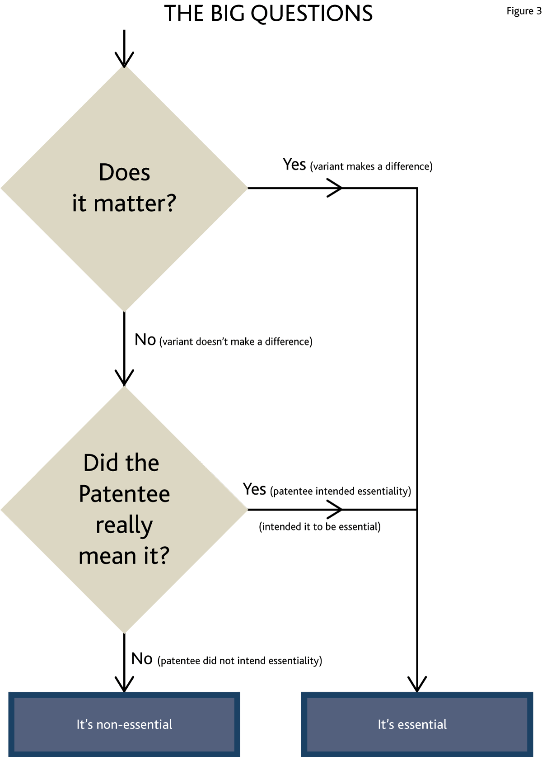
Notes:
The questions are asked in sequence, one building off the others and all have to be answered in a particular way before an element is found to be non-essential – It has to not make a difference as to how the invention works and the claim has to have been intended to include the variant.

Slide 46
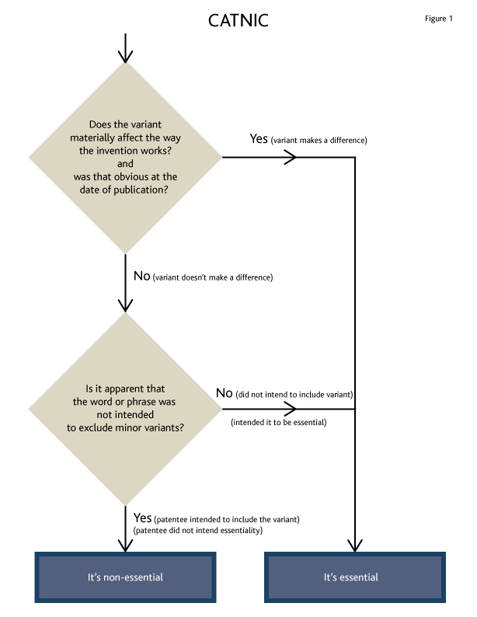

Slide 47
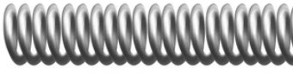
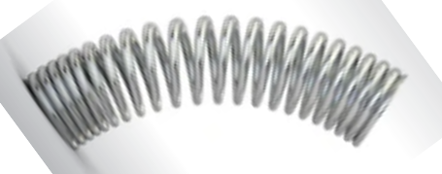
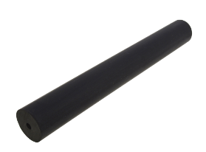
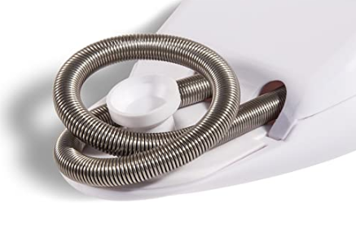
Improver
Improver: helical spring
Remington:
A rubber cylindrical rod with circumferential slits

Slide 48
Improver
(Catnic revisited and reformulated)
“If the issue was whether a feature embodied in an alleged infringement which fell outside the primary, literal or acontextual meaning of a descriptive word or phrase in the claim [“a variant”] was nevertheless within its language as properly interpreted, the court should ask itself the following three questions:
1.Does the variant have a material effect upon the way the invention works? If yes, then the variant is outside the claim. If no?
2.Would this (i.e. that the variant had no material effect) have been obvious at the date of publication of the patent to a reader of the patent skilled in the art? If no, the variant is outside the claim. If yes?
3.Would the reader skilled in the art nevertheless have understood from the language of the claim that the patentee intended that strict compliance with the primary meaning was an essential requirement of the invention? If yes, then the variant is outside the claim.

Slide 49
Improver
If the issue was whether a feature embodied in an alleged infringement which fell outside the primary, literal or acontextual meaning of a descriptive word or phrase in the claim [“a variant”] was nevertheless within its language as properly interpreted
Hoffman’s asking
  “What’s the term’s literal, acontextual meaning?”
  “Is the variant outside that meaning?”
  “Is the variant still within the language as properly interpreted?”
Notes:
That’s very different from Catnic

Slide 50
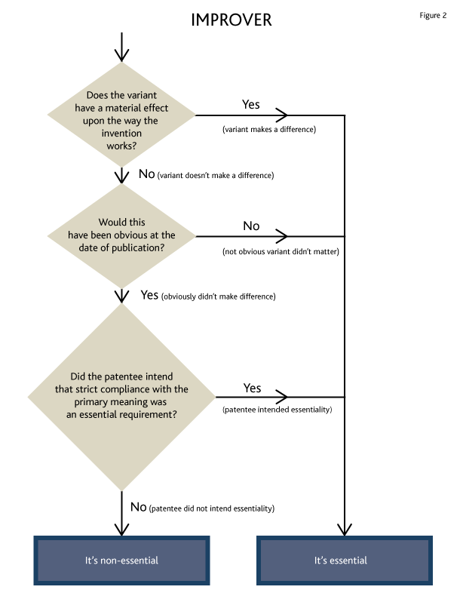

Slide 51
Notes:
The questions are otherwise the same, just the double negative is gone
Similar logic as Catnic

Slide 52
Improver cont’d
“On the other hand, a negative answer to the last question would lead to the conclusion that the patentee was intending the word or phrase to have not a literal but a figurative meaning (the figure being a form of synecdoche or metonymy) denoting a class of things which include the variant and the literal meaning, the latter being the most perfect, best-known or striking example of the class.”
Huh?

Slide 53
Improver cont’d
Synecdoche | a figure of speech in which a more inclusive term is used for a less inclusive one or vice versa, as a whole for a part or a part for a whole. e.g. “Nice wheels” = nice car “All hands on deck” = all people on deck
Metonymy | The substitution of a word denoting an attribute or adjunct of a thing denoting the thing itself; and instance of this. A thing used or regarded as a substitute or symbol of something else e.g. “The Crown” = The Queen “Toronto won by 2 goals” refers to the Leafs
Notes:
Ironic that you have to use a dictionary to understand a judgment on how to understand how words are used
I would respectfully suggest that patent claims are a very poor place to use literary devices.

Slide 54
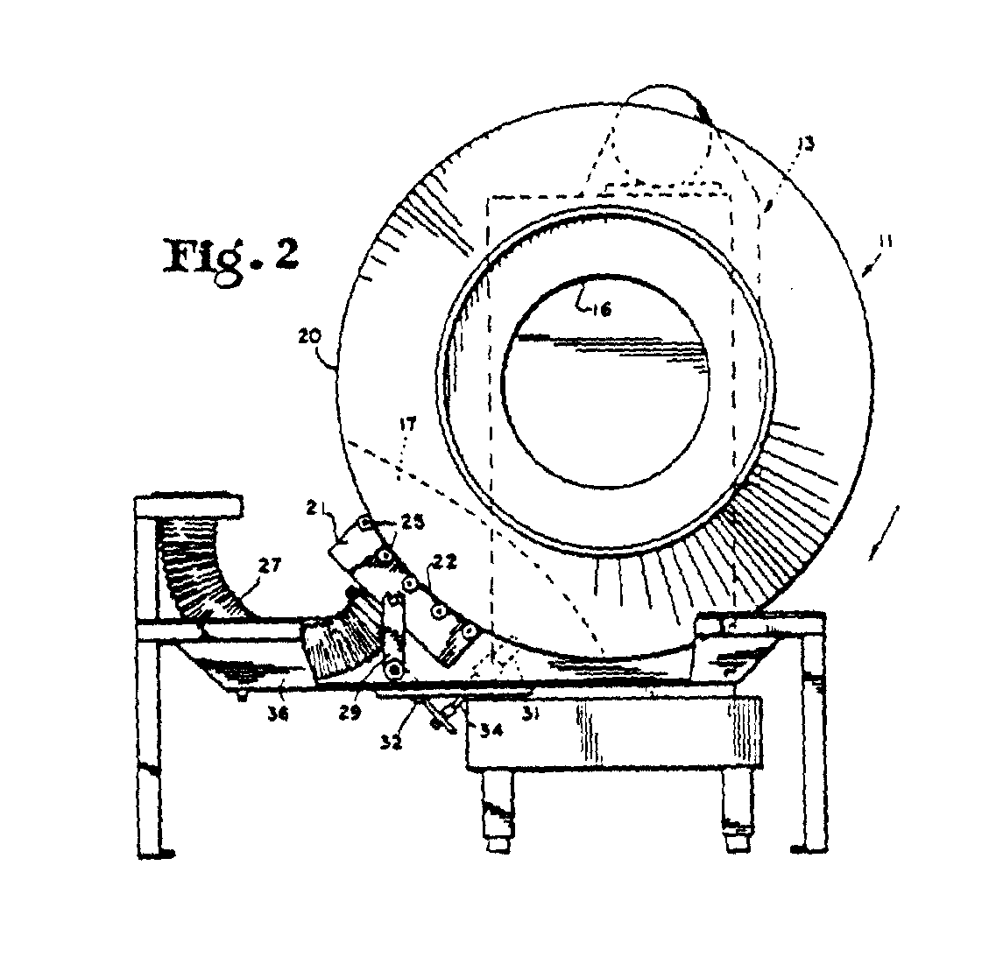
O’Hara
plenum (vacuum) was “flexibly biased against the drum”

Slide 55
O’Hara
“… would the specification make it obvious to a reader skilled in the art that the description of the patented machine as comprising "an exhaust inlet flexibly biased against the exterior" of the drum could not have been intended to exclude machines in which exhaust was not "flexibly biased against" the drum but was mounted in a fixed position as close as possible to the drum?”

Slide 56
O’Hara cont’d
“It should be realized that the answer to that question depends on the interpretation that is put on the claims. That answer, therefore, must be consistent with the text of the claims. A court must interpret the claims; it cannot redraft them. When an inventor has clearly stated in the claims that he considered a requirement as essential to his invention, a court cannot decide otherwise for the sole reason that he was mistaken. I also wish to add that, as the court, in interpreting the claims, is merely trying to find out what was the intention of the inventor, it cannot conclude that strict compliance with a word or phrase used in a claim is not an essential requirement of the invention unless it be obvious that the inventor knew that a failure to comply with that requirement would have no material effect upon the way the invention worked..”

Slide 57
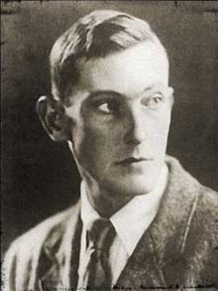
The George Mallory test of essentiality –
An element is essential “because it’s there”
Invention limited to what’s claimed
The answer must be consistent with the text of the claims.
A court must interpret the claims; it cannot redraft them.
the court … is merely trying to find out what was the intention of the inventor.
“You claimed it - it’s yours”

Slide 58
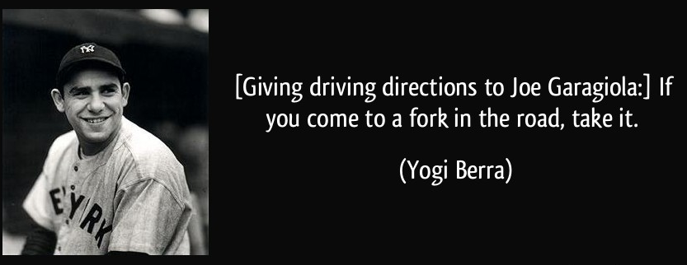
Whirlpool & Free World

Slide 59
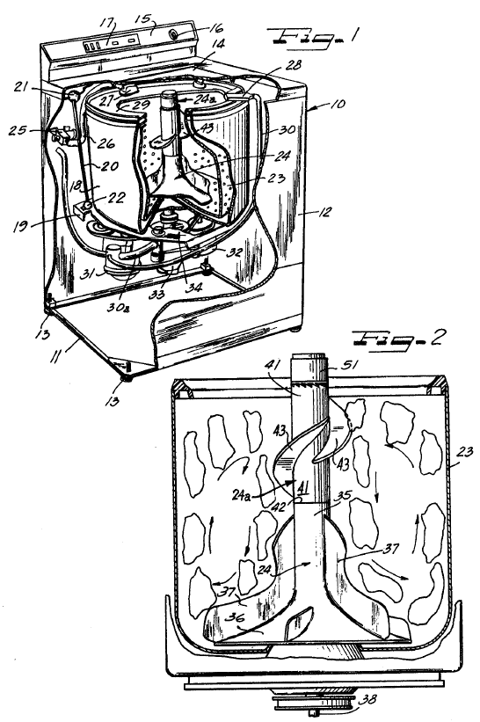
The Prior Art
1,049,803
“vanes”

Slide 60
The “principles” from Free World
(a) The Patent Act promotes adherence to the language of the claims.
(b) Adherence to the language of the claims in turn promotes both fairness and predictability.
(c) The claim language must, however, be read in an informed and purposive way.
(d) The language of the claims thus construed defines the monopoly. There is no recourse to such vague notions as the “spirit of the invention” to expand it further.
The claims language will, on a purposive construction, show that some elements of the claimed invention are essential while others are non-essential. The identification of elements as essential or non-essential is made:
on the basis of the common knowledge of the worker skilled in the art to which the patent relates;
as of the date the patent is published;
having regard to whether or not it was obvious to the skilled reader at the time the patent was published that a variant of a particular element would not make a difference to the way in which the invention works; or
according to the intent of the inventor, expressed or inferred from the claims, that a particular element is essential irrespective of its practical effect;
without, however, resort to extrinsic evidence of the inventor's intention.
(f) There is no infringement if an essential element is different or omitted. There may still be infringement, however, if non-essential elements are substituted or omitted

Slide 61
The “principles” from Free World
Essential & Non-Essential
The claims language will, on a purposive construction, show that some elements of the claimed invention are essential while others are non-essential. The identification of elements as essential or non-essential is made:
(iii) having regard to whether or not it was obvious to the skilled reader at the time the patent was published that a variant of a particular element would not make a difference to the way in which the invention works; or
(iv) according to the intent of the inventor, expressed or inferred from the claims, that a particular element is essential irrespective of its practical effect;
“Adhere to the language”
(Invention limited to what has been claimed)
(a) The Patent Act promotes adherence to the language of the claims.
(b) Adherence to the language of the claims in turn promotes both fairness and predictability.
(d) The language of the claims thus construed defines the monopoly. There is no recourse to such vague notions as the “spirit of the invention” to expand it further.

Slide 62
The “principles” from Free World
The Catnic questions:
#1 Does it matter as to how it works?
#2 Did inventor really mean it?
Essential & Non-Essential
(e) The claims language will, on a purposive construction, show that some elements of the claimed invention are essential while others are non-essential. The identification of elements as essential or non-essential is made:
(iii) having regard to whether or not it was obvious to the skilled reader at the time the patent was published that a variant of a particular element would not make a difference to the way in which the invention works; or
(iv) according to the intent of the inventor, expressed or inferred from the claims, that a particular element is essential irrespective of its practical effect;
and
or

Slide 63
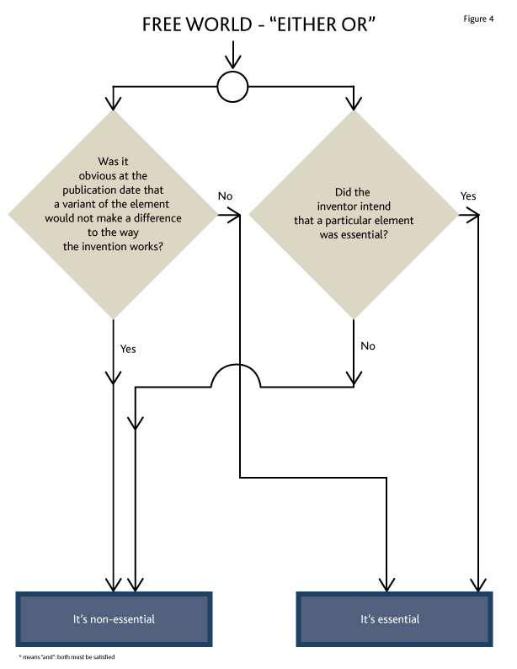

Slide 64
The Essential/Non-essential principles of Free World
The identification of elements as essential or non-essential is made:
  (iii) having regard to whether or not … a variant of a particular element would not make a difference to the way in which the invention works; or
  (iv) according to the intent of the inventor, expressed or inferred from the claims, that a particular element is essential irrespective of its practical effect;
Notes:
The “or” suggested to me that it’s an either or test.
So if either question says it’s essential, is it essential?
If either questions says it’s non-essential, is it non-essential?

Slide 65
Completing the questions in Free World
The identification of elements as essential or non-essential is made:
  (iii) having regard to whether or not … a variant of a particular element would not make a difference to the way in which the invention works. If it makes a difference, then the element is essential; or
  (iv) according to the intent of the inventor, expressed or inferred from the claims, that a particular element is essential irrespective of its practical effect. If the inventor stated it to be essential, then it is essential.;
If the element is not essential under both (iii) and (iv), then the element is non-essential.

Slide 66
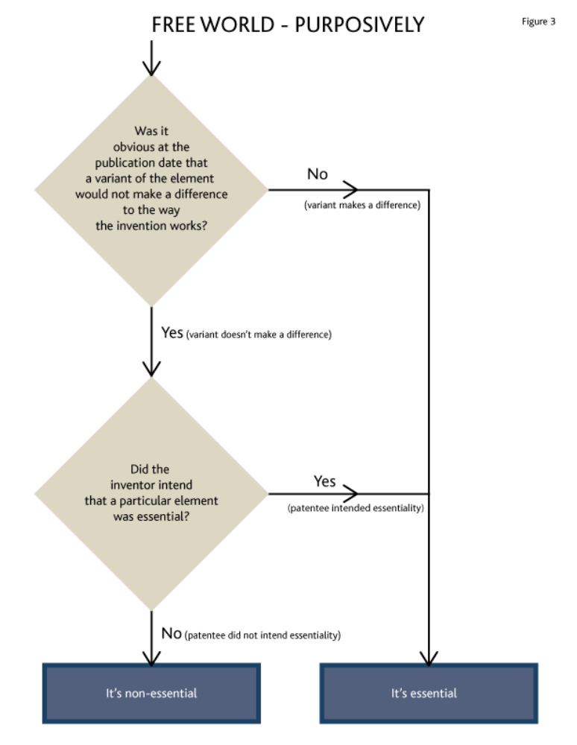

Slide 67
Just one more thing … he re-stated it at para. 55.
“For an element to be considered non-essential and thus substitutable, it must be shown either (i) that on a purposive construction of the words of the claim it was clearly not intended to be essential, or (ii) that at the date of the publication of the patent, the skilled addressees would have appreciated that a particular element could be substituted without affecting the working of the invention, i.e. had the skilled worker at that time been told of both the element specified in the claim and the variant and "asked whether the variant would obviously work in the same way", the answer would be yes..."

Slide 68
What hath Free World wrought?
“Or” means “or”
  If it doesn’t matter, then it’s non-essential
    Hansen J. in Westaim
      first layer cladding of 0.01 mm was essential
    Blanchard J. in Pfizer v. Novopharm
      “wet granulation” included dry granulation
Back to Improver
  Harrington J. in Biovail
    Non-essential under functionality, essential due to wording

Slide 69
Halford v. Seed Hawk – FCA a partial fix
Halford v. Seed Hawk (FCA per Sexton, Sharlow & Malone JJ.A.)
“An element may be found to be essential on the basis of the intent of the inventor as expressed or inferred from the claims, or on the basis of evidence as to whether it would have been obvious to a skilled worker at the time the patent was published that a variant of a particular element would make a difference to the way in which the invention works (Free World at paragraphs 31 and 55).” …
“… if it was not obvious at the date of patent publication that the substituted member had no material effect upon the way the invention works, then there is no infringement. Alternatively, if the functional equivalence was obvious, but the patentee intended strict compliance with the claim, then there is also no infringement (Free World at paragraph 55).”

Slide 70
Ask both FW Questions
Shire Canada Inc v Apotex Inc, 2016 FC 382 per Locke J.
[137] In my view, the SCC likely intended that, in order for a patentee to establish that a claim element is non-essential, it must show both (i) that on a purposive construction of the words of the claim it was clearly not intended to be essential, and (ii) that at the date of publication of the patent, the skilled addressees would have appreciated that a particular element could be substituted without affecting the working of the invention.
(followed in Choueifaty v Attorney General of Canada, 2020 FC 837)

Slide 71
Kirin-Amgen (the return of Hoffman)
“purposive construction” is the bedrock of patent construction and is universally applicable
The Catnic questions (the Protocol questions) had erroneously been used as a general rule “rather than guides which will in appropriate cases help to decide what the skilled man would have understood the patentee to mean”
there is only one compulsory question:
  What would a person skilled in the art have understood the patentee to have used the language of the claim to mean?

Slide 72
Actavis UK Limited et al v. Eli Lilly and Company
[2017] UKSC 48 (per Lord Neuberger, President)
Reintroduces “doctrine of equivalents” to patent infringement in UK
Overturns Kirin Amgen
Determine the scope of the claim.
When determining infringement, include equivalents.
a claim for “premetrexed disodium” was infringed by the Actavis products: (a) pemetrexed diacid, (b) pemetrexed ditromethamine, and (c) pemetrexed dipotassiumdiacid.

Slide 73
The questions
What would the claim have meant to a skilled reader as of the relevant date?
What do the words and phrases mean in the context of the patent?
  “… you must always construe a claim with reference to the whole context of the specification.”
Plimpton v. Spiller, U.K. C of A 1877

Slide 74
“Working around” the inconsistencies in Free World
Apply the “expanded version” of the Free World test
As in Halford:
  make each of the two questions decide if it’s essential;
  if it’s not essential under both, then it’s non-essential
Follow George Mallory:
  Under the second Free World question, find everything to be essential … “because it’s there” (as in O’Hara)

Slide 75
Canadian Overview
What do the words and phrases in the claim mean?
Catnic/Improver. Claim element is essential (and can’t be varied) if:
  the variant makes a difference to the way the invention works; or
  the Patentee did not intend to exclude it.
Free World/Whirlpool “inconsistency”. Claim element is non-essential (and can be varied or ignored) if
  a particular element could be substituted without affecting the working of the invention; or
  it was clearly not intended to be essential.

Slide 76
Claim element is non-essential (and can be varied or ignored) if:
Catnic/Improver
(translated to FW/W)
Free World/Whirlpool
(para. 55)
  the variant does not make a difference to the way the invention works; and
  the Patentee did not intend to exclude include it.
  a particular element could be substituted without affecting the working of the invention; or
  it was clearly not intended to be essential.

Slide 78
Scenario #1
Scenario #2
attend class
No
attend class
pass exam
yes
yes
yes
pass course
pass exam
No
yes
pass course

Slide 79
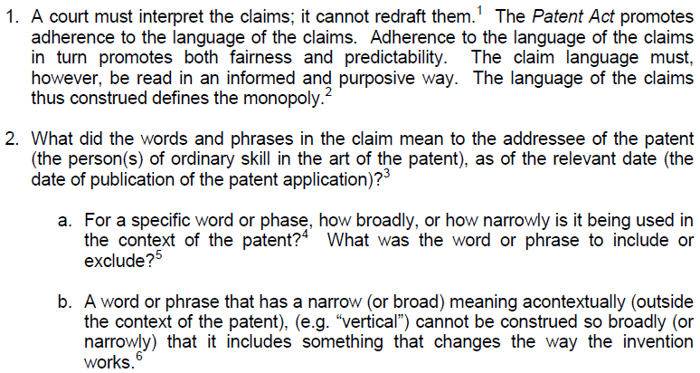
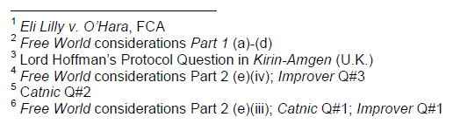
Cameron’s Universal Field Theory of Claim Construction

Slide 80
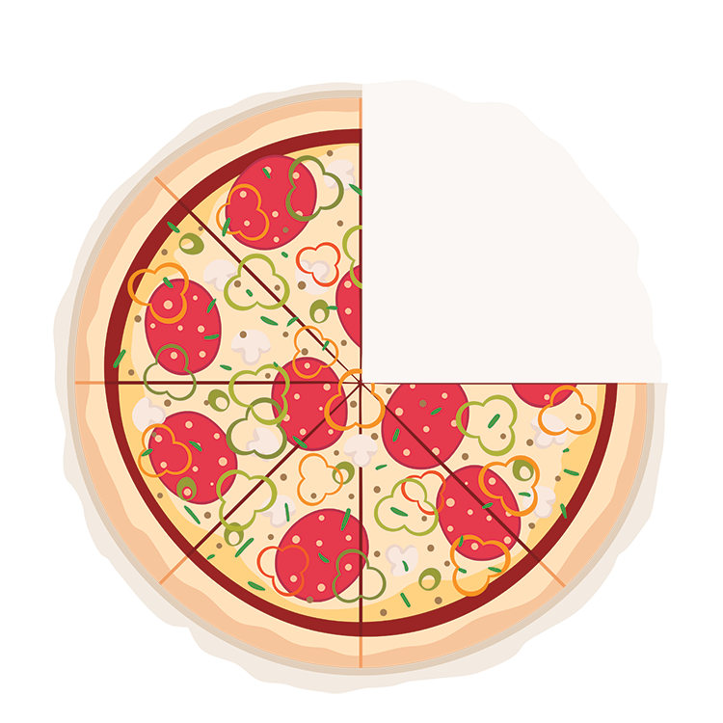
OLD
NEW
Pith and Substance
Essential elements
Taken the “pith and substance”
Infringement by taking all essential elements

Slide 81
Other Considerations
Use of the Disclosure
  Read patent as a whole
    Look for definitions – they count
  Disclosure should not expand or contract meaning
    Claim should NOT be limited to the preferred embodiment (FCA: Dableh)

Slide 82
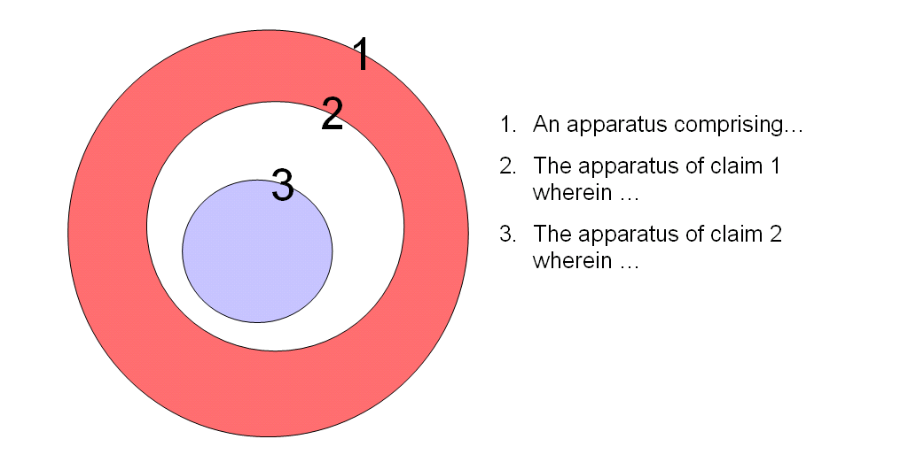
Claim Differentiation
Notes:
If a patent could be granted with a claim 1 claiming “all lawyers in a courtroom”, dependant claim 2 could be for “the lawyers of claim 1 wherein said lawyers are right-handed” and claim 3 could be for “the lawyers of claim 2 wherein said lawyers wear glasses.”
Claim 3 would include lawyers in the courtroom who are right-handed and wear glasses.
Claim 2 would include lawyers in the courtroom who wear glasses (those of Claim 3) as well as those that do not (those in the white region).
Claim 1 would include right-handed lawyers (those of Claim 2) and those that are not (those in the red region).

Slide 83
Claim Differentiation
Other independent claims
  Can’t use for construction, but same words should have same meaning

Slide 84
Other Considerations
Use of External material
  Can use it if it’s referred to in patent
  Can use it to understand the state of the art
  Since Dec. 2018, can use the Canadian file history
  Can’t use:
    Dictionaries (I say “why not?”)
    Inventor’s evidence as to his/her intention
  Issue Estoppel
    Law, no; facts probably

Slide 85
What it’s not: Problem/Solution
CIPO’s “problem/solution” approach to claim construction:
  “The identification of the essential elements of a claim cannot be performed without having first properly identified the proposed solution to the disclosed problem” [former Manual of Patent Office Practice, Section 12.02.02e.]

Slide 86
Choueifaty v Attorney General of Canada, 2020 FC 837
[37] …“using the problem-solution approach to claims construction is akin to using the ‘substance of the invention’ approach discredited by the Supreme Court of Canada in Free World Trust at paragraph 46”
[39] As Justice Locke, then of this Court, noted in Shire Canada Inc v Apotex Inc, 2016 FC 382 at paras 134-143, in order “to establish that a claim element is non-essential, it must show both (i) that on a purposive construction of the words of the claim it was clearly not intended to be essential, and (ii) that at the date of publication of the patent, the skilled addressees would have appreciated that a particular element could be substituted without affecting the working of the invention” [emphasis in original]. The problem-solution approach to claims construction focuses only on the second aspect above, it fails to respond, as taught in Free World Trust, to the issue of the inventor’s intention. Regarding the inventor’s intention, para 51 of Free World Trust states: “The words chosen by the inventor will be read in the sense the inventor is presumed to have intended, and in a way that is sympathetic to accomplishment of the inventor's purpose expressed or implicit in the text of the claims.”
[40] …“the Commissioner erred in determining the essential elements of the claimed invention by using the problem-solution approach, rather than the approach Whirlpool directs be used”;

Slide 87
Choueifaty v Attorney General of Canada, 2020 FC 837
[34] Paragraph 62 of Genencor International Inc v Canada (Commissioner of Patents), 2008 FC 608 [Genencor] is relied on by the Commissioner for its holding that the Whirlpool test is not applicable to patent examiners. It reads as follows:
  Whirlpool was, of course, an impeachment proceeding. It was not a re-examination proceeding and I am satisfied that the foregoing, in all its implications, was directed to trial judges and to judges of courts of appeal and not to patent examiners in the course of examinations to determine whether applications for patents should be granted or in the course of re-examinations as here.
[35] Genencor is not binding on me, and in my view, is no longer good law. It was made prior to the Federal Court of Appeal decision in Amazon. Amazon, like the present appeal, dealt with the Commissioner’s refusal to grant a patent. At paragraph 43, the Federal Court of Appeal finds that the Commissioner is required to employ the purposive construction test set out in Whirlpool and Free World Trust:
  However, it seems to me that the jurisprudence of the Supreme Court of Canada, in particular Free World Trust and Whirlpool, requires the Commissioner’s identification of the actual invention to be grounded in a purposive construction of the patent claims. It cannot be determined solely on the basis of a literal reading of the patent claims, or a determination of the “substance of the invention” within the meaning of that phrase as used by Justice Binnie, writing for the Supreme Court of Canada in Free World Trust, at paragraph 46. [emphasis added]

Slide 88
Claim Charts

Slide 89
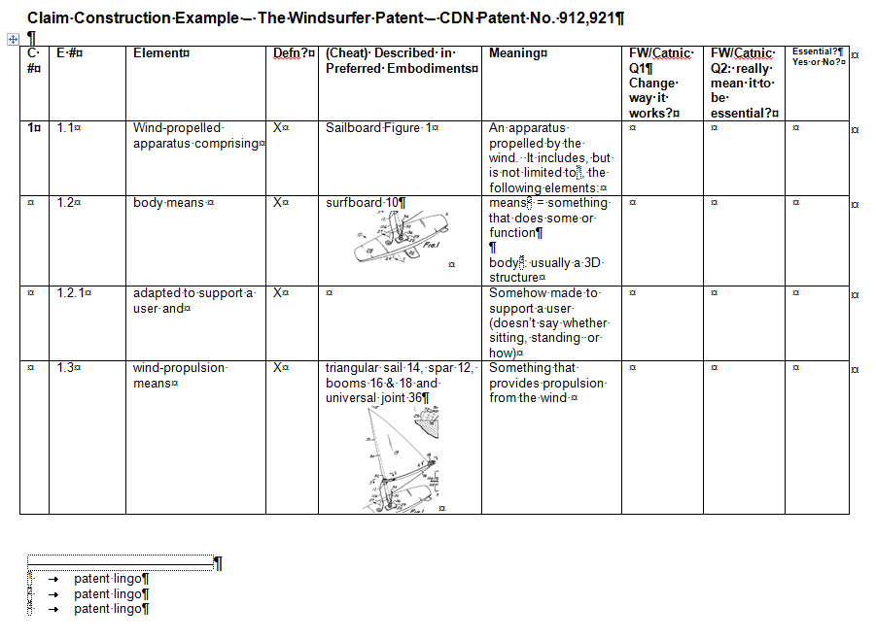

Slide 90
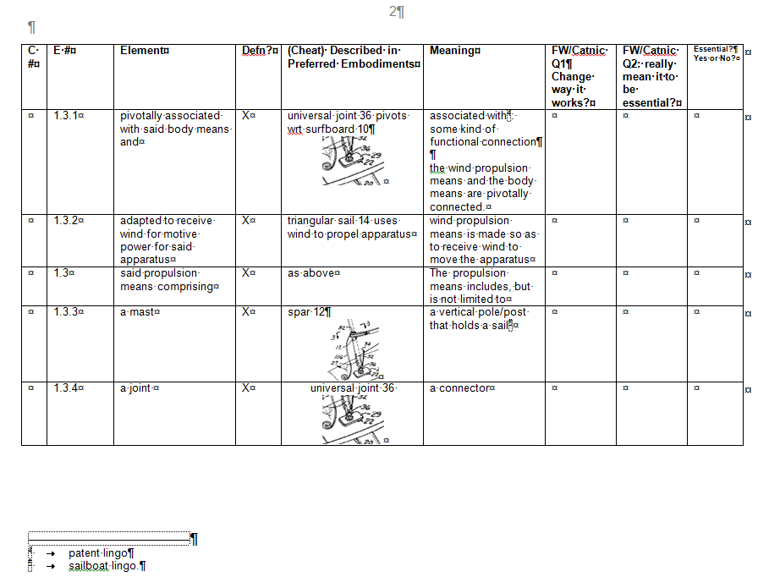

Slide 91
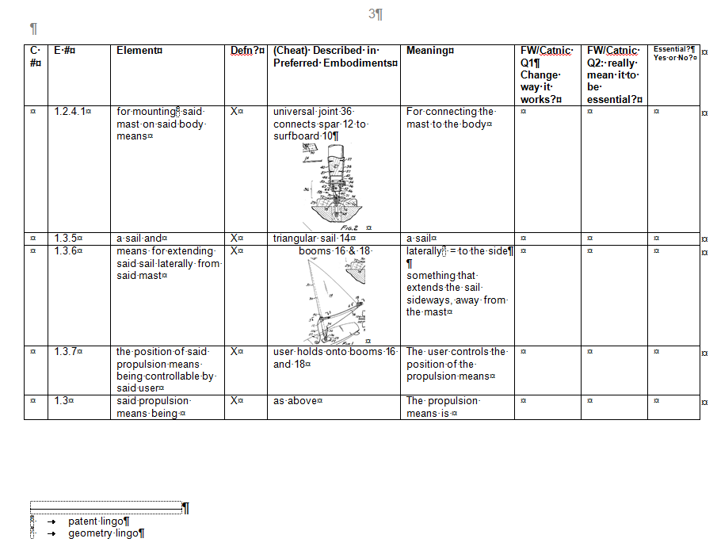

Slide 92
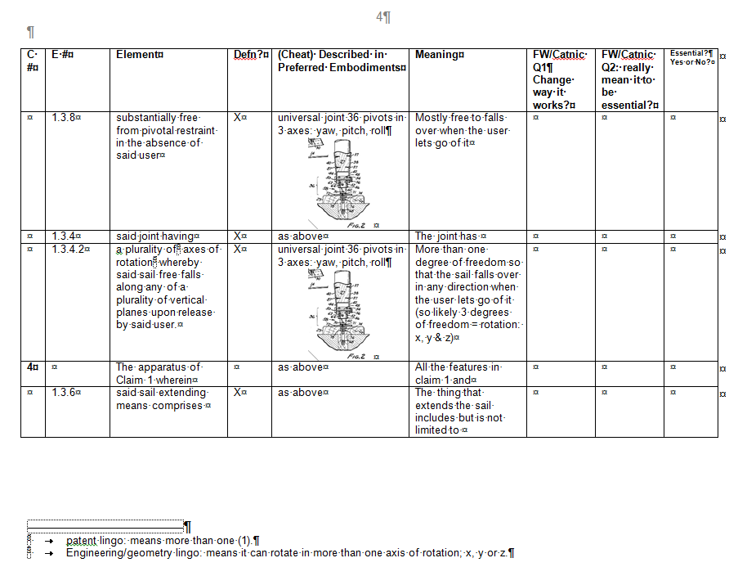

Slide 93
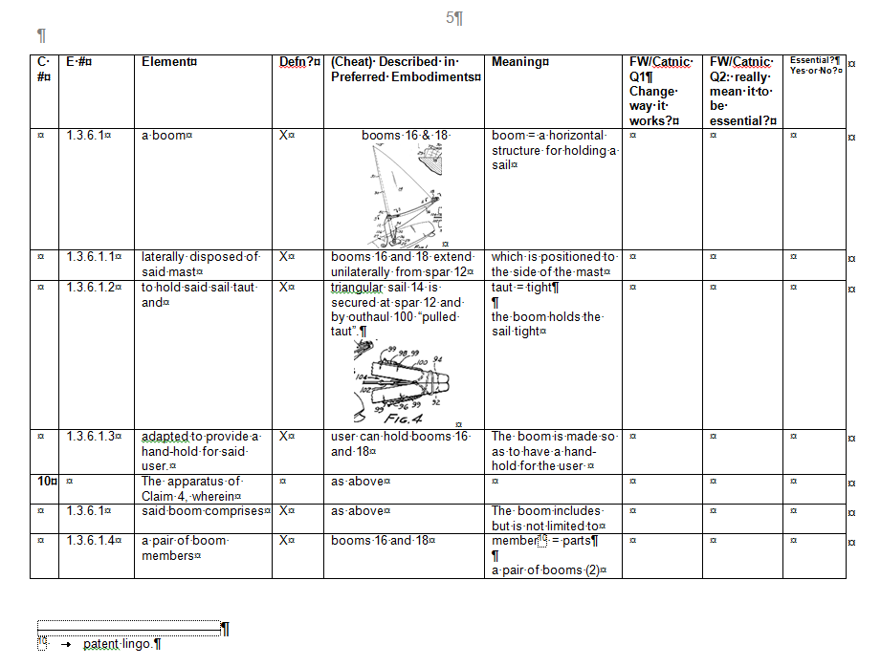

Slide 94
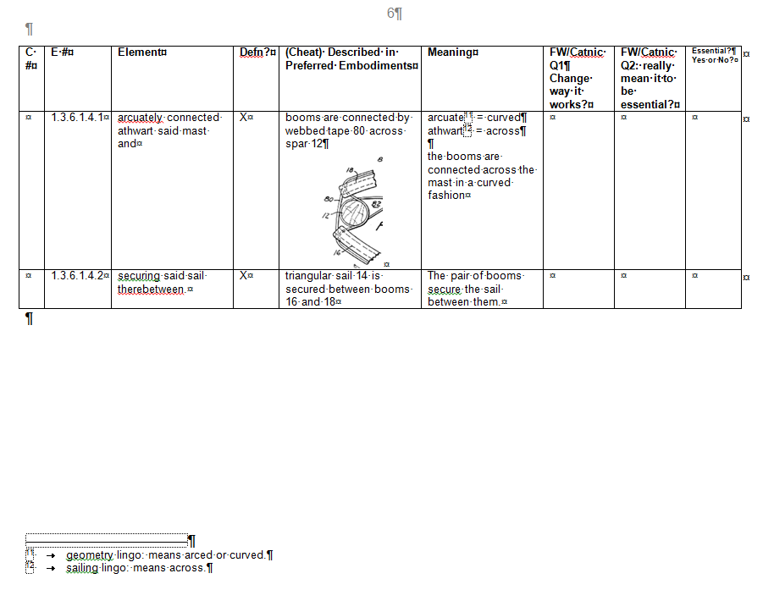

Slide 95
How to Construe a Claim (per DMC)
Do it first, before infringement or validity
  “as if the defendant had never been born”
Do it “purposively” = in context of the whole patent
  Read the whole patent (it’s all about context)
  Look for definitions, explicit or implied (they rule)
  Pay lip service to P&G (that you can’t look at disclosure unless term is ambiguous)
  Preferred embodiments are illustrative but not limiting (Dableh, FCA)
Use claim chart
  Interpret every phrase (or just “where the shoe pinches”)

Slide 96
How to Construe a Claim (per DMC)
Assume claim differentiation
  Same words have same meanings; different are different.
  Parent claim includes child, and things that are “not” the child’s added limitation.
External material
  Yes for meanings of words in the trade (experts & [maybe] technical dictionaries)
  Yes for factual issue estoppel
  Yes for Canadian file wrapper

Slide 97
How to Construe a Claim (per DMC)
Cite Free World/Whirlpool for using Catnic/Improver tests – “purposive construction”
  0. The case assumes there’s a variant.
  Is there an element different from what is (kinda literally) claimed?
  Does the variant change the way the invention works? If it does, then the claim element is essential and the variant is outside the claim.
  If it does not, did the inventor “not intend to exclude the variant” [intend to include it]? If inventor intended claim element to be essential, then the variant is outside in the claim.
  If:
    variant doesn’t change the way the invention works; and
    inventor didn’t intend to exclude the variant; then
    it’s non-essential element and
      Can be replaced; or
      Ignored when determining infringement.

