Slide 1
Patentable Subject Matter in Life Sciences
Melanie Szweras
mszweras@bereskinparr.com
May 9, 2023

Slide 2
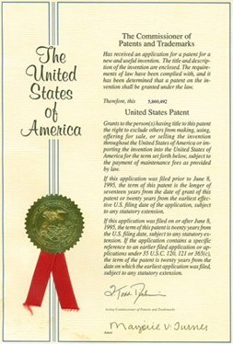
Patentable Subject Matter
No common law patent rights
Must look to Patent Act to determine what is patentable
Only those things which fall into categories of proper subject matter under Relevant Act are patentable
What is patentable may differ in different jurisdictions

Slide 3
Statutory Subject Matter
Section 2 of the Canadian Patent Act:
    “invention means any new and useful art, process, machine, manufacture or composition of matter, or any new and useful improvement in any art, process, machine, manufacture or composition of matter”
35 U.S. Code § 101
    “Whoever invents or discovers any new and useful process, machine, manufacture, or composition of matter, or any new and useful improvement thereof, may obtain a patent therefor, subject to the conditions and requirements of this title.”

Slide 4
Patentable Subject Matter
Should morality be taken into consideration for Canadian patents?
  regulate by specific morality provision in the Patent Act
  regulate under s. 2? (useful)
  regulate by alternative legislation

Slide 5
Patentable Subject Matter
“Designer Babies” - U.S. Patent No. 8,543,339
  issued September 2013
  method for predicting likelihood that a baby will have particular traits
    potentially allows recipients to select characteristics of interest in hypothetical offspring
  genetic diagnosis of pre-implanted embryos for serious genetic abnormalities is common
  where do you draw the line?

Slide 6
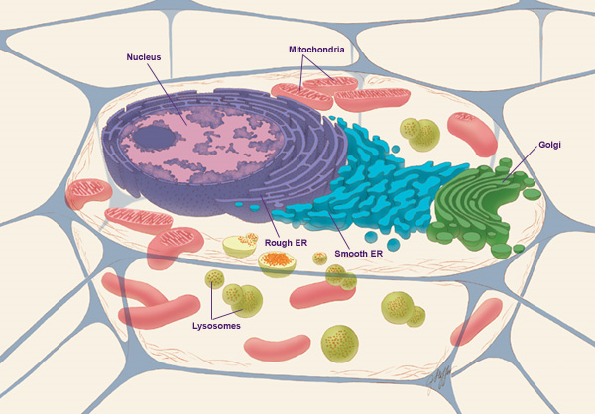

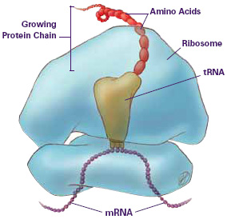
Biotechnology/Pharmaceutical Patentable Subject Matter
Small molecules/chemicals
Biologics
  DNA, RNA, proteins
    Enzymes
    Antibodies
  Vaccines
Methods
  Method of production
  Method of use in treatment
  Diagnostics (data acquisition vs data analysis problems)
  Processes

Slide 7
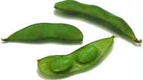
Patentable Subject Matter
Composition of Matter
Pioneer Hi-Bred Ltd. v. Canada (Commissioner of Patents), [1989] 1 S.C.R. 1623
  Claimed a new soya bean plant variety derived from cross-breeding
  Two kinds of Genetic Engineering:
    Crossing: relies on natural process – exception to patentability: law of nature (not an act of man)
    Molecular Manipulation (act of man)

Slide 8
Patentable Subject Matter
Composition of matter
Pioneer Hi-Bred Ltd. v. Canada (Commissioner of Patents), [1989] 1 S.C.R. 1623
FCA: a variety of soya is not a composition of matter or manufacture under Section 2 of the Patent Act
SCC: Not patentable – case was decided on the basis of insufficient disclosure of the invention – only the seed was filed

Slide 9
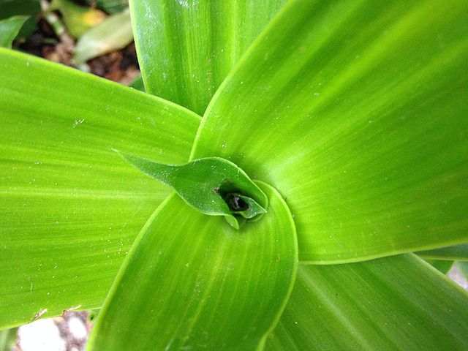
Patentable Subject Matter - Plants
Plant varieties can be protected under the Plant Breeders’ Rights Act
  Gives the breeder of a new plant variety the exclusive right to sell the propagating material for up to 25 years
  Registration is required
  Applies to reproductive material such
  as seeds, cuttings, bulbs and roots

Slide 10
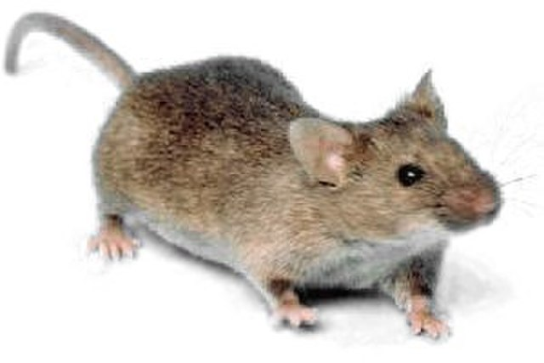
Patentable Subject Matter
Composition of Matter - Animals
Harvard College v. Canada (Commissioner of Patents),
[2002] 4 S.C.R. 45
Facts:
Made a transgenic animal that expressed a cancer gene – called the oncomouse
The gene was injected into eggs, which were implanted into a female mouse and offspring were bred to produce mice that express the gene and are thus prone to cancer
Claim 1: “A transgenic non-human mammal whose germ cells and somatic cells contain an activated oncogene sequence introduced into said mammal or an ancestor of said mammal, at an embryonic stage.”
Issue:
Are claims to an animal expressing this cancer-gene patentable? (act of man?)

Slide 11
Higher Life Forms - Animals
Supreme Court of Canada
Bastarache J. for the Majority (5:4):
Not patentable – not a manufacture or composition of matter
Definition of invention is exhaustive – not clear that higher-life forms were intended to be patentable
A higher life form is more than just a collection of atoms as opposed to a lower life form which is more “chemical-like”

Slide 12
Higher Life Forms - Animals
Supreme Court of Canada
Binnie J. Dissent:
Higher life forms are compositions of matter
Every cell in the mouse is different
Parliament didn’t foresee this but like lower life forms and computers, they didn’t intend to exclude (vs. majority’s intent to include)
Line between lower and higher life forms is arbitrary
Other countries allow patenting of higher life forms
What is a higher life form? Future tech/embedded AI?

Slide 13
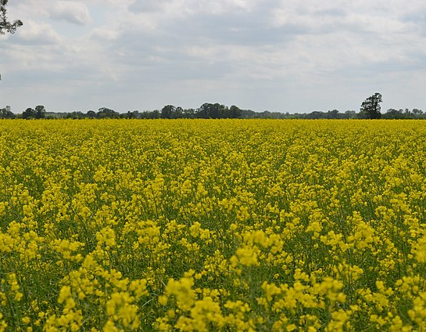
Higher Life Forms (cont.)
Monsanto Canada Inc. v. Schmeiser, SCC [2004] S.C.R. 902
Facts:
  Monsanto sells Round-Up Ready Canola seeds (transgenic) to farmers in order to grow plants that are resistant to Round-Up and Monsanto licensed farmers to use the Round-Up Ready Canola
  Some seeds blew onto Schmeiser’s neighbouring farm and he saved the seeds for the following year’s crop
  Schmeiser never sprayed Round-Up on his crop but still is sued for infringement

Slide 14
Higher Life Forms (cont.)
Monsanto Canada Inc. v. Schmeiser, SCC [2004] S.C.R. 902
Issues:
  Since plants as higher life forms are not patentable (Harvard mouse case), thus could the use of seeds and the growth of plants be an infringement of Monsanto’s cell and gene claims?

Slide 15
Higher Life Forms (cont.)
Monsanto Canada Inc. v. Schmeiser, SCC [2004] S.C.R. 902
Held:
  5:4 Claims to the gene and plant cells would protect use of the plant containing them (effectively overturns Harvard mouse case?)

Slide 16
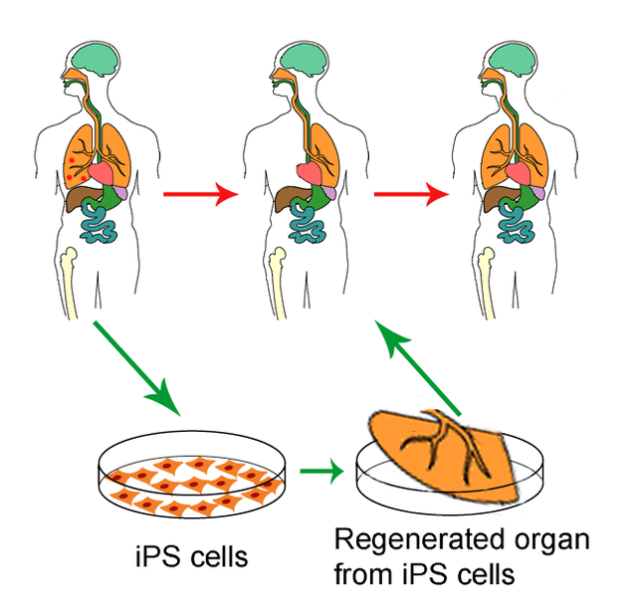
Higher Life Forms (cont.)
Manual of Patent Office Practice (Chapter 23 – Biotech & Medicinal)
Higher life forms: animals, plants, mushrooms, fertilized eggs and totipotent stem cells
  Animals: any stage of development from fertilized egg on, including totipotent stem cells capable of developing into an animal
  Plants: includes cutting, callus, rhizome, tuber, fruit, or seed (regardless of whether the seed is coated)
Lower life forms: Microscopic algae, unicellular fungi, bacteria, protozoa, viruses, transformed cell lines, hydridomas, most stem cells (embryonic, multipotent, pluripotent)

Slide 17
Higher Life Forms (cont.)
Organs and tissues are not compositions of matter and are not patentable.
Artificial organ-like or tissue-like structures, generated substantially by human intervention may be considered to be compositions of matter and therefore patentable subject matter.
Note: In Europe, cannot patent an invention that requires destruction of human embryos or their use as a base material

Slide 18

Higher Life Forms (cont.)
United States
  Chakrabarty (1980): living things are patentable
    The distinction is between product of nature and man-made inventions
  Not as simple as before – need to establish difference from product of nature (isolation is not sufficient - Myriad)
Europe
  Article 53 (b) EPC: plant or animal varieties or essentially biological processes for the production of plants and animals are not patentable.
  G1/98 (1999): transgenic plants are patentable so long as specific plant varieties are not claimed. Gene manipulation does not constitute essential biological processes.

Slide 19
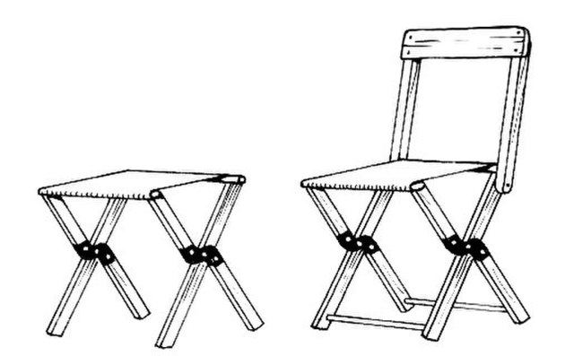
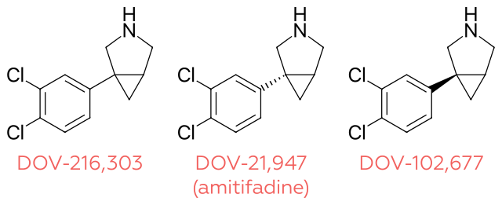
Patentable Subject Matter
Improvements
  Improvements of other inventions are patentable
    Pioneering inventions
    Improvement inventions
      Be careful about infringing the earlier invention (if patented)
      A patent on an improvement does give the patentee the right to use the earlier patented invention

Slide 20
Patentable Subject Matter
Improvement
  Apotex Inc v Sanofi-Synthelabo Canada Inc, 2008 SCC 61
  Originating patent
  Selection patent
    Compound is selected from a class of previously patented compounds
    Must be novel

Slide 21
Patentable Subject Matter
Improvement (Sanofi)
  Selection patents (referring to In re I.G. Farbenindustrie A.G.’s Patents (1930), 47 R.P.C. 289 (Ch. D.):
    Substantial advantage to be secured/disadvantage to be avoided
    All members of the selected group must have the advantage
    The selection must be of a special character peculiar to the selected group (non-selected members must not have the advantage)

Slide 22
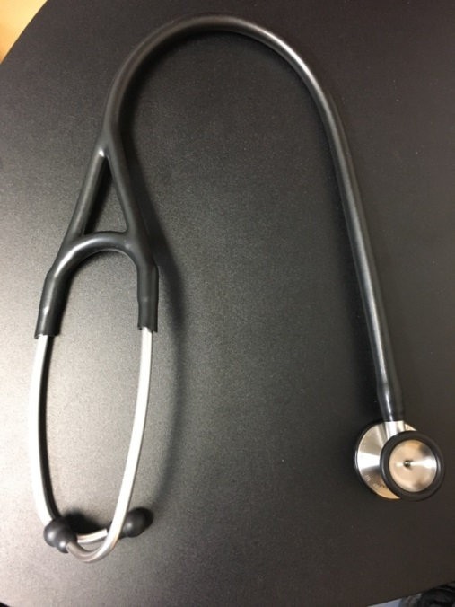
Diagnostic Methods in Canada
Re: Goldenberg 22 C.P.R. (3d) 159
  Case involved detection of radioactive substances after injection into the human body
  Found patentable
Courts have distinguished between:
  methods of medical treatment (not patentable) and
  diagnostic methods (generally patentable)

Slide 23
Patentable subject matter – laws of nature
Diagnostic methods have come under fire in the United States
Mayo Collaborative Services v Prometheus Laboratories 132 S Ct 1289 (2012)
  methods of optimizing therapeutic efficacy of a particular drug by administering the drug and measuring level of a metabolite
    Low metabolite level = should increase drug amount
    High metabolite level = should decrease drug amount
  Relates to a law of nature: metabolite level and risk that drug will be ineffective or toxic, i.e. the way the body metabolizes the drug
  A patent that describes the relationship and offers no additional features is not patentable
  Court’s Reasoning: don’t want to tie up the further use of a law of nature. Need to have additional elements that integrate the natural principle into claimed invention such that natural principle is practically applied
  Been extended to typical diagnostic methods:
    Presence of a particular mutation is indicative of a particular disease or disorder

Slide 24
USPTO Guidance on Laws of Nature/Natural Products
Is the claim directed to one of the four statutory categories of 35 U.S.C. § 101?
  → If Yes…
Is the claim directed to a judicial exception? (incl. laws of nature/natural products). For a nature-based product, the answer is no if it has markedly different characteristics from its naturally occurring counterpart
  → If Yes (or Maybe)…
Does the claim recite additional elements that amount to significantly more than the judicial exception(s)?

Slide 25
Diagnostic methods in Canada
Amazon (2010 FC 1011, aff’d in part 2011 FCA 328):
  The Court rejected the technological requirement for patentable subject matter
  The focus is on the practical application that the method as a whole provides, on the new and inventive method applying skill and knowledge and on whether such method yields a commercially useful result
Despite Amazon, Canadian Patent Office issued new practice guidelines, which looked to determine whether solution to problem is a data acquisition or data analysis – leading to many diagnostics being found to be unpatentable
Recently this problem-solution approach has been found to be wrong in law (Chouiefaty)

Slide 26
Diagnostic methods in Canada
Chouiefaty:
  Challenge to the patent office practice on claim construction
    Patent office: identify the problem that the patent is trying to solve; determine the essential elements of the invention as only those involved in the solution
      Acquisition step: determining/detecting mutation or level of gene or protein in a sample
      Analysis step: correlating detection with disease
    Result of patent office approach: ignore elements in the claims
    Often determined that the innovation was directed to the discovery of a correlation between a genetic alteration, or a level of an analyte, and a disease or medical prognosis and therefore the correlation was the solution to the Examiner-identified problem. Once the elements of detecting the genetic alteration or measuring the analyte were disregarded, the claim was then classified as a disembodied idea (i.e. a mental process or having no practical application)

Slide 27
Diagnostic methods in Canada
Chouiefaty:
  the Commissioner of Patents “erred in determining the essential elements of [Choueifaty’s] claimed invention by using the problem-solution approach,” rather than the approach the Supreme Court has directed to be used, in particular, one that considers the inventor’s intention and the words of the claim.
  As a result, the Canadian Patent Office released new practice guidelines:
  Examiners must now apply a new “actual invention” approach, which appears to comprise three steps:
    apply the purposive construction test to determine the essential and non-essential elements of a claim;
    to form part of the actual invention, an element “must cooperate with other elements of the claimed invention so as to become part of a combination of elements making up an actual invention.”
    determine whether the actual invention “has physical existence” or “manifests a discernible physical effect or change”, and “relates to the manual or productive arts.”

Slide 28
Diagnostic methods in Canada – Patent Office Practice - gatekeeper
Construe the claim based on purposive construction – all elements of a claim are presumed to be essential
Where an invention consists of a combination of elements cooperating together, all of the elements of the combination must be considered as a whole
Diagnostics
  Measuring element, comparing element and correlating element cooperate together for the invention to work
  Measuring element satisfies a physicality requirement – more than a disembodied idea

Slide 29
Patentable subject matter
Laws of nature are not patentable
Is nature patentable?
Are products of nature patentable?
  Is your DNA patentable?
  Can your DNA be tested for predisposition to disease without infringing patents?

Slide 30

Patentable subject matter: Genes
Are isolated genes patentable?
  U.S.
    Association for Molecular Pathology v US Patent and Trademark Office, 689 F 3d 1303 (Fed Cir 2012) (Myriad)
    BRCA genes
      Predisposition for breast and ovarian cancer
    15 claims from 7 patents assigned to Myriad
      Isolated genes
      Diagnostic methods – compare sample to normal sequence – look for mutations

Slide 31
Patentable subject matter: Genes
Myriad
  US District Court (May 2009)
    Isolated gene claims:
      isolated DNA molecules fall within the judicially created “products of nature” exception to §101 because such isolated DNAs are not “markedly different” from native DNAs
      unlike other biological molecules, DNA is the “physical embodiment of information,” and that this information is not only preserved in the claimed isolated DNA molecules, but also essential to their utility as molecular tools
      therefore, not patentable
Notes:
CHEO has been granted a license by the patent owner, Transgenomic, Inc. to use the genes for non-profit
diagnostic testing. The patent owners also agreed to grant licenses to other non-profit public
sector users.

Slide 32
Patentable subject matter: Genes
Myriad (Supreme Court)
  DNA
    Myriad did not create or alter any of the genetic information encoded in the BRCA1 and BRCA 2 genes
    just discovered where they were located on the chromosomes
    separating the genes from their natural environment is not an invention
    extensive research efforts alone can not satisfy the requirements of patentable subject matter
Notes:
CHEO has been granted a license by the patent owner, Transgenomic, Inc. to use the genes for non-profit
diagnostic testing. The patent owners also agreed to grant licenses to other non-profit public
sector users.

Slide 33
Patentable subject matter: Genes
    Myriad (Supreme Court)
      cDNA – synthetically created DNA – does not exist in nature
        patentable
      techniques and applications surrounding the isolated gene - patentable
      Impact on genetic testing?
        5 claims covering isolated DNA invalid
        Myriad has more than 500 valid and enforceable claims

Slide 34
Patentable subject matter: Genes
Canada and Europe: Isolated proteins and nucleic acids including human genes are currently patentable
  The Canadian courts have not had a chance to address this issue. The most recent challenge to the validity of gene claims resulted in a settlement. (CHEO v Transgenomics, 2016)
    CHEO was granted a license by the patent owner, Transgenomic, Inc. to use the genes for non-profit diagnostic testing. The patent owners also agreed to grant licenses to other non-profit public sector users.
  Europe: Rule 29(1&2) EPC: an element isolated from the human body […] including the sequence […] of a gene, may constitute a patentable invention even if […] identical to that of a natural element.

Slide 35

Patentable Subject Matter – Medical Treatments
Section 2 of the Patent Act provides for the definition of invention as follows:
  “any new and useful art, process, machine, manufacture or composition of matter, or any new and useful improvement in any art, process, machine, manufacture or composition of matter”
Are processes performed on an animal patentable?

Slide 36
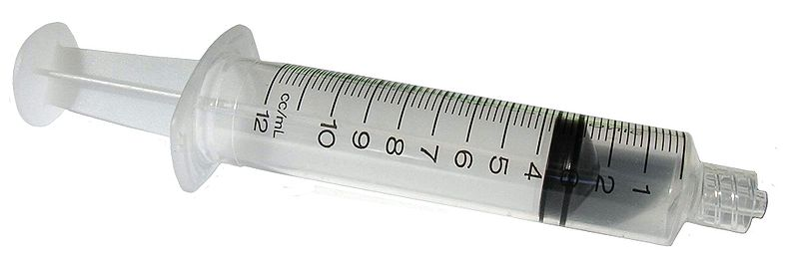
Medical Treatments (cont.)
Tennessee Eastman Company et al. v. Commissioner of Patents, SCC [1974] R.C.S. 111
Method of surgically bonding tissues using a certain compound (new use for an old compound)
Methods of medical treatment such as a process of surgery or therapy are unpatentable because such methods do not produce an essentially economic result in relation to trade, industry or commerce.
Also noted that methods of surgery relied on professional skill and would not come under “Art”.

Slide 37
Medical Treatments (cont.)
Any method that provides a practical therapeutic benefit to a subject by curing, preventing or ameliorating an ailment or pathological condition, or by treating a physical abnormality or deformity is a method of medical treatment and is unpatentable. (Tennessee Eastman, 1974)

Slide 38
Medical Treatments (cont.)
Not patent-eligible:
  Cosmetic dental procedure with medical function (filling cavities/caries) (Imperial Chemical Industries Ltd. v. Canada (Commissioner of Patents), FCA [1986] 3 F.C. 40; 9 C.P.R. (3d) 289)
  Method of medically treating non-humans (Re: Application No. 947803 [1974] C.D. 194, 32 C.P.R. (2d) 236 (PAB))
Patent-eligible: natural conditions
  Antiaging (Re: Senentek 77 C.P.R. (3d) 21)
  Contraception (Re: General Hospital Corporation 74 C.P.R. (3d) 544)

Slide 39
Medical Treatment vs. Use (compounds)
A method of treating condition Y by administering compound X. (not patentable)
But can get around this issue by drafting use claims that do not include active steps:
  A use of compound X for treating condition Y. (Canadian Style)
  A use of compound X in the preparation of a medicament for treating condition Y. (Swiss style)
  Compound X for use in the treatment of condition Y. (New European Style)
  Use vs. method - are we just arguing semantics?

Slide 40

New Uses of Known Compounds
Shell Oil v. Canada (Commissioner of Patents) (1982), 67 C.P.R. (2d) 1 (SCC)
chemical compounds (new and old) mixed with an adjuvant discovered to be useful as plant growth regulators
A new use for an old compound is patentable.
Re: Application for Patent of Wayne State University (1988) 22 C.P.R. (3d) 407 (PAB)
Applicant determined that an old compound could be used for reducing metastasis and neoplastic growth (cancer).
A new medical use for an old compound is patentable.

Slide 41
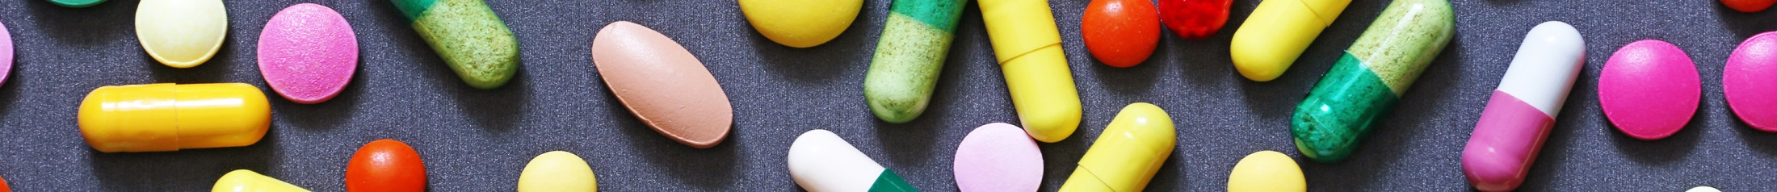
Dosage Regimens
Many dosage regimen limitations have been held invalid:
  a dose of 13 to 15 mg/kg/day (Axcan v Pharmascience, 2006 FC 527)
Any claim that prevents, interferes with or requires the professional skill of a physician is not patentable.
Limitations that have been upheld
  1.0 mg tablet as a daily dose (Merck v Pharmascience, 2010 FC 510)
Limitations which claim “vendible product” are allowable

Slide 42

Questions?

Slide 43
Melanie Szweras
mszweras@bereskinparr.com
May 9, 2023

