Slide 1
Patent Application Process/Prosecution and Claims Drafting
Melanie Szweras, Partner
May 9, 2023

Slide 2
Overview of the Patent Process
Define Invention
Patentability Search
Prepare and File Application
Examination
Issuance
Problem?
Your solution?
Other solutions?
Competitive landscape?
Evolution of your solution and field

Slide 3
Whether to File?
Can I keep it a trade secret?
  Where or how is it used?
  Can it be reversed engineered?
  How many employees will know the information?
  Are they stable employees?
Publish - I just want to stop others from patenting it
  Not critical to my product strategy
  It is unlikely that an application will successfully issue to patent

Slide 4
Whether to File?
Patent applications:
There are no guarantees
  Commercial life of the invention – can take 3-5 years at least to get a patent once you request examination
Not all applications result in a patent
  We do not know and cannot know all the prior art
  The Examiner may be stubborn
Consider on a risk/reward basis
  The more valuable a patent would be, the more likely you should file

Slide 5
Whether to File
Costs:
  Costs associated with patent protection and enforcement are very significant
  Patents are territorial
  Very general estimate: $7-10K for one country (filing cost – does not include prosecution and maintenance); well over $100K once you consider multi-national filings

Slide 6
Whether to File?
Are you ready to file the patent?
  Filing early to obtain priority date vs. filing once have enough support
Financing/Licensing
  Is a patent application necessary to secure funding?

Slide 7
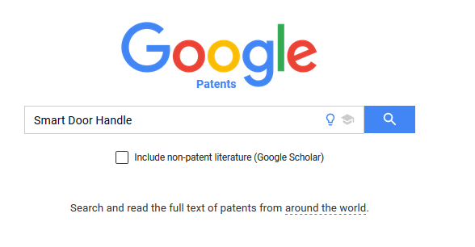
Overview of the Patent Process
Define Invention
Patentability Search
Prepare and File Application
Examination
Issuance
Sanity checks re:
- Uniqueness of your solution
- Other existing solutions
- Competitive landscape
What to Patent?

Slide 8
Searching
  Invention must be new, non-obvious and have utility in order to be patentable
Prior art search is thus recommended
Patent Databases:
  USPTO: www.uspto.gov
  CIPO: www.cipo.ic.gc.ca
  WIPO: www.wipo.int
  Esp@cenet: http://worldwide.espacenet.com
  Google Patents: https://patents.google.com
Art-specific databases:
  NCBI/PubMed
  Chem Abstracts
General Internet searching:
  Google

Slide 9
Limitations of Searching
Search strategy
  Key words
  Chosen databases
  Extent of search
  Limitations: Patent applications that are not yet published
Benefits
  Understand landscape in order to draft properly and not read on prior art
  Provides guidance on the scope of the application – broad or narrow
Note: patentability search different from right to manufacture or freedom to operate search

Slide 10
Overview of the Patent Process
Define Invention
Patentability Search
Prepare and File Application
Examination
Issuance
Where to Patent?
Filing Strategies?
When to Patent?
Inventorship?

Slide 11


Where to Patent?
No international patent!
Factors:
  Sales?
  Manufacturing?
  Competitors?
  Potential licensees?

Slide 12
Types of Applications
Country-specific patent application
  e.g. Canada, US, China, etc. each separately filed
The Patent Cooperation Treaty (PCT)
  An International Application through WIPO
  Deemed filing in most countries in the world
    BUT: each filing is not crystallized until national phase entry (i.e. filing in each individual country), which must be requested within 30 months (for most countries)
    National phase filings are very expensive and some require translation
  In certain countries, national phase can be delayed even further
  Why delay? Evaluate patentability, market, invention; raise money; license; keep options open

Slide 13







Filing Strategies and Timelines?
Provisional
Yr 0
Regular
Yr 1
Foreign Filing and the Paris Convention
  Paris Convention gives an applicant one year to file one or more corresponding applications and claim “priority” back to the filing date of the previous application (regular or provisional)
  This relieves the applicant of filing in every country in the first instance
  Example: Could do U.S. provisional first, and then file Canadian regular application within one year claiming priority to the provisional application
Initial_1
Yr 0
PCT
Yr 1
Regular
Yr 2.5*
PCT
Initial_1
Yr 0
PCT
Yr 1
Regular
Yr 2.5*
PCT

Slide 14
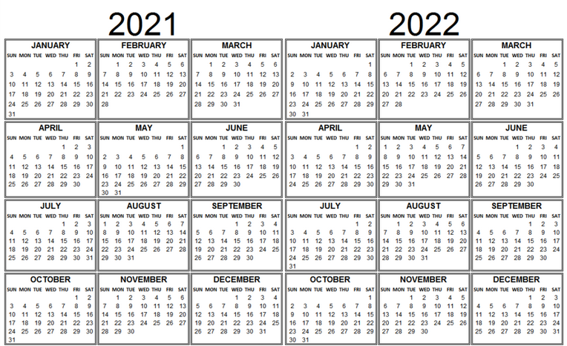

Filing Strategies and Timelines?
Provisional Application
  Can be a shorter application
  Does not require claims
  Will not be published
  Must be converted to regular application within one year
Reasons to file a provisional application:
  Is R & D still ongoing?
  Is the strategy still being developed?
  Is it possible you may decide not to proceed?
  Are there large regulatory delays before the product will be on the market?
  Gets filing date to reserve place in line or due to impending public disclosure

Slide 15
Types of Applications
Regional Patent Systems (such as Europe, Africa, Russia)
  Can designate over 20 countries – EPO conducts examination and grants patent, which must be perfected or validated in the individual countries where protection is desired
  General rule of thumb – if interested in more than 3 European countries, better to file with EPO
  Translations and validations can be very costly

Slide 16
Patent Application Process
Applicant can be the inventor or someone who obtained title to the invention from the inventor
Can have joint inventors
Patent Agent is usually used to draft, file and prosecute a patent – a Patent Agent needs to be appointed if:
  The applicant is not an inventor;
  There is more than one inventor and the application is not filed jointly by all of the inventors; or
  A transfer has been recorded
Notes:
Patent Rules - Rule 27(2)
Mandatory appointment of patent agent
27 (2) An applicant for a patent must appoint a patent agent to represent them before the Patent Office in respect of their application for a patent if
(a) the application is filed by a person other than the inventor;
(b) there is more than one inventor and the application is not filed jointly by all of the inventors; or
(c) a transfer, in whole or in part, of the application has been recorded by the Commissioner under section 49 of the Act.
Patent Rules - Rule 28(2)
Mandatory appointment of associate patent agent
28 (2) A patent agent who does not reside in Canada and is appointed as the patent agent by an applicant for a patent, a patentee or other person to represent them in any business before the Patent Office, must appoint a patent agent who resides in Canada as an associate patent agent in respect of that business.

Slide 17
Timing – Filing an Application
Most countries require absolute novelty (e.g. Japan, EU)
  Must have first application on file before any public disclosure
Some countries offer grace period for inventor-derived public disclosures but if desire multi-national protection, should have application on file before first public disclosure (e.g. United States, Canada)

Slide 18
Grace Periods
In Canada, an invention is anticipated (and thus not patentable) if:
  It is more than a year after an inventor-derived public disclosure in Canada or elsewhere (grace period); or
  It has been disclosed by a third party prior to the claim date (absolute novelty)
    “Claim date” means the date of a claim in an application for a patent in Canada, as determined in accordance with section 28.1 [Patent Act, s. 2] - (each claim can have own claim date)
  A third party has filed for the same invention before your claim date/filing date (absolute novelty)

Slide 19
Extending National Phase (Canada Example)
For applications filed after October 30, 2019
National Phase Entry of PCT filing
National Phase Reinstatement Deadline
Priority Application
PCT filing
0 months
12 months
30 months
42 months
The application may be reinstated within 12 months of the 30 month deadline if the failure to enter national phase was unintentional
Notes:
Applicant who fails to pay national phase entry fee prior to 30 month deadline may request for reinstatement by:
submitting a statement that the failure was unintentional within the 12 months following the 30 month deadline; and
Patent Rules – S.154(3)(a)(i)
paying the national fee ($400) and reinstatement fee ($200) within the 12 months following the 30 month deadline, plus translation into English or French, if required.
Patent Rules - S. 154(3)(a)(iii) and 154(3)(a)(iv)
Patent Rules – S. 154 (3)
Reinstatement of rights
154 (3) An applicant who fails to comply with the requirements of subsection (1) and, if applicable, subsection (2) not later than 30 months after the priority date, is deemed to have complied with those requirements within that period if
(a) not later than 12 months after that period, the applicant
(i) submits to the Commissioner a request that the rights of the applicant be reinstated with respect to that international application and a statement that the failure was unintentional,
(ii) complies with the requirements of paragraphs (1)(a) and (b),
(iii) pays the basic national fee, which is
(A) the small entity fee set out in item 21 of Schedule 2, if the small entity status condition set out in subsection 44(2) is met and if a small entity declaration is filed in respect of the application in accordance with subsection 44(3) not later than 12 months after the time referred to in subsection (1), and
(B) in any other case, the standard fee set out in that item, and
(iv) pays the fee for reinstatement of rights set out in item 22 of Schedule 2; and
(b) the applicant,
(i) before the third anniversary of the filing date of the international application, pays
(A) if the small entity status condition set out in subsection 44(2) is met and if, before that third anniversary, a small entity declaration is filed in respect of the application for a patent in accordance with subsection 44(3), the small entity fee set out in item 8 of Schedule 2 for the second anniversary of the filing date of an application for a patent, and
(B) in any other case, the standard fee set out in that item for the second anniversary of the filing date of an application for a patent, or
(ii) on or after the third anniversary of the filing date of the international application but not later than 12 months after the time referred to in subsection (1), pays
(A) if the small entity status condition set out in subsection 44(2) is met and, if not later than 12 months after the time referred to in subsection (1), a small entity declaration is filed in respect of the application for a patent in accordance with subsection 44(3), the small entity fee set out in item 8 of Schedule 2 for the second and third anniversary of the filing date of an application for a patent, and
(B) in any other case, the standard fee set out in that item for the second and third anniversary of the filing date of an application for a patent.

Slide 20
How to File in Canada?
The application must be drafted and approved, need to prepare a petition, which must include:
  The title “Petition” or “Request”
  A request for the grant of a patent
  The title of the invention; and
  The name and postal address of the applicant
Note: Public Servants Inventions Act – if you are a public servant then must disclose such and cannot file outside of Canada without the Minister’s permission
Notes:
Patent Rules – S. 53
Petition
Title and content
53 A petition must bear the title “Petition” or “Request” and must contain
(a) a request for the grant of a patent;
(b) the title of the invention; and
(c) the name and postal address of the applicant.

Slide 21
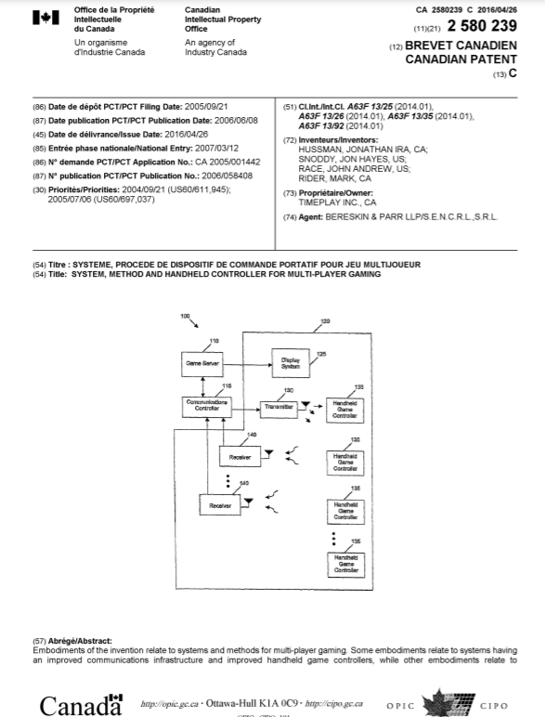
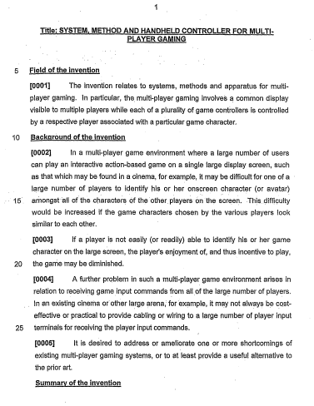
Anatomy of a Patent Document

Slide 22
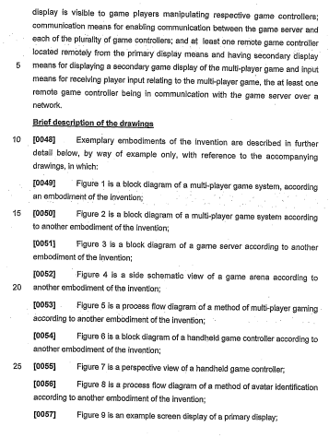
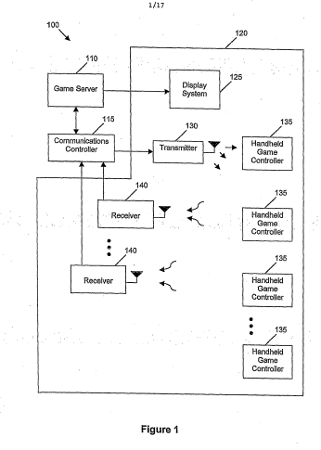
Anatomy of a Patent Document

Slide 23
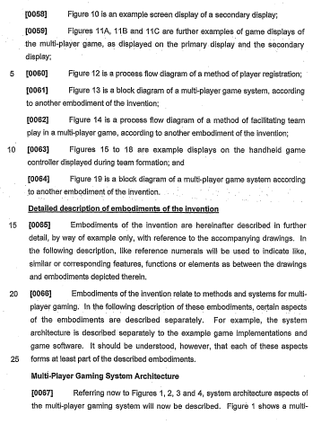
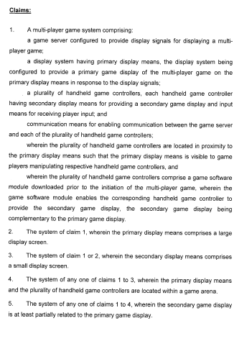
Anatomy of a Patent Document

Slide 24
Overview of the Patent Process
Define Invention
Patentability Search
Prepare and File Application
Examination
Issuance
Examiner reviews application and performs a search
Examiner objects and rejects; Applicant responds
Appeal?

Slide 25
The Examination Process
Publication
  18 months from the priority date
  Can request earlier publication
Examination
  Need to request examination (s. 35 Patent Act)
  Anyone can request examination
  Requests for examination may be deferred up to 4 years from filing in Canada
  Currently a delay of about 1-2 years to start examination once it is requested (depends on art)
  An Examiner is assigned to the file – should be technically competent – will do a prior art search
  Can request expedited examination if you have a reason (like infringer on market) and you pay a fee (or PPH)

Slide 26
The Examination Process
What does the Examiner do?
  Examiner reviews the application and requisitions compliance with the Patent Act and Patent Rules
  Will often issue one or more Office Actions alleging that the application is not allowable (e.g. not new or inventive, claims are unclear, not supported, lack utility, etc.)
  Applicant responds with arguments and/or amendments
  Back and forth between Patent Office and Patent Agent

Slide 27
Examination
Examiner can reject claims on several grounds, such as:
    Subject Matter (s.2)
    Anticipation (Lack of Novelty) (s.28.2)
    Obviousness (s.28.3)
    Double Patenting
    Unity of Invention/Restriction Requirement
    Lack of Utility
Examiner can make a variety of formality rejections
    To claims as well as other parts of the application

Slide 28
The Examination Process
Amendment is limited
  Cannot introduce new subject matter (s. 38.2 Patent Act)
  Some jurisdictions need literal support in description (e.g. Europe)
Amendment may broaden or narrow the scope of the claims
Patent to issue to a single invention
May be required to restrict to a single invention and pursue claims to other inventions in additional applications (called divisional applications)

Slide 29
The Examination Process
Be careful of what you say in responding to Office Actions!
File wrapper estoppel (s.53.1 Patent Act)
  a written communication, or any part of such a communication, may be admitted into evidence to rebut any representation made by the patentee in the action or proceeding as to the construction of a claim in the patent if it is prepared in respect of the prosecution of the application for the patent between the applicant and the Commissioner.

Slide 30
Patent Application Process
Protests – filing prior art
  Third party may file prior art with a statement
  Third party involvement is limited
  Could actually strengthen a patent
Note: Other jurisdictions (e.g. EPO and the United States) have opposition procedures that allow third parties to be quite involved

Slide 31
Patent Application Process
Abandonment and Reinstatement
  The Applicant will receive notice of a due date
    The notice may be built into a requisition (ex. Office Actions and Notices of Allowances)
      Failure to act by the deadline set in the requisition results in abandonment
    If no prior notice was given (ex. Payment of Examination Fee/Maintenance Fee), after missing the original deadline, CIPO will send a notice setting a further deadline
      Failure to act and pay the original fee plus a late fee by the further deadline or 6 months after the original deadline will deem the application abandoned

Slide 32
Patent Application Process
Abandonment and Reinstatement
  Late payment of fees or abandonment may give rise to third party rights
    Third party rights provide exceptions to infringement
  The Applicant can reinstate the application within 12 months of deemed abandonment by completing the original requirement
    In some cases, reinstatement can require the Commissioner to determine that the failure occurred in spite of due care required of the circumstances
  Must pay reinstatement fee and request reinstatement for each act of abandonment

Slide 33
Timeline for Canadian Application Examination
Reinstatement as of right if the deadline is missed
Publication of provisional application
National Phase Entry of PCT filing
Deadline to request examination in Canada
Priority Application (provisional)
PCT filing
Third Party Rights
0 months
12 months
18 months
30 months
60 months
66 months
Notes:
For applications that are filed after October 30, 2019 (excluding divisionals), the time period to request examination is 4 years from filing date. Reinstate as of right within 6 months of original deadline (4.5 years from filing date)
File request, pay exam fee and reinstatement fee
Patent Rules – S. 81
Prescribed time — subsection 35(2) of Act
81 (1) For the purposes of subsection 35(2) of the Act, the prescribed time for making a request for examination and for paying the fee is any time before
(a) in respect of an application for a patent other than a divisional application, the end of a period of four years after the filing date of the application; and
(b) in respect of a divisional application, the later of
(i) the end of the time that is applicable under this subsection in respect of the original application, and
(ii) the end of a period of three months after the presentation date of the divisional application.

Slide 34
Timeline for Canadian Application Examination
(Reinstating under due care standard)
CIPO provides notice of failure to request Examination
Deadline to request examination in Canada
Application deemed abandoned
Deadline to reinstate by showing due care
Window for reinstatement is 12-months from the further deadline set by the notice
60 months
2 month period
12 month period
Under due care standard: Applicant must state reasons for failure to request exam and the Commissioner must determine that the failure occurred in spite of due care required by the circumstances
Notes:
If don’t reinstate by the 6 month mark: “due care” standard also applies
Applicant must state reasons for failure to request exam and the Commissioner must determine that the failure occurred in spite of due care required by the circumstances
Window for reinstatement is 12-months from the further deadline set by the notice
Patent Rules – S. 81
Prescribed time — subsection 35(2) of Act
81 (1) For the purposes of subsection 35(2) of the Act, the prescribed time for making a request for examination and for paying the fee is any time before
(a) in respect of an application for a patent other than a divisional application, the end of a period of four years after the filing date of the application; and
(b) in respect of a divisional application, the later of
(i) the end of the time that is applicable under this subsection in respect of the original application, and
(ii) the end of a period of three months after the presentation date of the divisional application.
Patent Act – s. 73(3)
Reinstatement
73 (3) Subject to the regulations, an application that is deemed to be abandoned is reinstated if
(a) the applicant, within the prescribed time,
(i) makes a request for reinstatement to the Commissioner,
(ii) states, in the request, the reasons for the failure to take the action that should have been taken in order to avoid the abandonment,
(iii) takes the action that should have been taken in order to avoid the abandonment, and
(iv) pays the prescribed fee; and
(b) the Commissioner determines that the failure occurred in spite of the due care required by the circumstances having been taken and informs the applicant of this determination.
Patent Act – s. 73(1)
Deemed abandonment of applications
73 (1) An application for a patent in Canada shall be deemed to be abandoned if
(a) the applicant does not reply in good faith, within the prescribed time, to any requisition made by an examiner in connection with an examination;
(b) the applicant does not comply with a notice given under subsection 27(6);
(c) the prescribed fee and late fee referred to in a notice sent under paragraph 27.1(2)(b) are not paid before the later of the end of six months after the applicable prescribed date and the end of two months after the date of the notice;
(d) the request referred to in a notice sent under paragraph 35(3)(b) is not made and the prescribed fee and late fee referred to in that notice are not paid before the end of two months after the date of the notice;
(e) the request referred to in a notice sent under subsection 35(5) is not made and the prescribed fee referred to in that notice is not paid within the prescribed time; or
(f) the applicant does not pay the prescribed fees stated to be payable in a notice of allowance of patent within six months after the date of the notice.
Patent Rules – Rule 135(1)
Non-application of certain portions of subsection 73(3) of Act
135 (1) Subparagraph 73(3)(a)(ii) and paragraph 73(3)(b) of the Act do not apply
(a) in respect of a failure under paragraph 73(1)(a), (b) or (e) or subsection 73(2) of the Act; or
(b) in respect of a failure under paragraph 73(1)(d) of the Act if, within six months after the applicable time prescribed by subsection 35(2) of the Act and in respect of that failure, the applicant makes a request for reinstatement to the Commissioner, takes the action that should have been taken in order to avoid the abandonment and pays the fee prescribed by section 134 of these Rules.

Slide 35
Timeline for Canadian Application Examination
(Where the notice is given by 64 months)
CIPO provides notice of failure to request Examination
Deadline to request examination in Canada
Application deemed abandoned
Deadline to reinstate by showing due care
Due care required to reinstate
Third Party Rights
60 months
62 months
64 months
66 months
12 month period
76 months
Under due care standard: Applicant must state reasons for failure to request exam and the Commissioner must determine that the failure occurred in spite of due care required by the circumstances
Notes:
Reinstate as of right within 6 months of original deadline (4.5 years from filing date)
File request, pay exam fee and reinstatement fee
Otherwise “due care” standard also applies
Applicant must state reasons for failure to request exam and the Commissioner must determine that the failure occurred in spite of due care required by the circumstances
Window for reinstatement is 12-months from the further deadline set by the notice
Patent Rules – S. 81
Prescribed time — subsection 35(2) of Act
81 (1) For the purposes of subsection 35(2) of the Act, the prescribed time for making a request for examination and for paying the fee is any time before
(a) in respect of an application for a patent other than a divisional application, the end of a period of four years after the filing date of the application; and
(b) in respect of a divisional application, the later of
(i) the end of the time that is applicable under this subsection in respect of the original application, and
(ii) the end of a period of three months after the presentation date of the divisional application.
Patent Act – s. 73(3)
Reinstatement
73 (3) Subject to the regulations, an application that is deemed to be abandoned is reinstated if
(a) the applicant, within the prescribed time,
(i) makes a request for reinstatement to the Commissioner,
(ii) states, in the request, the reasons for the failure to take the action that should have been taken in order to avoid the abandonment,
(iii) takes the action that should have been taken in order to avoid the abandonment, and
(iv) pays the prescribed fee; and
(b) the Commissioner determines that the failure occurred in spite of the due care required by the circumstances having been taken and informs the applicant of this determination.
Patent Act – s. 73(1)
Deemed abandonment of applications
73 (1) An application for a patent in Canada shall be deemed to be abandoned if
(a) the applicant does not reply in good faith, within the prescribed time, to any requisition made by an examiner in connection with an examination;
(b) the applicant does not comply with a notice given under subsection 27(6);
(c) the prescribed fee and late fee referred to in a notice sent under paragraph 27.1(2)(b) are not paid before the later of the end of six months after the applicable prescribed date and the end of two months after the date of the notice;
(d) the request referred to in a notice sent under paragraph 35(3)(b) is not made and the prescribed fee and late fee referred to in that notice are not paid before the end of two months after the date of the notice;
(e) the request referred to in a notice sent under subsection 35(5) is not made and the prescribed fee referred to in that notice is not paid within the prescribed time; or
(f) the applicant does not pay the prescribed fees stated to be payable in a notice of allowance of patent within six months after the date of the notice.
Patent Rules – Rule 135(1)
Non-application of certain portions of subsection 73(3) of Act
135 (1) Subparagraph 73(3)(a)(ii) and paragraph 73(3)(b) of the Act do not apply
(a) in respect of a failure under paragraph 73(1)(a), (b) or (e) or subsection 73(2) of the Act; or
(b) in respect of a failure under paragraph 73(1)(d) of the Act if, within six months after the applicable time prescribed by subsection 35(2) of the Act and in respect of that failure, the applicant makes a request for reinstatement to the Commissioner, takes the action that should have been taken in order to avoid the abandonment and pays the fee prescribed by section 134 of these Rules.

Slide 36
Timeline for Canadian Application Examination
(Where the notice is given after 64 months)
Application deemed abandoned
CIPO provides notice of failure to request Examination
Deadline to request examination in Canada
Deadline to reinstate by showing due care
Due care required to reinstate
Third Party Rights
60 months
65
66 months
67
12 month period
79 months
Under due care standard: Applicant must state reasons for failure to request exam and the Commissioner must determine that the failure occurred in spite of due care required by the circumstances
Notes:
Reinstate as of right within 6 months of original deadline (4.5 years from filing date)
File request, pay exam fee and reinstatement fee
Otherwise “due care” standard also applies
Applicant must state reasons for failure to request exam and the Commissioner must determine that the failure occurred in spite of due care required by the circumstances
Window for reinstatement is 12-months from the further deadline set by the notice
Patent Rules – S. 81
Prescribed time — subsection 35(2) of Act
81 (1) For the purposes of subsection 35(2) of the Act, the prescribed time for making a request for examination and for paying the fee is any time before
(a) in respect of an application for a patent other than a divisional application, the end of a period of four years after the filing date of the application; and
(b) in respect of a divisional application, the later of
(i) the end of the time that is applicable under this subsection in respect of the original application, and
(ii) the end of a period of three months after the presentation date of the divisional application.
Patent Act – s. 73(3)
Reinstatement
73 (3) Subject to the regulations, an application that is deemed to be abandoned is reinstated if
(a) the applicant, within the prescribed time,
(i) makes a request for reinstatement to the Commissioner,
(ii) states, in the request, the reasons for the failure to take the action that should have been taken in order to avoid the abandonment,
(iii) takes the action that should have been taken in order to avoid the abandonment, and
(iv) pays the prescribed fee; and
(b) the Commissioner determines that the failure occurred in spite of the due care required by the circumstances having been taken and informs the applicant of this determination.
Patent Act – s. 73(1)
Deemed abandonment of applications
73 (1) An application for a patent in Canada shall be deemed to be abandoned if
(a) the applicant does not reply in good faith, within the prescribed time, to any requisition made by an examiner in connection with an examination;
(b) the applicant does not comply with a notice given under subsection 27(6);
(c) the prescribed fee and late fee referred to in a notice sent under paragraph 27.1(2)(b) are not paid before the later of the end of six months after the applicable prescribed date and the end of two months after the date of the notice;
(d) the request referred to in a notice sent under paragraph 35(3)(b) is not made and the prescribed fee and late fee referred to in that notice are not paid before the end of two months after the date of the notice;
(e) the request referred to in a notice sent under subsection 35(5) is not made and the prescribed fee referred to in that notice is not paid within the prescribed time; or
(f) the applicant does not pay the prescribed fees stated to be payable in a notice of allowance of patent within six months after the date of the notice.
Patent Rules – Rule 135(1)
Non-application of certain portions of subsection 73(3) of Act
135 (1) Subparagraph 73(3)(a)(ii) and paragraph 73(3)(b) of the Act do not apply
(a) in respect of a failure under paragraph 73(1)(a), (b) or (e) or subsection 73(2) of the Act; or
(b) in respect of a failure under paragraph 73(1)(d) of the Act if, within six months after the applicable time prescribed by subsection 35(2) of the Act and in respect of that failure, the applicant makes a request for reinstatement to the Commissioner, takes the action that should have been taken in order to avoid the abandonment and pays the fee prescribed by section 134 of these Rules.

Slide 37
Overview of the Patent Process
Define Invention
Patentability Search
Prepare and File Application
Examination
Issuance
Pay issue and maintenance fee
Manage the Patent:
- Monetize (license, litigate, sell)
- Abandon
- Donate if no longer useful

Slide 38
Patent Application Process
Allowance and Issuance
  Get Notice of Allowance once approved by Examiner
  Must pay a final fee
  The Patent Office will issue the patent within about 3 months
  Any divisional applications must be filed prior to issuance
  In Canada, need to pay yearly maintenance fees to keep patent in force (timing of maintenance fees may differ by jurisdiction)

Slide 39
Patent Application Process
What happens if application is refused by the Patent Office?
  When Examiner considers applicant has not traversed a rejection, may make next rejection on the same grounds final (historically difficult to get in Canada)
  Applicant must amend as required by the Examiner or argue over on next response or the application will go to the Patent Appeal Board, where Applicant can be heard
  Commissioner receives Patent Appeal Board’s findings
  Decision can be appealed to the Federal Court

Slide 40
Post-Issuance Amendments
Three major provisions available to clean up patent if necessary:
  Disclaimer
    To disclaim (narrow) a part of a patent
  Re-examination (can be requested by 3rd parties)
    Re-opens examination
    Cannot broaden scope of claims
    Based on prior art
    Can lead to cancelled, confirmed or amended claims
  Reissue
    Also re-opens examination
    Can broaden
    Test is inadvertence, accident or mistake – need to show meant to protect initially
    4-year time limit from date of issuance

Slide 41
Budget
Define Invention
Patentability Search
Prepare and File Application (Provisional)
File Application (Regular/PCT)
Examination
Issuance
  Cost: Depends on complexity of invention and number of features to be searched etc.
  Cost (DRAFTING): Depends on complexity of invention, number of inventive concepts etc.
  Cost (FILING)
  Cost (DRAFTING):
  If application revised to add or remove subject matter
  Cost (FILING): Depends on the jurisdictions/filing strategy etc.
  Cost: Depends on jurisdiction, complexity of invention , number of objections, nature of objections, business goals etc.
  Cost: Depends on jurisdiction
Yr0: 1-2 weeks
Yr0: 2-4 weeks
Yr0: 4-6 weeks
Yr0: 12+ months
Yr2 – 4*
Yr4-5*

Slide 42
Claim Drafting
Written as a single sentence, ending with a period
Appear towards the end of the issued patent or patent application
Claim identifier preceding the sentence, e.g. “Claim 1”, “Claim 2”, etc.
Parts of a Claim (3-part format in North America):
  Preamble or introductory phrase – describes the field of the claimed invention (e.g. a method of treatment, a pharmaceutical formulation, a nanoparticle, a radio transmitter, etc.)
  Transitional phrase (e.g. comprising – means including as well as others as opposed to consisting of)
  Body – each element that is required – main and sufficient elements should be described; and also describes the relationships between elements and their functions

Slide 43
Types of Claims
  Product or apparatus
  System
  Process or method
  Method of use and use
  Markush (“selected from the group consisting of…”)
  Jepson (“the improvement comprising…”)

Slide 44
Claim Drafting Approach
What does the invention do?
What essential elements are needed?
What are the functions of the essential elements?
Test your draft claims and revise if needed

Slide 45

Claim Drafting
What is the function?
  Essential
    Chamber for holding beverage
    Handle?
  Optional
    Handle?
    Removable handle?
    Sidewall being made of glass?
    Transparent glass sidewall?

Slide 46
Claim Drafting
PREAMBLE
A drinking cup comprising:
  - a horizontal base for supporting the cup on a surface;
  - a sidewall extending upwardly from the base, wherein the base and the sidewall define a chamber for holding liquid; and
  - a handle connected to the sidewall.
TRANSITIONAL EXPRESSION
BODY

Slide 47
Claim Drafting
Clarity of Language
  Antecedents
    The first time an element is introduced, it must be identified using an indefinite article (e.g. “a” or “an”)
    Subsequent references to the same element should use a definite article (e.g. “the” or “said”)
      A drinking cup comprising:
        a horizontal base…;
        a transparent glass sidewall extending upwardly from the base…
  Ambiguous terms should be avoided unless explicitly defined in the description– e.g. “about”, “substantially”, etc.
  Negative limitations should be avoided
  Language must be consistent
  Be careful about what you are claiming: heat blood sample to 100C vs heat blood sample at 100C

Slide 48
Claim Drafting
Independent (broadest) vs. Dependent
Dependent Claims:
  Depend from a parent claim (independent or dependent)
  Incorporate all elements from parent claim(s)
  Add an element or further define an element
  Has narrower scope than parent claim, but may provide stronger protection
  A system comprising: A and B.
  The system of claim 1, further comprising C.
  The system of claim 2, wherein C includes C1 and C2.
2
3
1

Slide 49
Claim Drafting
A drinking cup comprising:
  - a horizontal base for supporting the cup on a surface;
  - a sidewall extending upwardly from the base, wherein the base and the sidewall define a chamber for holding liquid; and
  - a handle connected to the sidewall.
2. The drinking cup of claim 1, wherein the handle is removably
connected to the sidewall.
3. The drinking cup of claim 1, wherein the sidewall is a transparent glass sidewall.

Slide 50
Tips on Claim Drafting
What you write in the description affects the claims
Use consistent terms in the description and claims
Handle numerical ranges correctly
Recognize your ultimate audience

Slide 51
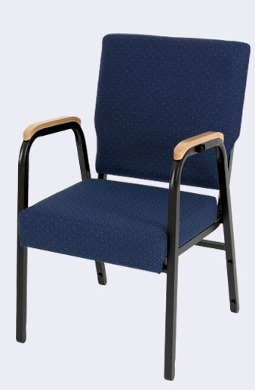

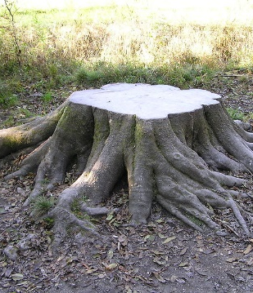
Claim Drafting - Workshop
Invention
Prior Art

Slide 52
Chair Claim
What are the elements of a chair?
  Essential
    Seat
    Support element
  Optional
    Chair back
    Additional support elements
    Wheels
    Cushion
    Arm rests

Slide 53
Chair Claim
What is the function?
  Essential
    Support a person in a sitting position
  Optional
    Adjustability of seat back
    Adjustability of height
    Moveable

Slide 54
Chair Claims
A chair comprising:
  a seat; and
  a vertical element providing support for the seat.
A chair comprising:
  a seat; and
  a vertical element providing support for the seat;
  wherein the vertical element is connected to the underside of the seat;
  wherein the seat is raised to a position above the ground by the vertical element.

Slide 55
Dependent Claims
The chair of claim 1, wherein the seat comprises a cushion.
The chair of claim 1 or 2, wherein the support comprises a plurality of vertical elements.

Slide 56
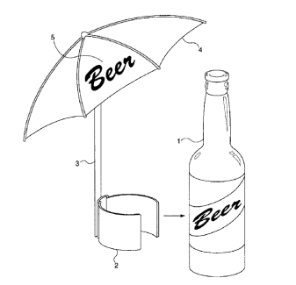
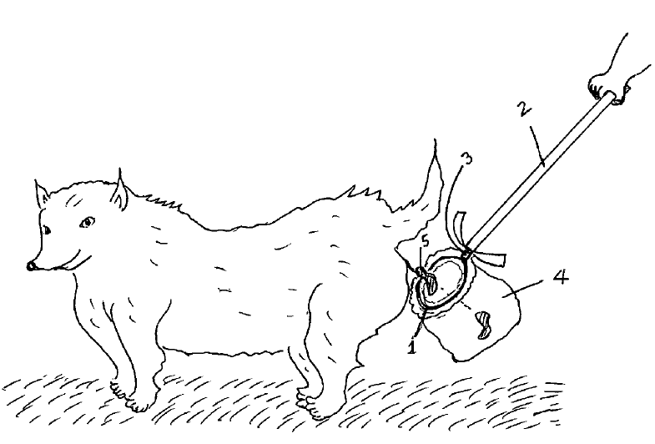
Drafting Exercise
Group A
Group B

Slide 57
Drafting Exercise:
Group A: Beerbrella (U.S. Pat. No. 6,637,447)
“Beverage accessories are known in the art for use with beverage containers, be they glasses, cans, or bottles, and in particular with alcoholic beverages. Many of these accessories provide novelty amusement as well as practical effects, such as increased insulation to keep a beverage cold.”
“One problem with these Prior Art devices is that although they do provide insulation for beverages, they do not shield the beverage from the direct rays of the sun. A beverage left out in the sun, even if insulated or cooled with ice, quickly warms due to the effect of the intense infrared radiation from the sun, particularly on hot, sunny summer days.”

Slide 58
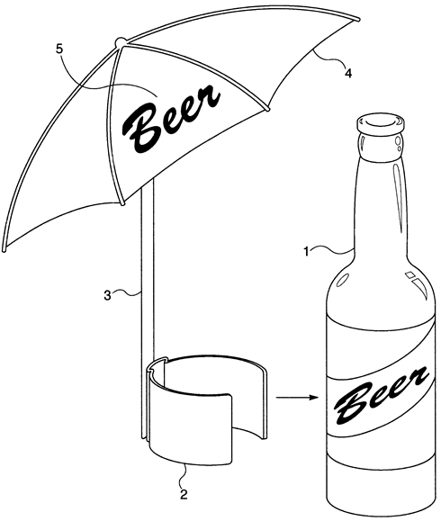
Group A:
Beerbrella (U.S. Pat. No. 6,637,447) (cont.)
Notes:
on second and third images on top, the apparatus comprises a pivot
Bottom images show a strap and a cup as attachment devices

Slide 59
Drafting Exercise:
Group B: Dog Waste Catcher (US 7,090,268 B2)
“The present invention relates to a portable device which is very simple, economical, and easy to make and operate to catch and hold a dog's droppings excreted while walking the dog. It is carried by the dog's owner or caretaker while he or she takes the dog for a walk and is capable of collecting the dog's waste before it falls on the ground or grass.”
“What is needed is a device that is simple, light-weight, economical, easy to make and use to catch the dog waste before it comes in contact with the ground or grass without having to bend over and repositioning a collecting device.”

Slide 60
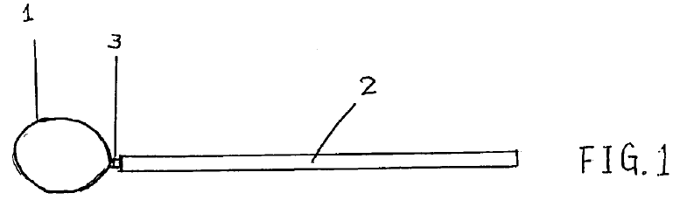
Group B
Dog Waste Catcher (US 7,090,268 B2)

Slide 61
Drafting Exercise
Group A
Group B

Slide 62
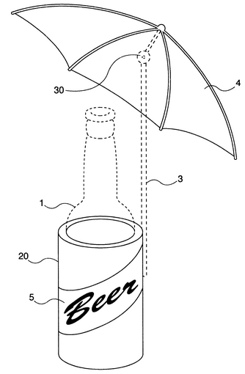
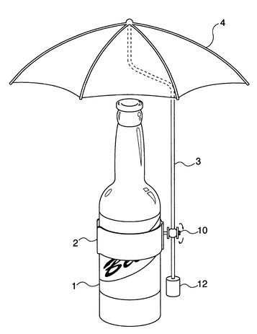
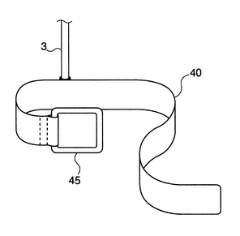
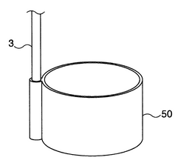
Group A:
Beerbrella (U.S. Pat. No. 6,637,447) (cont.)
Notes:
on second and third images on top, the apparatus comprises a pivot
Bottom images show a strap and a cup as attachment devices

Slide 63
Group A:
Beerbrella (U.S. Pat. No. 6,637,447) (cont.)
What are the elements?
  Essential
    Attachment member (2)
    Umbrella (4)
    Shaft (3)
    Beverage container (1) ??
  Optional
    Type of attachment device
      Clip, strap, cup…
    Pivot
    Umbrella features
      Size, material…

Slide 64
Group A:
Beerbrella (U.S. Pat. No. 6,637,447) (cont.)
Sample independent claims:
1. A shading apparatus, comprising:
an attachment member for removably attaching the shading apparatus to a beverage container;
a shaft, coupled to the attachment member and extending vertically; and
an umbrella, coupled to the shaft at a point above the attachment member.
1. A combined beverage container and shading apparatus, comprising:
a beverage container;
an attachment member for removably attaching the shading apparatus to the beverage container;
a shaft, coupled to the attachment member and extending vertically with respect to the beverage container; and
an umbrella, coupled to the shaft at a point above the attachment member.

Slide 65
Group A:
Beerbrella (U.S. Pat. No. 6,637,447) (cont.)
Sample dependent claims:
The apparatus of claim 1, wherein the umbrella has a diameter of five to seven inches.
The apparatus of claim 1, wherein the umbrella is a paper umbrella.
The apparatus of claim 1, wherein the umbrella is a solid plastic umbrella.
The apparatus of claim 1, wherein the umbrella is a cloth umbrella.
The apparatus of claim 1, further comprising a pivot coupling the shaft to the umbrella.
The apparatus of claim 1, wherein the attachment member is a clip.
The apparatus of claim 1, wherein the attachment member is a strap.
The apparatus of claim 1, wherein the attachment member is a cup.

Slide 66
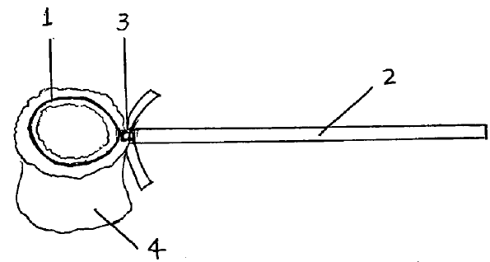

Group B
Dog Waste Catcher (US 7,090,268 B2)

Slide 67
Group B
Dog Waste Catcher (US 7,090,268 B2)
What are the elements?
  Essential
    Loop-shaped device (1)
    Carrying rod (2)
    Means of attaching loop to rod (3)
    Replaceable bag for receiving waste (4) ??
  Optional
    Type of bag: plastic, paper, cloth…
    Shape of loop: round, oval, square…
    Means of attachment: metal wire, elastic…
    Properties of rod
      Extendable, diameter, material…

Slide 68
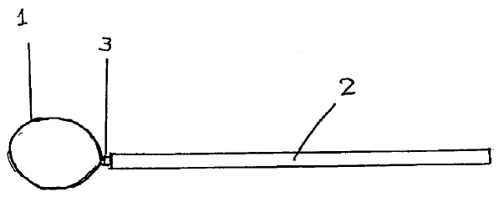
Group B
Dog Waste Catcher (US 7,090,268 B2)
Sample independent claims:
  A dog waste catcher comprising:
    a loop-shaped device;
    a carrying rod; and
    a means of attaching the loop-shaped device to an end of the carrying rod.
  A dog waste catcher comprising:
    a rod; the rod having a carrying end and a containment device securing end for fastening a containment device.

Slide 69
Group B
Dog Waste Catcher (US 7,090,268 B2)
Sample dependent claims:
  The dog waste catcher of claim 1, further comprising a bag wherein the open end of the bag is attached to the loop-shaped device.
  The dog waste catcher of claim 1, wherein the rod is extendable.
  The dos waste catcher of claim 2, wherein the bag is replaceable or washable.
  The dog waste catcher of claim 2, wherein the bag is of material selected from plastic, paper, and cloth.
  The dog waste catcher of claim 1, wherein the rod is made of material selected from wood, plastic, bamboo, and metal.
  The dog waste catcher of claim 1, wherein the rod comprises a handle.
  The dog waste catcher of claim 1, wherein the loop-shaped device is removable.

Slide 70
Melanie Szweras, Partner
mszweras@bereskinparr.com
May 9, 2023

