Slide 1

Intellectual Property Trials
U of T Patent and Trade Secret Course
Allyson Whyte Nowak
  March 2022

Slide 2
What We will Cover in Today’s Lecture
Overview of getting a case to Trial
The importance of pleadings
Proving your case
Specific Trial Related Issues

Slide 3
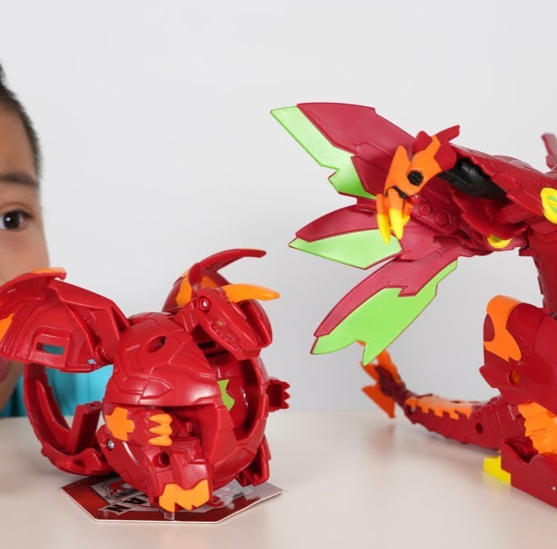
Viewed in the context of a real case:
Spin Master v. Mattel (Federal Court File No. T-1231-17)
Spin Master owns Canadian Patent No. 2,547,539 Patent, “Transformable Toys”
Spin Master sued Mattel for infringement of claims 8-11 by the sale of Mattel’s “TURNING MECARD” toys
there were corresponding actions being litigated in the US and the UK

Slide 4
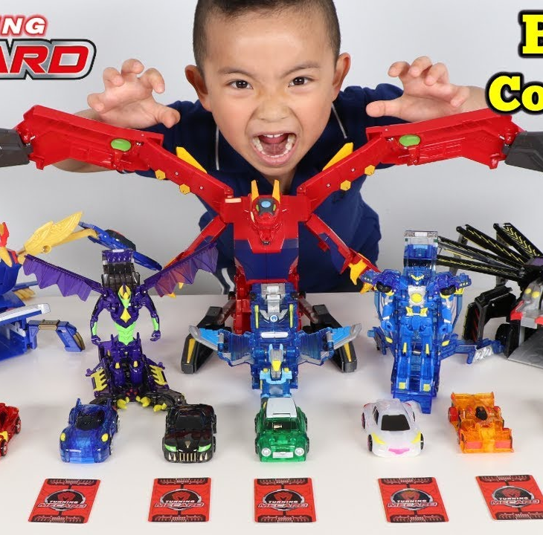
TURNING MECARD Toys
Spin Master’s BAKUGAN transformer toys were first introduced in 2008
Highly successful franchise accompanied by a card game and anime series
Mattel’s TURNING MECARD toys were introduced in the downswing of the BAKUGAN franchise history
BUT BAKUGAN was about to be relaunched

Slide 5
Steps in a Typical Patent Infringement Action
Exchange of Pleadings
Exchange of Affidavits of Documents i.e. documentary discovery
Examinations for Discovery i.e. oral discoveries
Refusals motions
Exchange of Expert Reports
Pre-Trial and/or Trial Management Conferences
Trial
Appeal(s)
* interlocutory motions and mediation can occur at any stage

Slide 6
Timeline of the Spin Master v. Mattel Action
Claim Issued
August 9, 2017
Action set down for Trial
April 6, 2018
Action Dismissed
April 16, 2019
Motion to strike – decision released October 12, 2017
Pleadings closed December 2017
Discoveries held in May 2018
Refusals motions held July 2018
Action set down for Trial April 2018 for 10 day trial starting April 1, 2019
Action settled on the eve of trial

Slide 7
Pleadings Frame the Action
Documentary Production
Discovery
Remedies
Determine the relevance of documents that must be produced
Questions posed must be in relation to unadmitted allegations of fact
Pleadings ultimately constrain a Court’s ability to deal with an issue

Slide 8
Pleading/Proving an Infringement Case
Plaintiff must plead/prove facts to show:
ownership of the patent
a license
facts establishing infringement
entitlement to relief
Defendant must:
respond to allegations
plead facts which negate infringement or constitute a defence to infringement
counterclaim to invalidate the patent
deny entitlement to relief

Slide 9
Spin Master’s Claim
Spin Master sued Mattel for infringement of claims 8-11 of the 539 Patent by the sale of Mattel’s “TURNING MECARD” toys
Spin Master also alleged that Mattel was liable for inducing infringement as a result of (i) the sale of accessories for the TURNING MECARD toys and (ii) the airing of an accompanying TV anime series
Spin Master sought:
an accounting of Mattel’s profits or damages
delivery up or destruction under oath
injunctive relief
interest
costs

Slide 10
Mattel’s Defence
Mattel put in issue the ownership of the ‘539 Patent
Mattel denied infringement
Counterclaimed seeking a declaration that the ‘539 patent including claims 8-11 were invalid as:
  anticipated by the prior art (Schedule “A” listed 18 prior art references)
  obvious in light of the prior art (Schedule “A”)
  overbroad
  a result of a section 53 misrepresentation
Similarities, if any, between BAKUGAN and TURNING MECARD brands and their marketing are derived from a common genre dating back to the TRANSFORMERS franchise
Mattel relied on a Gillette Defence: if any of the asserted claims 8-11 of the 539 Patent encompass the TURNING MECARD Toys, which is denied, then the asserted claims 8-11 of the 539 Patent are anticipated by the asserted prior art

Slide 11
Case and Trial Management Guidelines for Complex Proceedings
Last amended May 18, 2021
Intended to apply to complex proceedings, or proceedings which are expected to require at least five (5) trial days
New emphasis on the cooperation amongst counsel
Guidelines address:
Electronic documents
Discovery planning
Limits on discovery
Expert evidence
Experimental testing
Pre-trial preparation

Slide 12
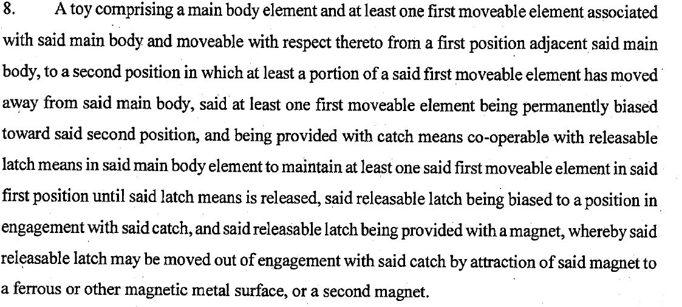
Claim 8 of the 539 Patent “Transformable Toy”

Slide 13
Where the Shoe Pinched
[A] latch being provided with a magnet, whereby said releasable latch may be moved out of engagement with said catch by attraction of said magnet to a ferrous or other magnetic metal surface, or a second magnet.
The Mattel Mecard toys all include magnets that are designed to interact with metallic cards
Mattel argued that: (i) the Mecard Toys have an external lever which causes the latch to release; (ii) the latch in the Mecard Toys is not “provided with a magnet”; and (iii) the transformation does not operate according to the principle of operation claimed in claim 8 of the patent.
The change in vehicle shape in the Mattel toy was not triggered by the magnet but rather by the act of hitting up against the card – the magnet simply allowed the card to be displayed
Spin Master argued that: (i) the magnet was involved in the vehicle shape transformation; (ii) the Mecard toys relied on magnetic attraction; (iii) the asserted claims do not state that the magnet in the claimed toy must move and it is not required or appropriate that such restriction must be read into the claims.

Slide 14
Interlocutory Motions
Motion to Strike
Discovery motions x2
Motion to Strike Reply Expert report
Mattel brought a motion to strike portions of the statement of claim
Refusals motion
Mattel sought Letters of Request
Inventors not employees of the plaintiff
Inventors resident in Japan
Mattel sought to strike portions of the expert report of the accounting expert on the basis that the plaintiff had split its case

Slide 15
Intellectual Property Trials
Parties may choose the location of the Trial
Trials tend to be longer than in the United States and Europe, lasting on average, between 2-6 weeks
There is an informal group of judges with IP expertise who tend to preside over patent actions
Parties will know who the trial judge is closer to trial through the conduct of Trial Management Conferences

Slide 16
Trial Management: Rule 270
Two to three months before trial, counsel will meet with the trial judge and set the schedule for the exchange of:
witness lists
will say statements
expert qualifications
As well as the delivery to the trial judge of:
the trial record
expert reports

Slide 17
Spin Master v. Mattel
Trial Management Conferences were held in the lead up to Trial
December 6, 2019
February 5, 2019
Parties discussed and ultimately jointly filed:
Trial record
Agreed chronology
Joint Statement of Issues
Draft anticipated trial calendar
Written Outlines for the Parties’ Openings

Slide 18
Witness Lists
How do you select your fact witnesses?
They must have personal knowledge of an unadmitted fact
Be able to identify a document to be tendered at trial
Be able to identify a document as having been made in the usual and ordinary course of business

Slide 19
Spin Master’s Witnesses
James Martin
SVP Marketing
Julia Truchsess – infringement and validity
Andy Harington – accounting expert

Slide 20
Mattel’s Witnesses
Ronald Wong
Senior Manager (Controller) Mattel Canada
Donna Polimac
Director Marketing Mattel Canada
Barry Kudrowitz infringement and validity
Ross Hamilton
Accounting expert
Ed Duncan
SVP, Global Head of Design Boys Action, Games

Slide 21
Will-say Statements
In the Spin Master v. Mattel action, the will-say statement of one of Mattel’s witnesses might read (in part) like this:
Donna Polimac will give evidence relating to:
educational and professional background
roles at Mattel Canada and as Senior Manager Marketing Boys during the relevant time period
responsibilities in her position today and in the relevant time period
business of Mattel
background to the introduction of the TURNING MECARD toys in Canada
Identification and description of marketing and financial documents showing Mattel revenues and costs
No witness statements for experts – they are confined to what is in their expert report

Slide 22
Statement of Issues for Trial
Defining the notional Person of Skill in the Art, to whom the Spin Master Patent is addressed;
Determining the meaning of Claims 8, 9, 10 and 11 of the Spin Master Patent, as of the date of publication of the patent: August 20, 2007; and
What are the Claim Dates for Claims 8, 9, 10 and 11 of the Spin Master Patent?
1. Claims Construction of the ‘539 Patent

Slide 23
Statement of Issues for Trial (cont’d)
Do the MECARD toys, including the Alta, Phoenix, Crang, Tador, Geryon and Andromagician toys, that have been sold by Mattel in Canada, infringe the ‘539 Patent:
Are the essential elements of each of Claims 8, 9, and 10 of the Spin Master Patent found in each of the Mattel MECARD toys?
Are the essential elements of Claim 11 found in certain of the identified Mattel MECARD Toys?
2. Infringement

Slide 24
Statement of Issues for Trial (cont’d)
Are claims 8, 9, 10 and 11 of the ‘539 Patent invalid for anticipation – was the subject matter of those claims previously disclosed in view of six different prior art references and the common general knowledge of a person skilled in the art:
Matsuda (MAT131): Japanese Examined Utility Model Publication; Jan 5, 1994
Honda (MAT134): Japanese Unexamined Utility Model Publication; Nov 10,1989
Wilhelm (MAT20): US Patent 6,592,427; Jul 15, 2003
Poulain (MAT132): French Patent Application; 01/07/1977
Tomiyama (MAT133): Japanese Utility Model Publication; May 15, 1963
Aprile (MAT23): PCT Patent Application; May 18, 2006
3) Validity of the ‘539 Patent
Anticipation

Slide 25
Statement of Issues for Trial (cont’d)
Are claims 8, 9, 10 and 11 of the Spin Master Patent invalid for obviousness – was the subject matter of those claims obvious in view of the asserted prior art alleged to be relevant:
(Kobayashi (MAT7), Maruyama (MAT11), Shannon (MAT19), Saucier (MAT22)) or, in combination with the common general knowledge. Including:
determining what specific toys, or parts or structures shown in commercialized toys, if any, form part of the common general knowledge of a Person of Skill in the Art as of the Claim Date of the Spin Master Patent
3. Validity
Obviousness

Slide 26
Statement of Issues for Trial (cont’d)
Are Claims 8, 9, 10 and 11 invalid by virtue of being broader than the invention disclosed or made?
4) Validity
Overbreadth

Slide 27
Statement of Issues for Trial (cont’d)
If Spin Master is successful in establishing infringement by Mattel of a valid claim of the Spin Master Patent, is Spin Master entitled to the following remedies:
Mattel’s profits arising from the period in which Mattel was actively in the market with the MECARD toys found to have infringed or convoyed with the toys found to have infringed, and if so, what is the appropriate quantum?
Permanent injunction with respect to the toys found to have infringed
Delivery up/destruction with respect to the toys found to have infringed
Pre-judgment and post-judgment interest
Costs
Remedies

Slide 28
Proving Your Case at Trial
Admissions
Pleadings
Discovery read-ins
Request to Admit (Rule 255)
Agreed Statement of Facts
Viva Voce Evidence
Witnesses (fact or expert)
Commission evidence Rule 271
Documentary Evidence
Documents
(need to be properly authenticated and accepted as proof of the truth of its contents)
Experimental Testing
distinguishable from a demonstration
Must be in accordance with the Federal Court case and Trial Guidelines for Complex Proceedings

Slide 29
Experimental Testing
If a party “intends to establish any fact in issue by experimental testing conducted for the purpose of litigation” in a patent infringement or impeachment action, it shall no later than 2 months before the scheduled service of the expert report(s) to which the testing relates, provide reasonable notice to the other parties as to:
the facts to be proven by such testing;
the nature of the experimental procedure to be performed;
when and where the adverse parties’ counsel and representative(s) can attend to watch the experiment(s); and
when and in what format the data and test results from such experiment(s) will be shared with the adverse parties.
Otherwise a party needs leave of the Court to lead evidence at the trial or hearing as to any experiments conducted by or for it for the purpose of the litigation.

Slide 30
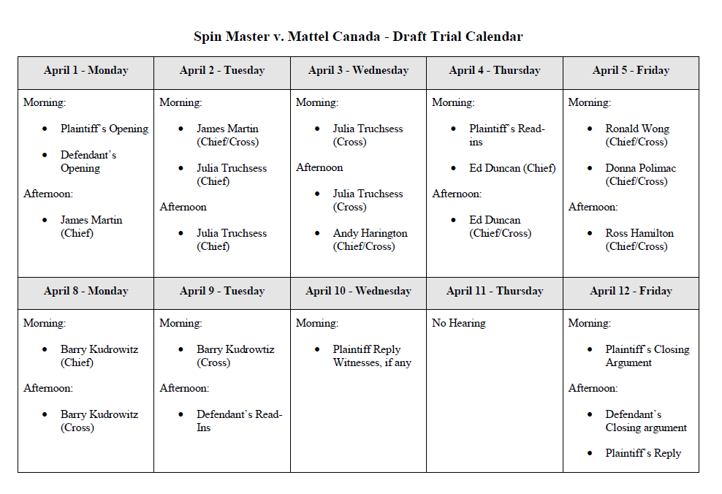
Spin Master v. Mattel – Draft Trial Calendar

Slide 31
Documentary Evidence
There are 2 issues to be addressed:
Authenticity
tends to be by way of agreement of the parties
alternatively, you need to call a witness to testify that he or she prepared or received the document
can be done through a discovery admission, agreement or Request to Admit
fairly routine
Proof of the truth of their contents
issue is tied to the rule against hearsay
can be dealt with by agreement of the parties but still need a witness or some other means to tender the document into evidence

Slide 32
The Conduct of a Patent Trial
The Plaintiff’s Case
Opening by the Plaintiff
Plaintiff leads evidence establishing
Ownership of the patent
Status of the licensee as a “person claiming under the patent”
Facts establishing infringement (can be by way of admissions, witnesses, discovery read-ins)
Expert evidence on the construction of the patent and infringement

Slide 33
A Patent Trial (cont’d)
The Defence
Defendant can choose to make an opening after the Plaintiff or choose to wait until the close of the Plaintiff’s case on infringement
The Defendant responds to the evidence on infringement (cross-examination of the Plaintiff’s witnesses and calling of its own expert and/or fact witnesses)
The Defendant leads evidence on the issues of invalidity (expert and/or fact witnesses and possibly by way of admissions and discovery read-ins)

Slide 34
A Patent Trial (cont’d)
The Plaintiff’s Case in Defence to Invalidity and Reply
The Plaintiff responds to the evidence on invalidity (cross-examination of the Defendant’s witnesses and calling of its own expert and/or fact witnesses)
Reply evidence (Rule 278(2))
Closing arguments by Plaintiff and Defendant with right of reply

Slide 35
Trial Specific Issues - Reply Evidence
Rule 278(2)
A party shall have a right of reply to the arguments of adverse parties and if the party raises a new point of law, an adverse party may answer on that point.
Application of the Rule
Plaintiff must exhaust evidence in the first instance
Permitted only where necessary
Confirmatory evidence not permitted

Slide 36
Opening Statements – A Flavour
Spin Master
This litigation is based on Spin Master’s allegation that Mecard toys are covered by one of more of the Spin Master Patent claims, and therefore Mattel has infringed the patent by selling the toys in Canada. The Spin Master Patent describes a transformable toy with a magnet that is designed to interact with a metallic card (“M” below) so that the toy will transform.
The plaintiff patentee in this case is a successful Canadian toy company, competing in a global market. The corporate representative who will testify at trial about the plaintiff Spin Master Ltd. (“Spin Master”) is James Martin. Mr. Martin will describe the history and success of the Canadian company Spin Master. He will explain how Spin Master has built its business on innovation and how intellectual property and patent rights are a central and crucially important part of that business.
Mattel
Mattel expects that Spin Master will make much of Mattel's knowledge of Bakugan's success and suggest to the Court that Mattel wilfully brought the Mecard Toys to market in Canada with full knowledge of Bakugan and its success, and the 539 Patent. Mattel does not shy away from these facts. This Court has held that there is nothing inherently improper in emulating a successful business model.
It will be Mattel's submission that the Supreme Court's warning in Free World Trust is particularly apt in this case: As stated, the ingenuity of the patent lies not in the identification of a desirable result but in teaching one particular means to achieve it. The claims cannot be stretched to allow the patentee to monopolize anything that achieves the desirable result. It is not legitimate, for example, to obtain a patent for a particular method that grows hair on bald men and thereafter claim that anything that grows hair on bald men infringes.

Slide 37
Trial Specific Issues - Expert Reports
Code of Conduct
General duty to the Court
overriding duty to assist the Court impartially
must be independent and objective
Contents of an expert report
Statement of issues
Qualifications (CV)
Facts and Assumptions
Summary of Opinions
Points of Agreement/Disagreement
Reasons for Opinion
Documents Relied On
Summary of Methodology

Slide 38
Expert Issues
Code of Conduct Rule 52.2
fair objective and non-partisan evidence
s.7 Canada Evidence Act
Drafting expert reports
Blinding

Slide 39
Blinding
Justice Zinn
"this court has recognized that evidence from experts who have not seen the patent nor been apprised of the positions of the litigants is to be given greater weight on issues going to obviousness and patent construction than the evidence of an expert with full knowledge of the patent's disclosure and the positions of the parties“
(AI!ergan Inc. v. Apotex Inc., 2016 FC 344 at para 13).
Justice Locke
"I agree with Shire that favouring the evidence of experts who have been blinded has not been raised to the level of a legal principle that must be applied in all cases, and is merely persuasive ...
I am mainly interested in the substance of an expert's opinion and the reasoning that led to that opinion.

Slide 40
“Hot Tubbing” in the Federal Court
In Apotex Inc. v. Astrazeneca Canada Inc. 2012 FC 559, Justice Hughes described the procedure flowing from Rule 282.1 as follows:
“At the end of the testimony of Ms Wehner and Dr. Garven I conducted a "hot tubbing" examination in which each of them took the stand at the same time, remaining under oath. They answered questions put to them by me and responded to the answers given by each other. At the end of this process, each Counsel was invited to put follow-up questions to these witnesses.”

Slide 42
  Norton Rose Fulbright US LLP, Norton Rose Fulbright LLP, Norton Rose Fulbright Australia, Norton Rose Fulbright Canada LLP and Norton Rose Fulbright South Africa Inc are separate legal entities and all of them are members of Norton Rose Fulbright Verein, a Swiss verein. Norton Rose Fulbright Verein helps coordinate the activities of the members but does not itself provide legal services to clients.
  References to ‘Norton Rose Fulbright’, ‘the law firm’ and ‘legal practice’ are to one or more of the Norton Rose Fulbright members or to one of their respective affiliates (together ‘Norton Rose Fulbright entity/entities’). No individual who is a member, partner, shareholder, director, employee or consultant of, in or to any Norton Rose Fulbright entity (whether or not such individual is described as a ‘partner’) accepts or assumes responsibility, or has any liability, to any person in respect of this communication. Any reference to a partner or director is to a member, employee or consultant with equivalent standing and qualifications of the relevant Norton Rose Fulbright entity.
  The purpose of this communication is to provide general information of a legal nature. It does not contain a full analysis of the law nor does it constitute an opinion of any Norton Rose Fulbright entity on the points of law discussed. You must take specific legal advice on any particular matter which concerns you. If you require any advice or further information, please speak to your usual contact at Norton Rose Fulbright.

