Slide 1
Trade Secrets
Don Cameron
Bereskin & Parr LLP
January 20, 2022

Slide 2
Trade Secrets/Confidential Information
What is it?
How do you share it and protect it?
How do you enforce against it’s mis-use?

Slide 3
1. What is it?

Slide 4
Trade Secrets/Confidential Information
Confidential Info
Trade $ecrets

Slide 5
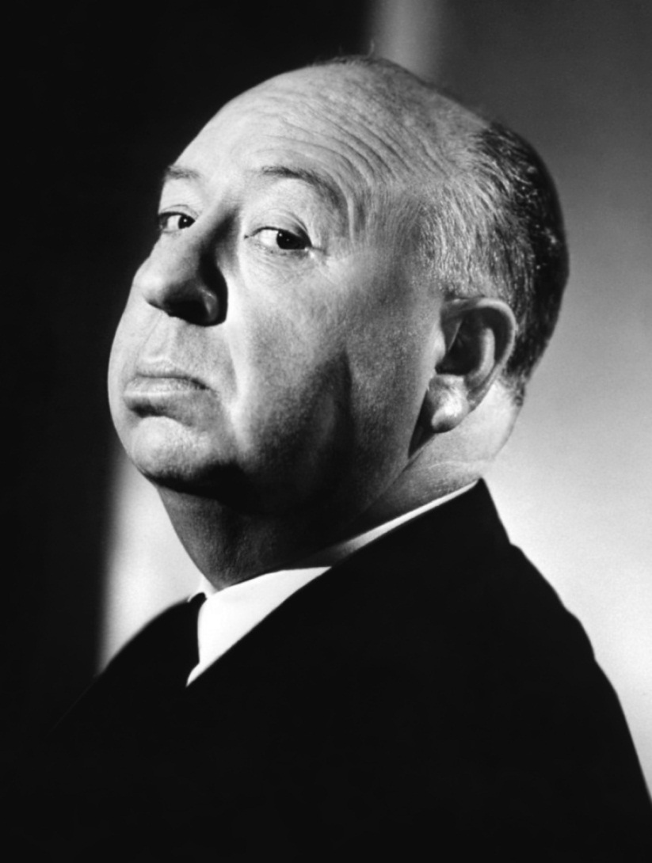
What is a Trade Secret?
To paraphrase Alfred Hitchcock, it’s like a “McGuffin”:
“Something that somebody has, that everyone else wants.”

Slide 6
Is it Property?
No, for purposes of the Criminal Code
  Not “taken” R. v. Stewart
Yes?
  Buy it, sell it, license it
  for fashioning the appropriate remedy for the wrongful taking of it:
    “The foundation of the action for breach of confidence does not rest solely on one of the traditional bases for action of contract, equity or property. The action is sui generis relying on all three …”
Notes:
R. v. Stewart – first of the SCC trilogy
Taking a photograph of the employee list for the Constellation hotel was not a theft, as the employee list was not a “thing”
Duffy Mott v. FBI Foods – last of the trilogy
In crafting a remedy, a sui generis or unique approach is to be taken, drawing from the law of 1) contract, 2) fiduciary duty – see Lac v. Corona, the second case in the trilogy, for an example and 3) property law – the right approach on the remedy depends on the facts

Slide 7
Access to Information Act
[109] Another influential decision is that of Phelan J. in AstraZeneca, which was a review of a decision to release records related to an NDS. Phelan J. held that Parliament’s intention was to protect genuine trade secrets based on the common law definition of the term. He cited the Société Gamma definition, but noted that the question is not whether the interpretation of “trade secrets” should be broad or narrow but whether the record falls within the legal definition of “trade secrets” (paras. 62-63). He referred with apparent approval to Health Canada’s Access to Information Act — Third Party Information — Operational Guidelines, which sets out four criteria to be met by a trade secret (para. 64). These elements are the same as in the Guidelines in evidence before us, which read:
- the information must be secret in an absolute or relative sense (i.e. known only by one or a relatively small number of persons);
- the possessor of the information must demonstrate that he has acted with the intention to treat the information as secret;
- the information must be capable of industrial or commercial application;
- the possessor must have an interest (e.g. an economic interest) worthy of legal protection. [Annex A]
[110] Phelan J. concluded, at para. 65:
  The type of information which could potentially fall into this class includes the chemical composition of a product and the manufacturing processes used. However, it is not every process or test which would fall into this class particularly where such process or test is common in a particular industry.
[111] Health Canada argues that this is the appropriate definition of “trade secret”. I agree. I particularly underline Phelan J.’s comment that the point is not whether the term is to receive a “broad” or a “narrow” definition (para. 63), but rather that the term should be given its traditional legal meaning.
[112] Phelan J.’s reasons, along with the portion of the Guidelines which he adopts, appropriately capture that traditional legal meaning. A “trade secret” for the purposes of s. 20(1) of the Act should be understood as being a plan or process, tool, mechanism or compound which possesses each of the four characteristics set out in the Guidelines which I have quoted above. This approach is consistent with the common law definition of “trade secrets” and takes account of the clear legislative intent that a trade secret is something different from the broader category of confidential commercial information which is separately and specifically protected under the Act. This approach is also consistent with the use of “secrets industriels” in the French version of the Act, as discussed above.

Slide 8
New in 2020: Criminal Code s. 391
Trade secret
391 (1) Everyone commits an offence who, by deceit, falsehood or other fraudulent means, knowingly obtains a trade secret or communicates or makes available a trade secret.
Trade secret — prior knowledge
(2) Everyone commits an offence who knowingly obtains a trade secret or communicates or makes available a trade secret knowing that it was obtained by the commission of an offence under subsection (1).
Punishment
(3) Everyone who commits an offence referred to in subsection (1) or (2) is guilty
  (a) of an indictable offence and is liable to imprisonment for a term not exceeding 14 years; or
  (b) of an offence punishable on summary conviction.
For greater certainty
(4) For greater certainty, no person commits an offence under subsection (1) or (2) if the trade secret was obtained by independent development or by reason only of reverse engineering.
Definition of trade secret
(5) For the purpose of this section, trade secret means any information that
  (a) is not generally known in the trade or business that uses or may use that information;
  (b) has economic value from not being generally known; and
  (c) is the subject of efforts that are reasonable under the circumstances to maintain its secrecy.

Slide 9

The Secret
Recipes
Formulae
Customer lists
“Know-how”
Non-patentable inventions

Slide 10
The Secret
Public information may become confidential, and a protectable trade secret, when skill and ingenuity are added
Notes:
But 3 part, or 3 requirements, test needs to be met

Slide 11
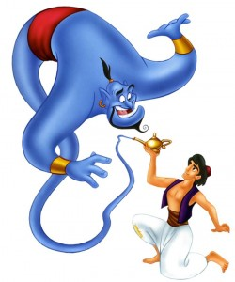
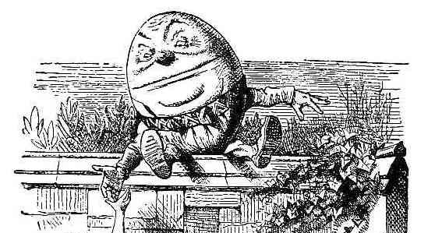
1. “A secret is a secret until it is no longer a secret.”

Slide 12
IP Asset Shelf Life
NEW
Coke
recipe
$ Worth
OLD
Time

Slide 13
IP Asset Shelf Life
NEW
Coke recipe
no longer secret
$ Worth
OLD
Time

Slide 14
2. How do you share it and protect it?

Slide 15
Trade Secrets
Very Fragile
Assets walk out the door every night
You have to:
Protect them physically
  Limit access to trade secrets within your company
Protect them with the law

Slide 16
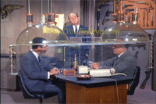
Protect it physically
“The Cone of Silence”
Lock the doors
Don’t let the public in
Screen the cleaning staff
Shred your paper garbage
Build firewalls to prevent hacking

Slide 17
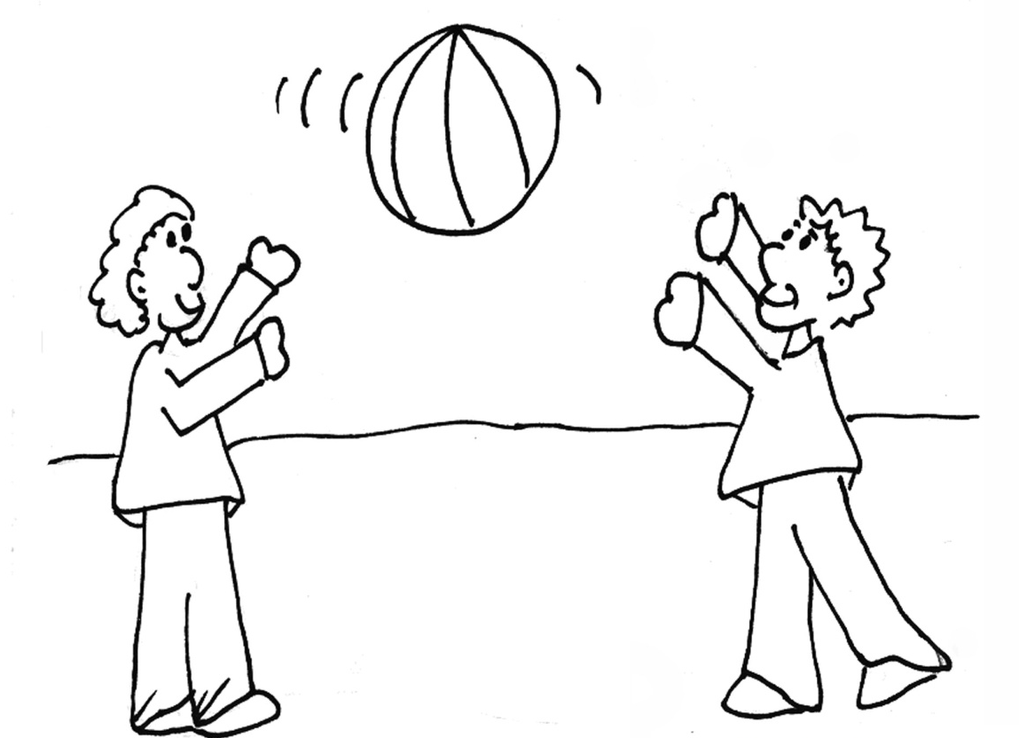
3 Prerequisites
A secret
Communicated in “circumstances of confidence”
Used by the recipient only for the permitted use.
1
3
2

Slide 18

“Communicated in Circumstances of Confidence”
Hierarchy of obligations that are easier to prove and, therefore, “better”.
A+ | Written Contract
B | Duty Imposed by Law (e.g., Fiduciary Duty)
C- | “Nature of the Trade”

Slide 19
Not New/An Anticipation
Sanofi SCC: To be an anticipation, it must:
  Disclose the invention (not be a secret)
  Enable one to make/use it
That includes testing
  Baker Petrolite

Slide 20

It’s (generally) OK to “reverse engineer” a Trade Secret
How do they get the Caramilk in the Caramilk bar?

Slide 21
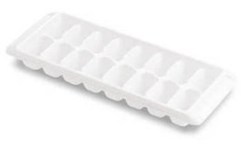
Just look at it
Make “ice cube tray” out of chocolate
Put the “caramilk” in
Put a slab of flat chocolate on the “top”
Fuse it to the “ice cube tray”

Slide 22
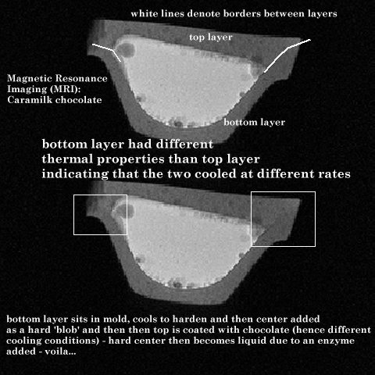
Or, be more sophisticated

Slide 23


Corollory:
You can’t stop independent creators
If someone else thinks of it, independently, then it was never received in circumstances of confidence.
There’s no breach of any obligation of confidence

Slide 24
3. Used only for the permitted purpose
… anything else is a mis-use

Slide 25
Remedies Against 3rd Parties
What’s fair? What’s equitable?
  Innocent 3rd party – no injunction
  3rd party who knew or learned it’s confidential, can be enjoined

Slide 26
Remedies
Injunction
  Interim/interlocutory
    Can sometimes put the genie back in the bottle
  Permanent
    Until secret isn’t a secret
    Springboard doctrine – stay in the penalty box for longer
Anton Piller Order - to preserve evidence
  Hobb’s choice: produce or be in contempt

Slide 27
Remedies
Money
  Damages
    Reasonable royalty – FBI Foods
  Profits
Constructive trust

Slide 28
Remedies
Lac Minerals v. International Corona
  Core drilling results provided over the hood of truck, with informal oral understanding between the parties about JV or other business arrangement to develop gold property
  SCC justices differed on whether this was a breach of fiduciary duty case or not
  Justice Sopinka writing for the majority finding that it was a breach of confidence case

Slide 29
Remedies
Cadbury Schweppes v. FBI Foods
  Remedy is fact-specific
    Contract, tort, property or trust all, potentially, in play
  Equity will pursue the information into the hands of a 3rd party

Slide 30
Confidentiality in Litigation
Tension:
  Courts are supposed to be open v. trade secrets are valuable
Solution:
  Implied undertaking rule
    What’s learned in litigation, stays in litigation
  Protective Orders
    Just between us
  Confidentiality Orders
    Sierra Club: 3rd party secrets are worth protecting for a higher purpose

Slide 31
Thank You
Bereskin & Parr LLP

