Slide 1
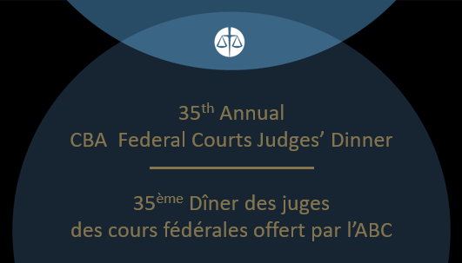

Slide 2
Tribute to / Hommage à
Donald M. Cameron
by/par
R. Scott MacKendrick
Notes:
Thank you, Scott for that kind introduction.
Honourable Chief Justices
Honourable Justices of the Federal Court of Appeal and Federal Court
Associates Judges, Federal Court staff
Mesdams et messieurs.
Cher confreres et consouers,
I was in our spare bedroom the other day
Thinking about what tonight I might say
When I spied with one eye, one of our daughter’s old books.
“Oh, the Places You’ll Go”.
So I gave it a look.

Slide 3

Notes:
“Oh, the Places You’ll Go”.
So I gave it a look.
It tells of a life to come
with all its ups, and its downs.
I thought, if that book inspired her in her youth,
Might it inspire me now that I’m long in the tooth?

Slide 4


Notes:
So my speech is entitled: “Oh, the Places I’ve Been”.
Perhaps you will learn, from the things that I’ve seen.

Slide 5
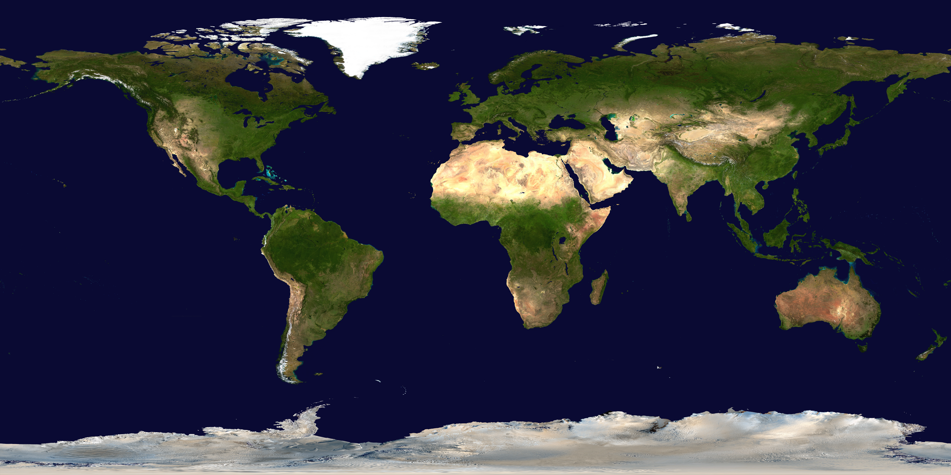
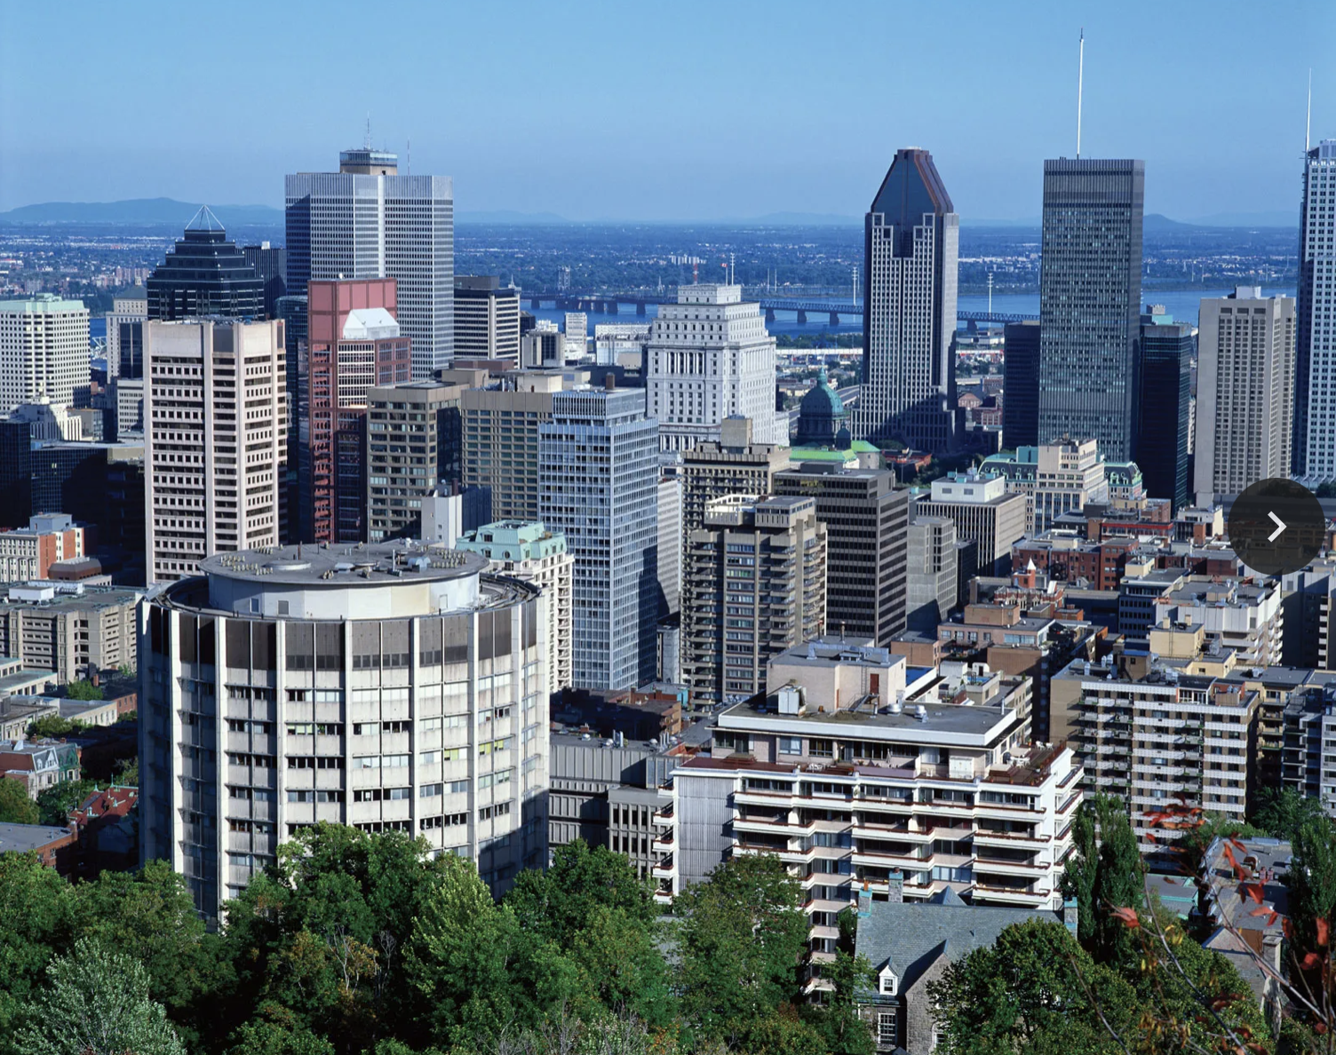
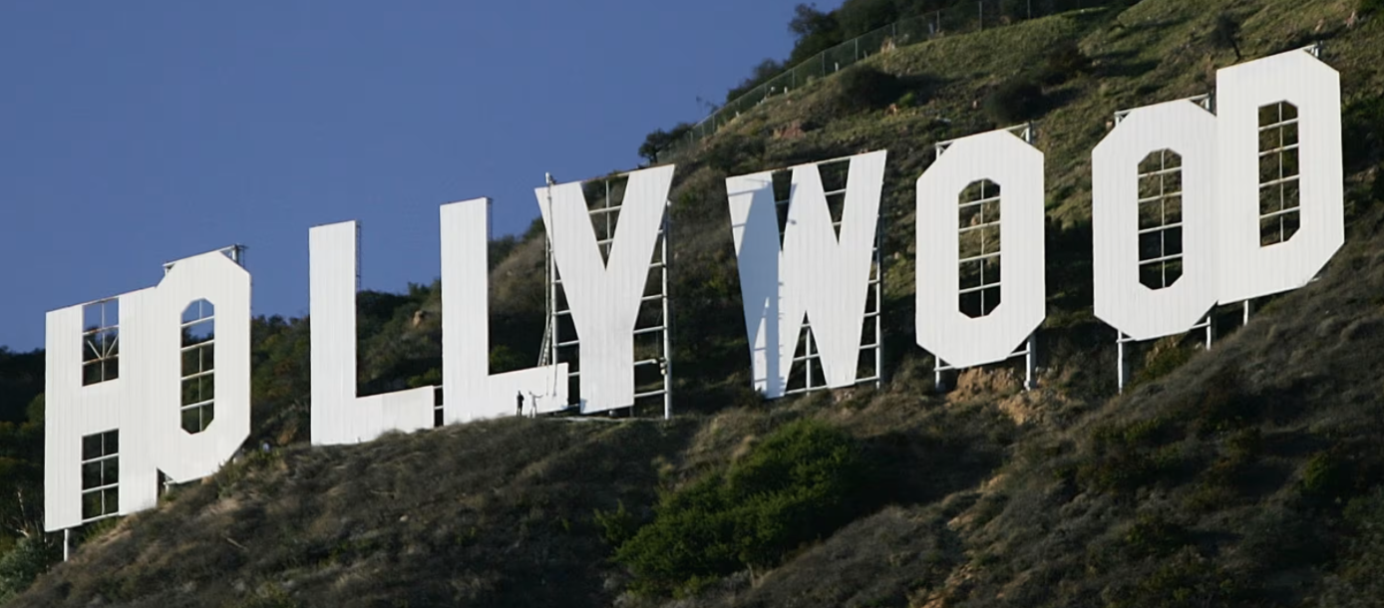
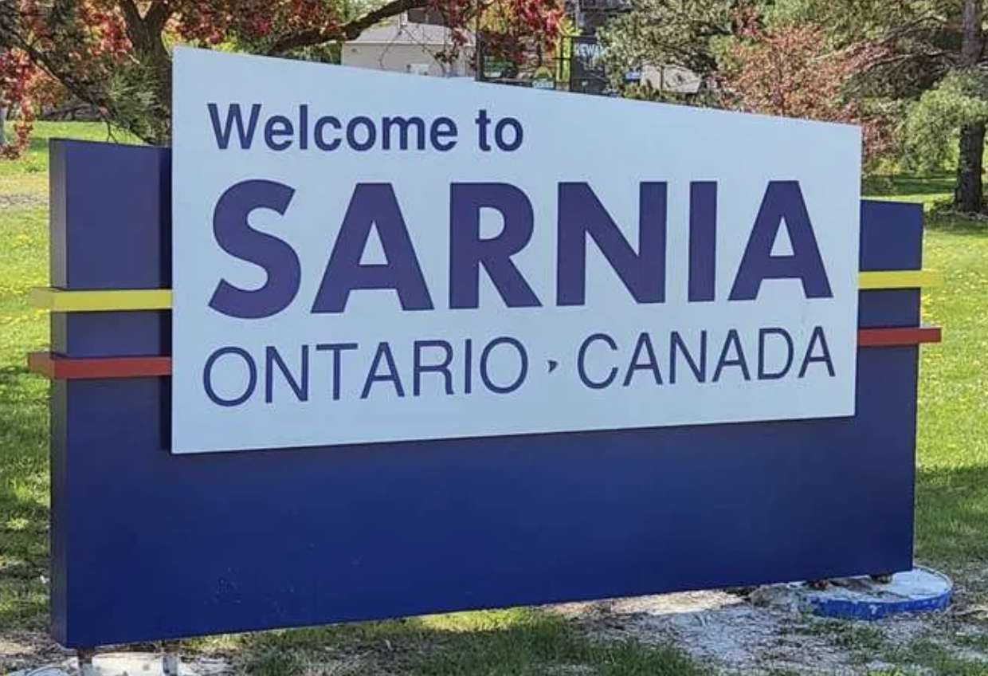
Alberta
Kingston
Germany
New Jersey
Seattle
Wilmington
Japan
Raleigh
Notes:
Oh, the places I’ve been, some far and some near.
For meetings with clients and experts each year.
1.To Japan once with Ron, and again once with Roger.
2. To Wilmington, Delaware to discuss aramid fiber.
3. To Kingston, Ontario and
4. Calgary, Alberta
5.To Munich and Frankfurt and
6. Raleigh, North Carolina
7. à la Belle province pour des interros et des procès en français
8. For Viagra and Cialis, in Seattle we would stay.
9. To Napa, La Jolla and Thousand Oaks, California
10. To New Brunswick, New Jersey.
11. And even to Sarnia.

Slide 6
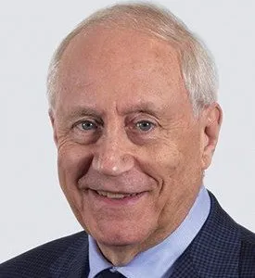
“… they’ll pay
you to learn.”
Notes:
[Aside] In 1978, Dan Bereskin interviewed me for a summer job at R,B&P.
He told me that one of the perks of IP law is that clients pay you to learn.
He had me at “learn”.
And learn I did, everywhere that I went
And although the places had lots to be seen

Slide 7

Notes:
It was the people I met, that much more to me, mean.

Slide 8
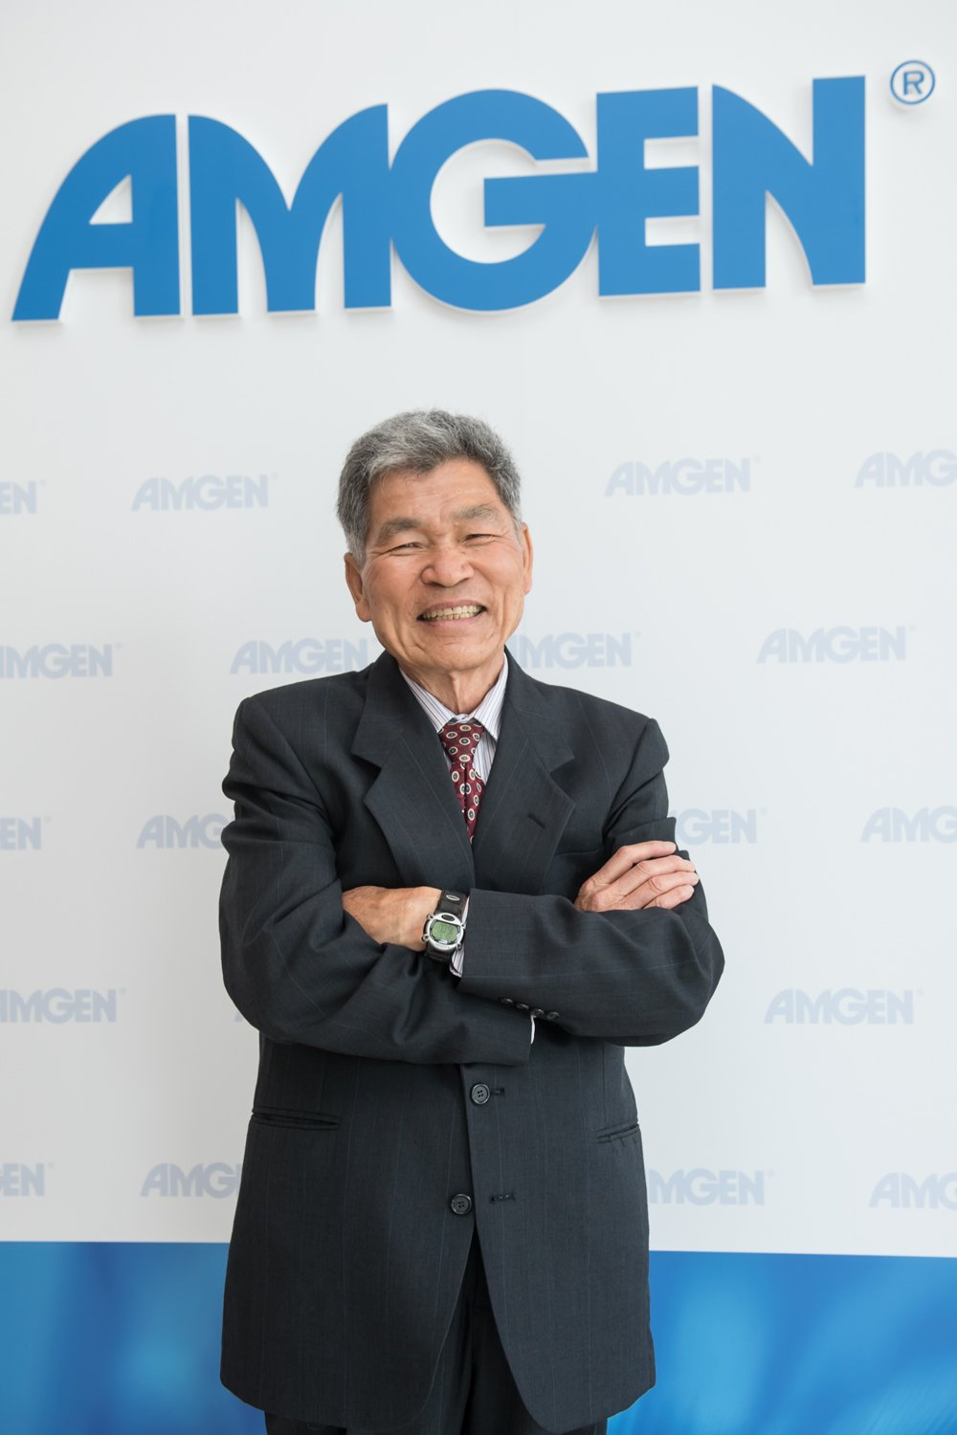
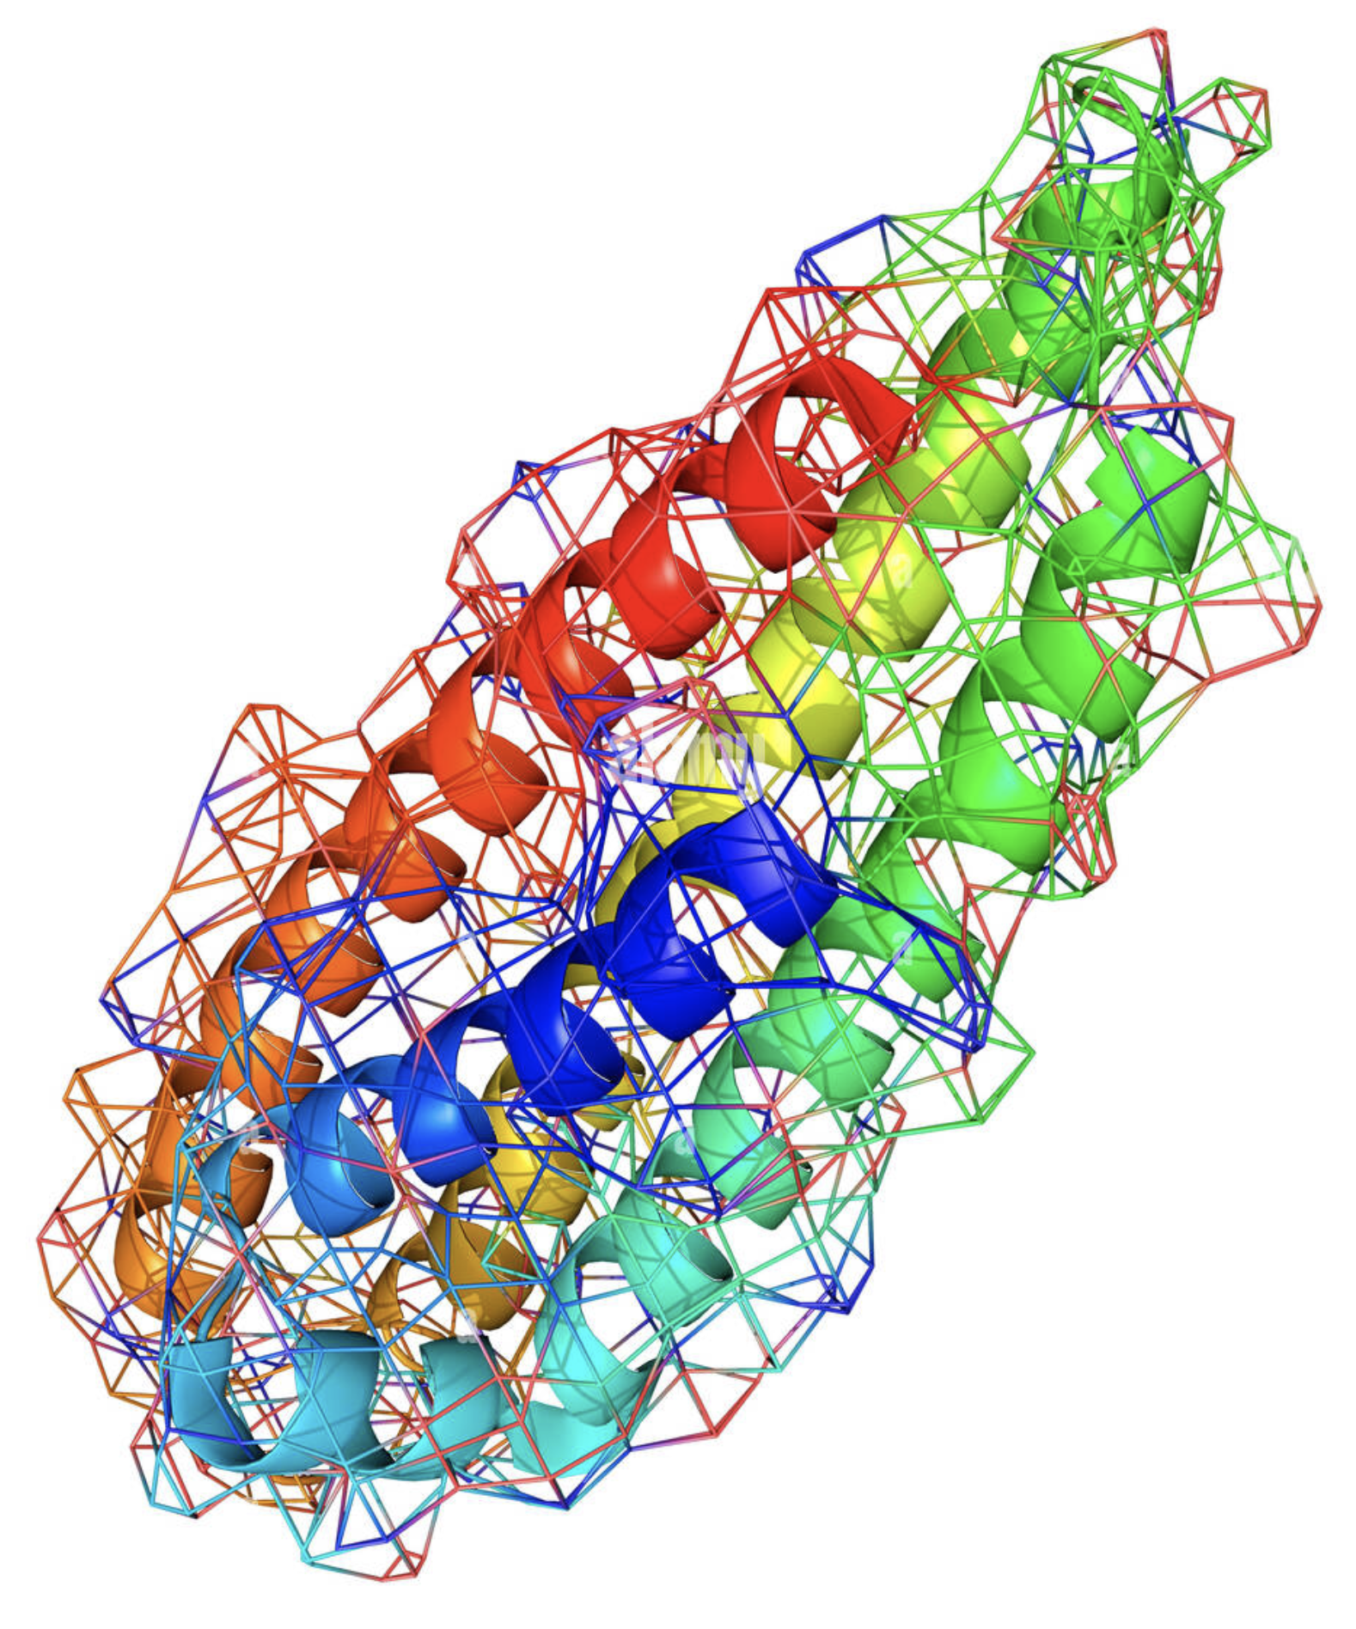
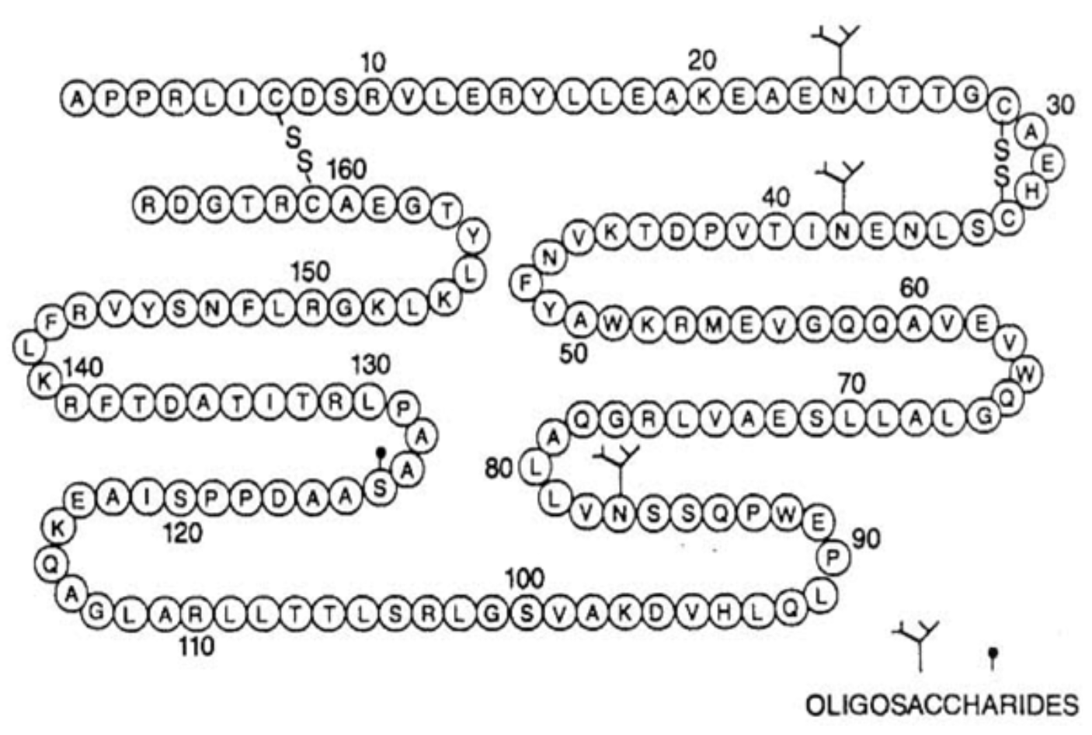
Dr. Fu-Kuen Lin
Notes:
the man who invented erythropoetin, Dr. Fu-Kwen Lin,
that invention alone was what first built Amgen.

Slide 9
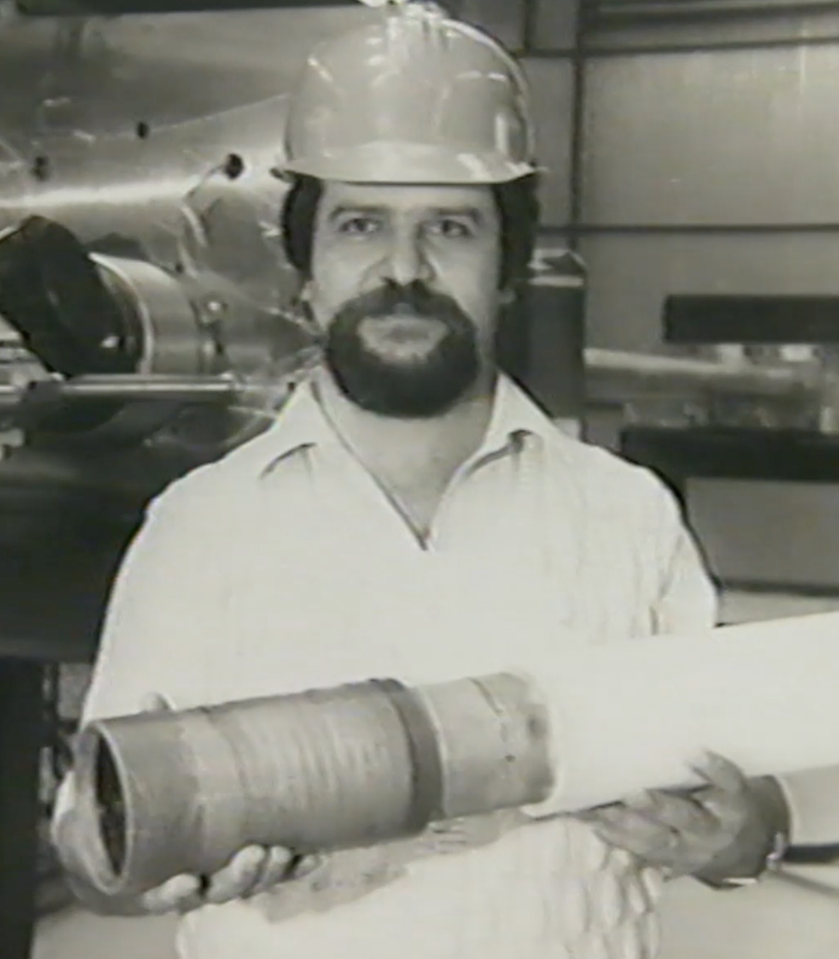
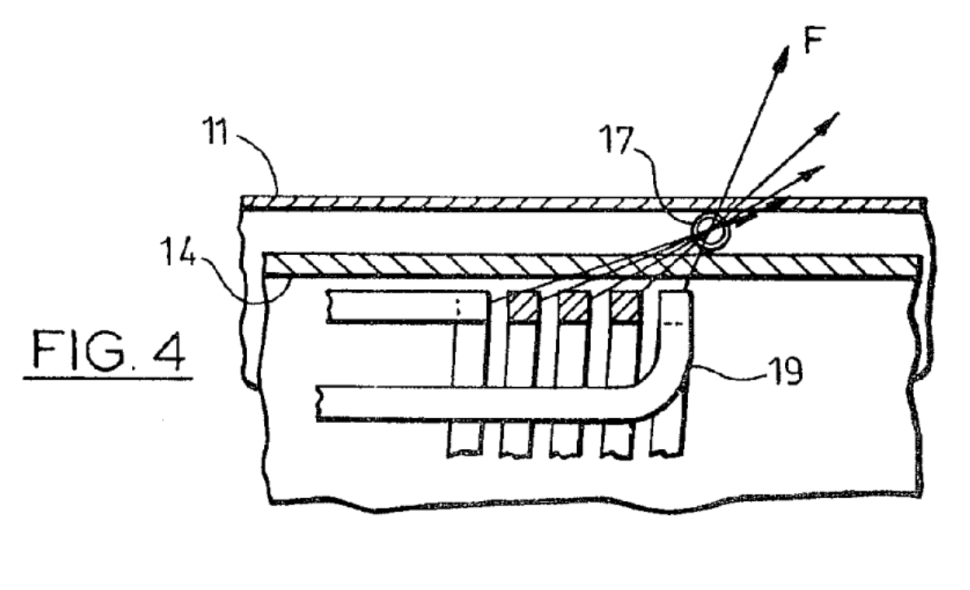
Dr. Joseph Dableh
Notes:
the man who fixed CANDU reactors: Dr. Joseph Dableh
Our win against Ontario Hydro was important both to him, and to me.

Slide 10
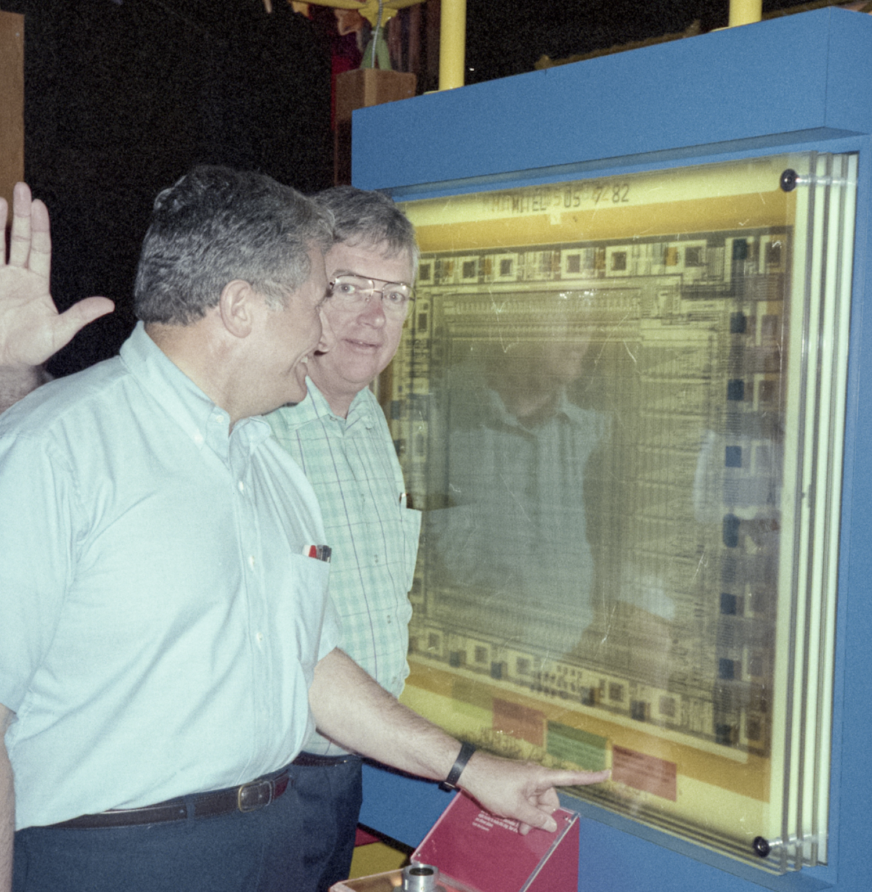
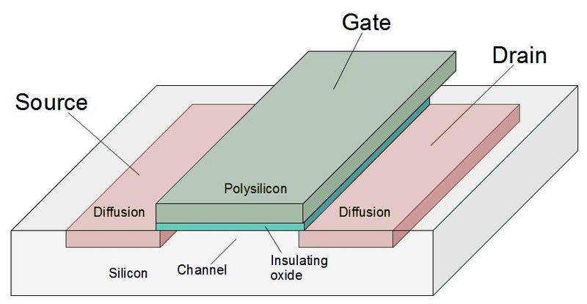
Don Klein & Bob Kerwin
Notes:
Bob Kerwin and Don Klein, 2 of the 3
Who at Bell Labs made transistors, almost too small, to see.

Slide 11
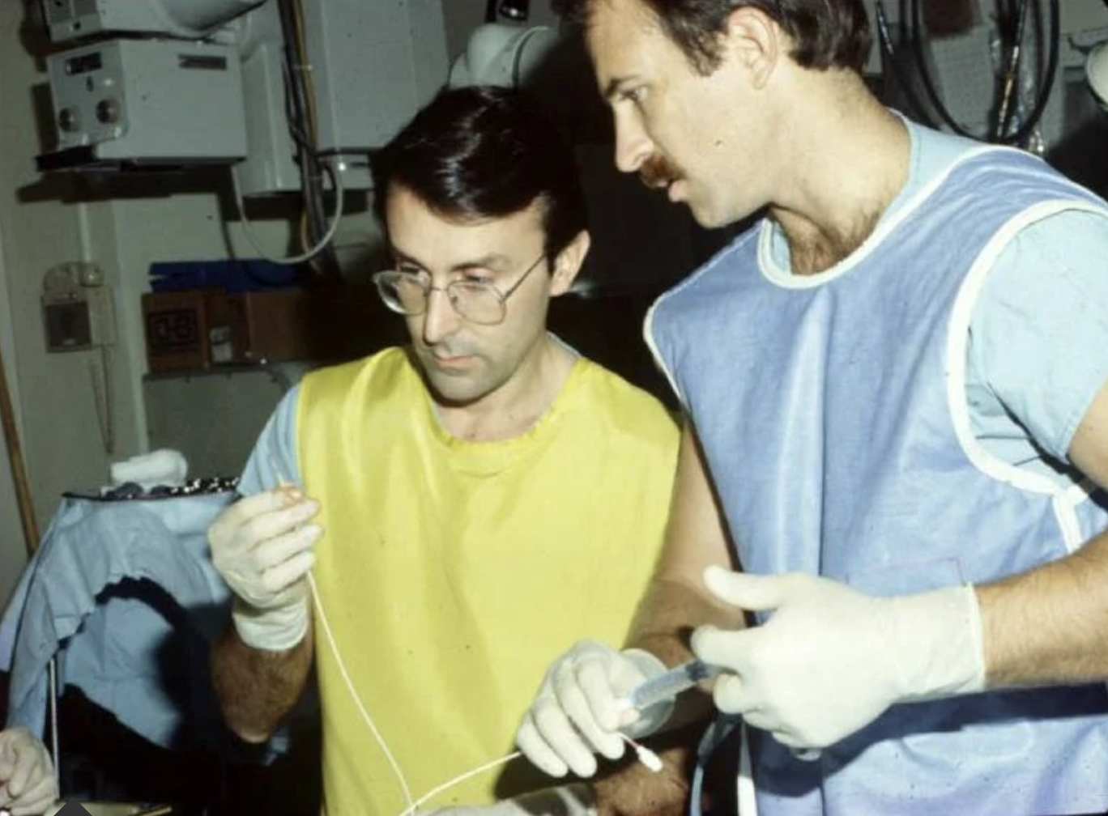
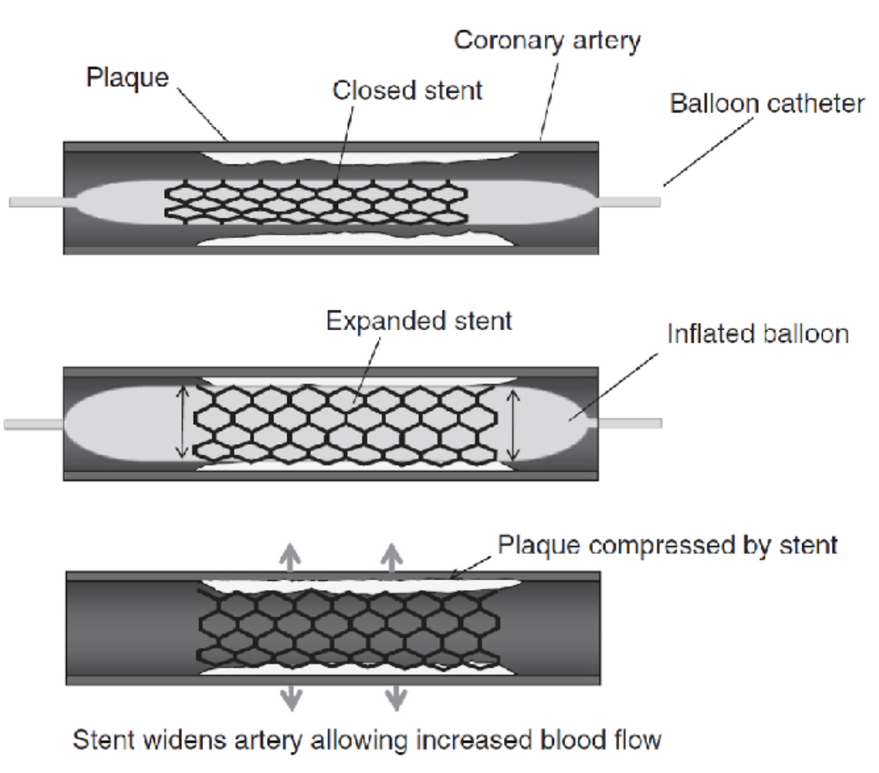
Dr. Julio Palmaz & Dr. Richard Schatz
Notes:
Drs. Palmaz and Schatz: What did they invent?
Why the wonderful, marvellous, ballon expandable stent!
Jean Chretien a recu un stent mardi cette semaine.

Slide 12
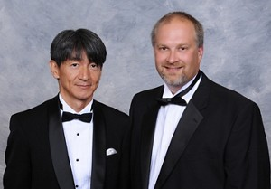
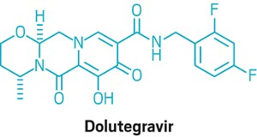
Takashi Kawasugi & Brian Johns
Notes:
Takashi Kawasuji and Brian Johns
Declared “Heros of Chemistry” as AIDS medicine icons.

Slide 13


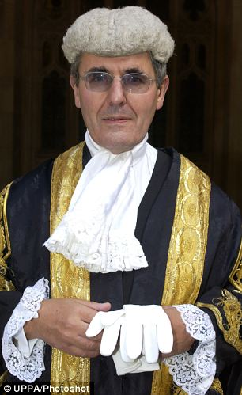
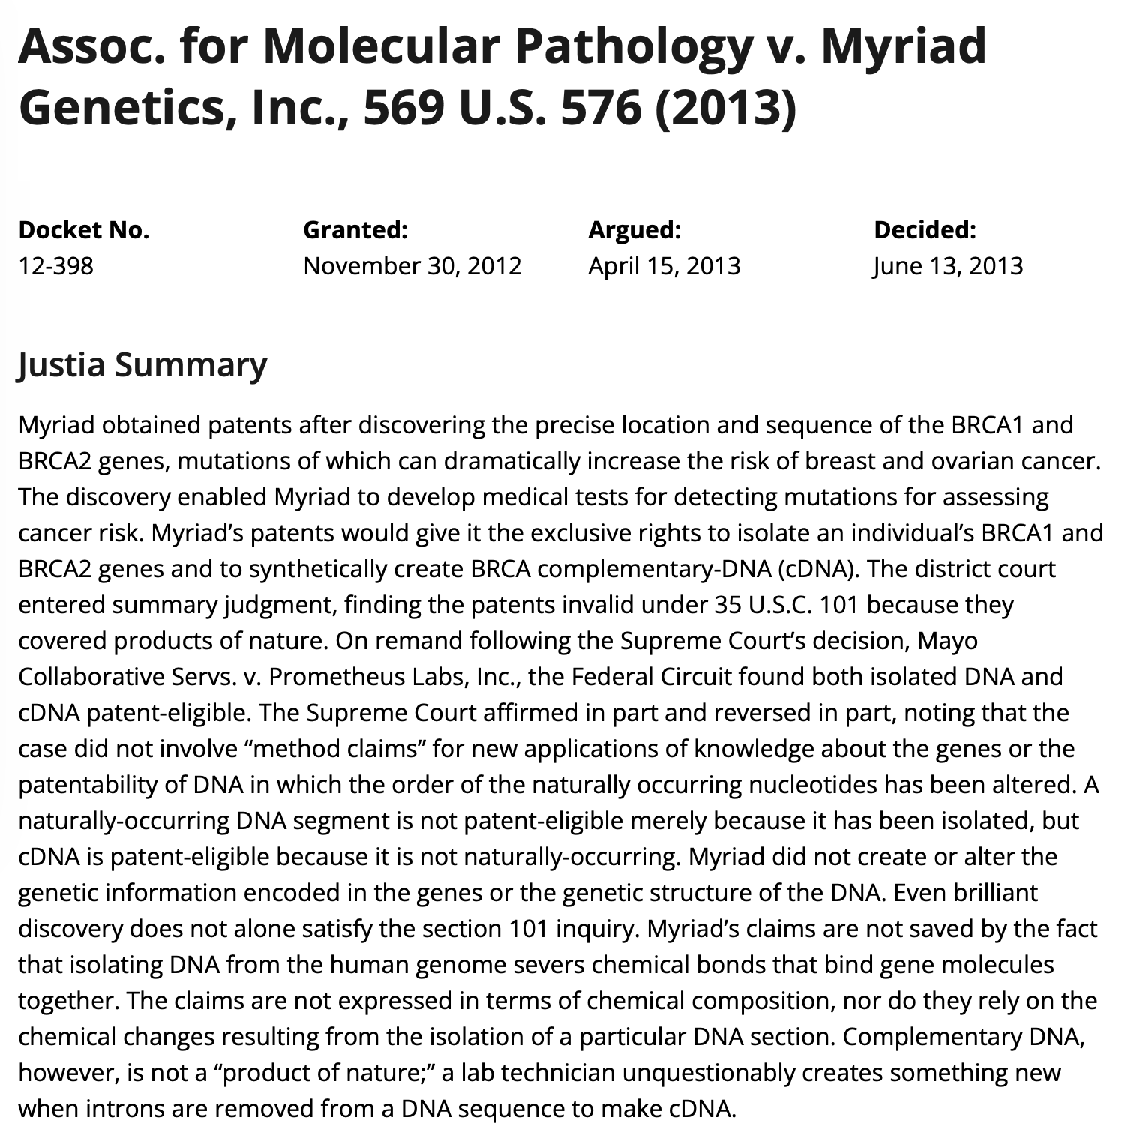
Sir Robin Jacob
Notes:
For 10 years on my podcast that I called Jurisdiction
I spoke to dozens who to my questions would listen.
My hero Sir Robin Jacob on pharma competition
And the ACLU lawyer who invalidated the BRCA gene patent
thus creating, a brand new freedom, of genetic expression.
The judges and staff of the Federal Court.
Some became friends, like the late Chris Burke
Legal assistants and law clerks helped too
Karen Milley for the first 10, Erika DeSouza the last twenty-two.

Slide 14

Notes:
And mentors I had
Having them made me glad.

Slide 15
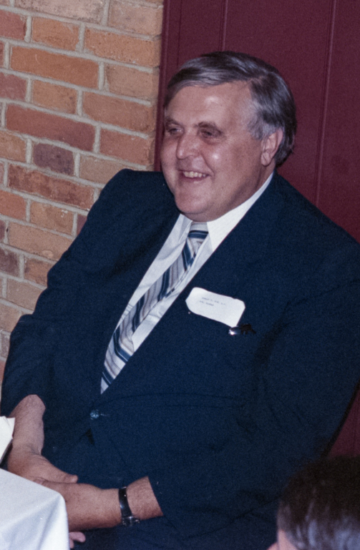
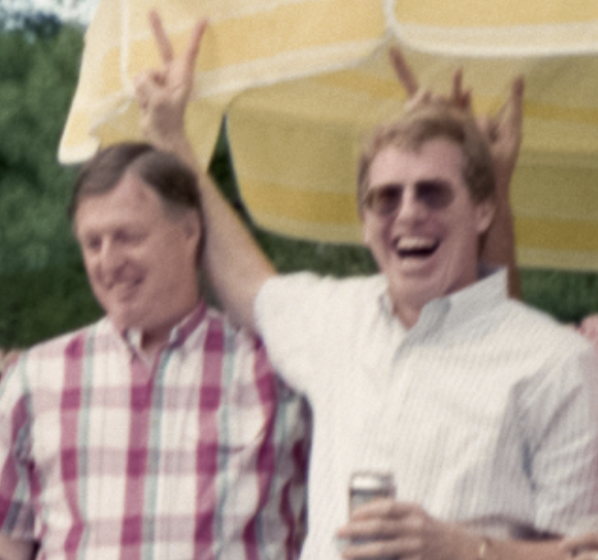
Donald F. Sim Roger Hughes Ron Dimock
Notes:
Sim, Hughes and – the one and only – Ron Dim-ock.
They gave me experience, chock-a-block.
Thanks to them, I learned.
And from them, I learned A LOT.

Slide 16
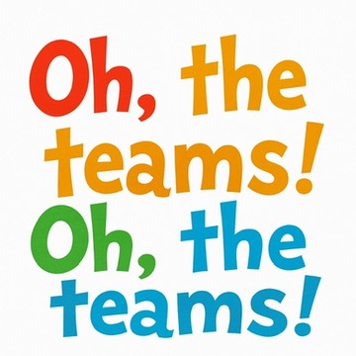
Notes:
And the teams I was on, Oh, the teams I was on.

Slide 17
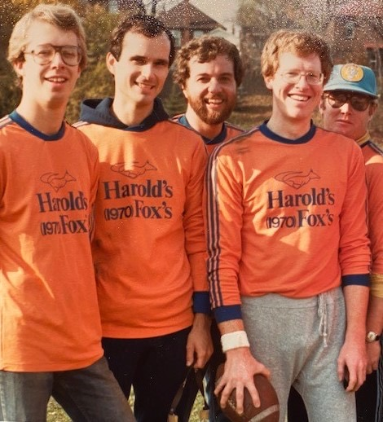
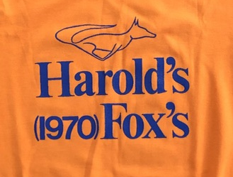
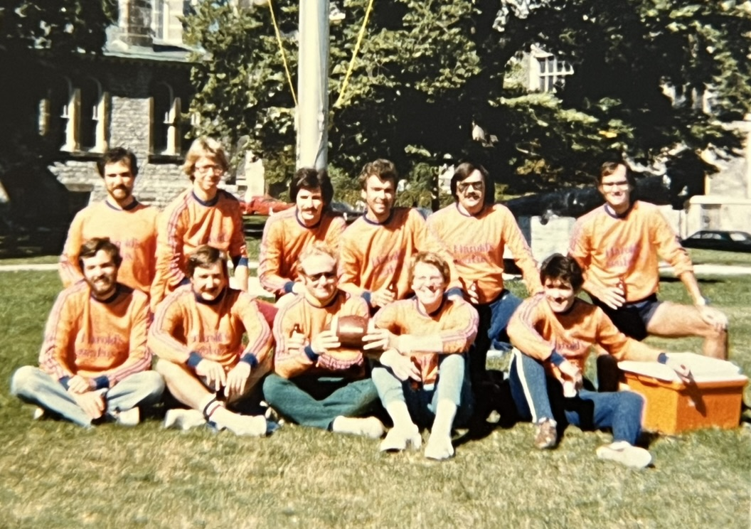
Notes:
One of the first teams I joined was called Harold’s Foxes
Competitors Monday thru Friday, football teammates on Sundays.
From 6 different IP firms, it checked all the boxes.
[Aside] It was a preview.
I was joining a profession where competitors could be friends
And have a laugh working together.

Slide 18
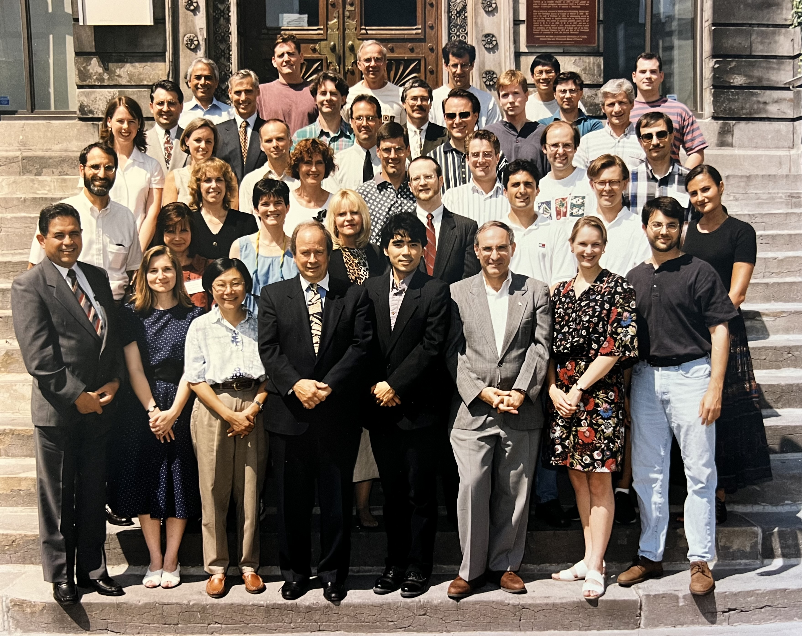
Notes:
The people on other projects were special too
At the Montreal IPIC course, there were quite a few.
And the folks who lectured at the Law Society’s IP Year in Review

Slide 19
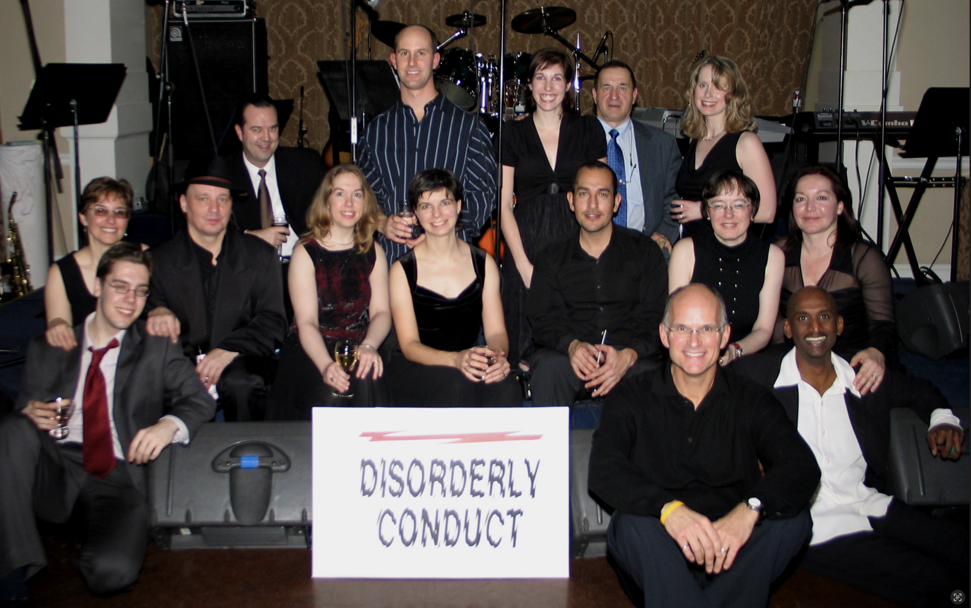
Notes:
Some were colleagues, as in our band at Ogilvy Renoo

Slide 20
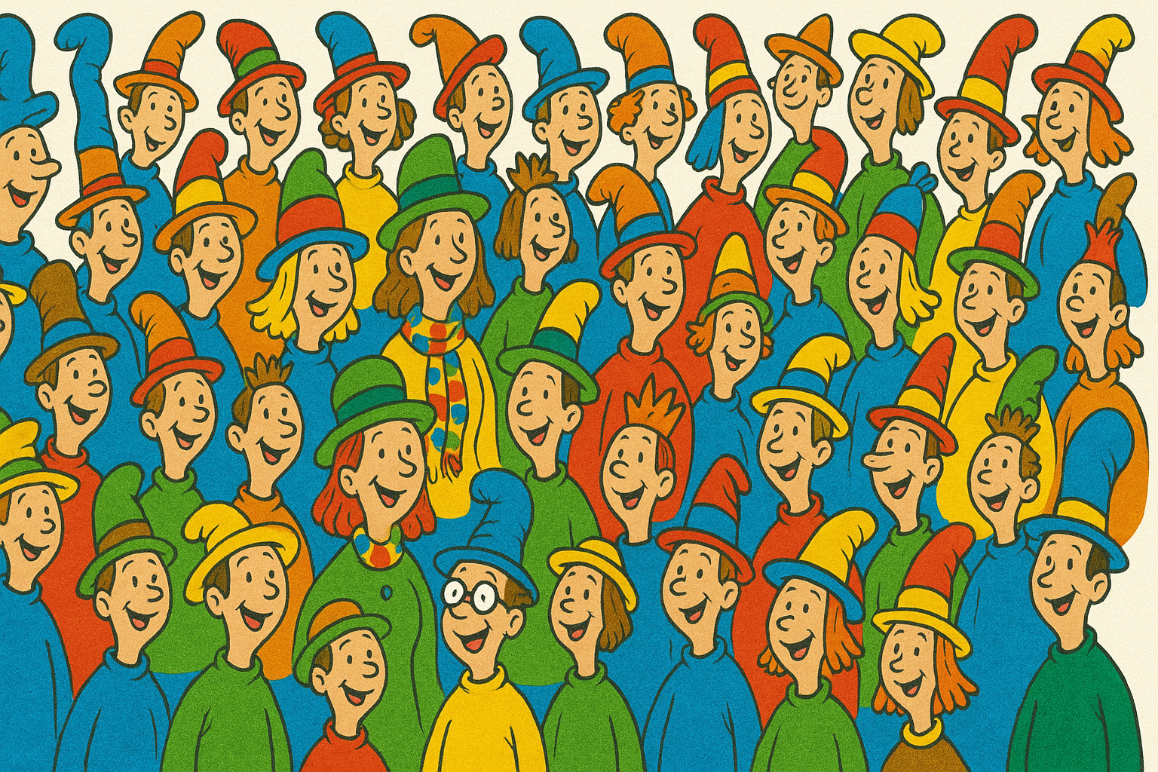

Notes:
20 years ago did I recruit
A veritable Who’s Who-ville of IP lawyers
for the National Judicial Institute.
At first, only judges could look.
Then in 2012, they were published as 3 separate books.
The IP Benchbooks ran from ’04 until last year
I’d like to again thank the contributors whom I hold most dear:

Slide 21
Toni Ashton
Eileen McMahon
David Aitken
Meghan Dillon
Cynthia Rowden
Bill Richardson
Adele Finlayson
Daphne Lainson
Ruth Corbin
Mark Evans
Tony Creber
Gord Zimmerman
Colleen Spring Zimmerman
Belle Van
Stephen Garland
Adam Bobker
Anastassia Trifonova
Martin Brandsma
Camille Aubin
Notes:
Ashton, McMahon, Aitken, Dillon, and Rowden,
Richardson, Finlayson, Lainson, and Corbin.
Evans, Creber, Zimmermans (two) and Van,
Garland, Bobker, Trifonova, Brandsma and Aubin

Slide 22
Mark Davis
Kevin Graham
Tom Feather
Sheldon Burshtein
Don MacOdrum
Michelle Wassenaar
Kelly Gill
Timothy Bourne
Russel Latham
Susan Beaubien
Avery Lee
Jean Lee
Alpesh Patel
Bryan Norrie
Marcus Klee
Sanjukta Tole
Christina Capone Settimi
Notes:
Davis, Graham, Feather, Burshtein and MacOdrum,
Wassenaar, Gill, Bourne, Latham, and Beaubien.
Avery Lee, Jean Lee, Patel and Norrie,
Marcus Klee, Tole, and Capone Settimi

Slide 23
Ron Dimock
Scott MacKendrick
Alexander Monic
Francois Grenier
Barry Gamache
Geoff Mowatt
Artemis Lai
Jonathan Colombo
William Audet
Richard Naiberg
Arthur Renaud
Notes:
Dimock, MacKendrick and Monic
Grenier and Gamache, the latter of Robic
Mowatt, Lai and Jonathan Colombo,
Audet, Naiberg, and Arthur Renaud.

Slide 24
Doug Deeth
Tamara Winegust
Max Rothschild
Glenn Bloom
Barry Fong
Sydney Young
Jill Jarvis Tonus
Laura Macdonald
Andrea Long
Notes:
Deeth, Winegust, Rothschild, Bloom and Fong
Young, Jarvis Tonus, Macdonald and Long
And a few who bailed out of their practice of law
I think to avoid having to update their chapters at all,
They get honorable mentions:

Slide 25
Honourable mentions:
The Honourable:
George Locke
Michael Manson
Janet Fuhrer
(just as honourable):
Alexandra Steele
John Cotter
Notes:
The Honourables:
Locke, Manson and Fuhrer
And, in my mind, just as honourable,
Steele and Cotter
Thank you all joining with me on that wonderful writing adventure.

Slide 26
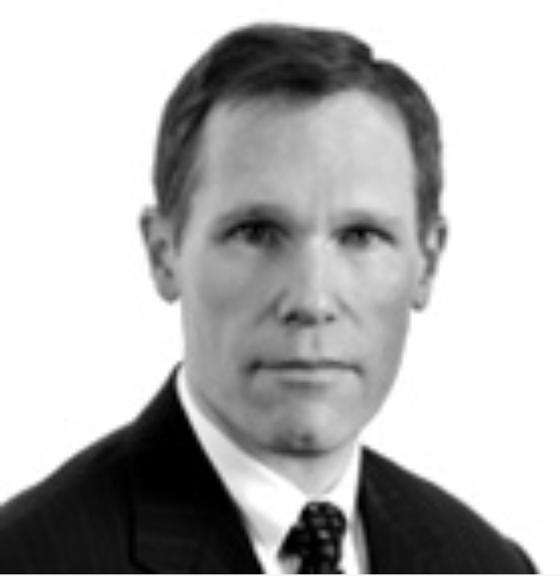
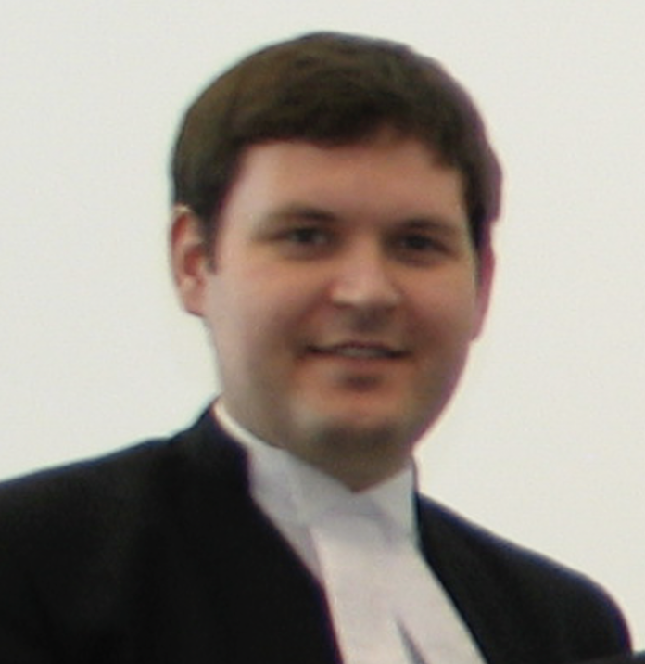
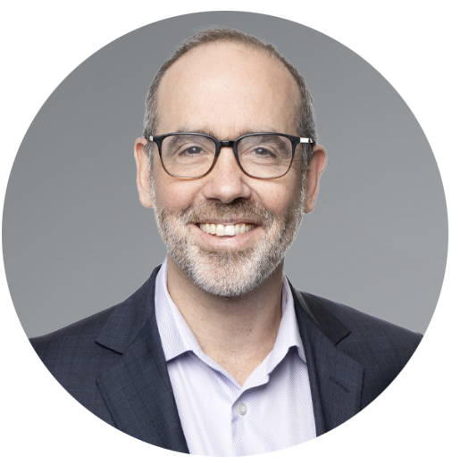
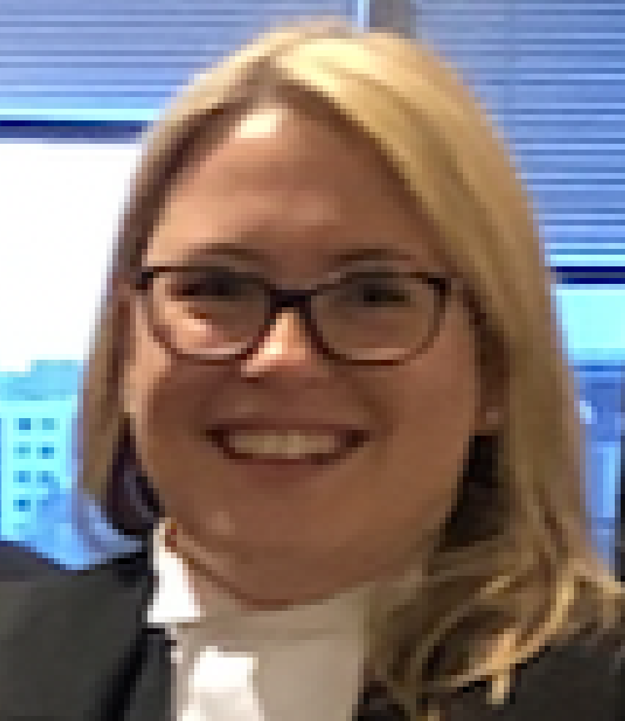
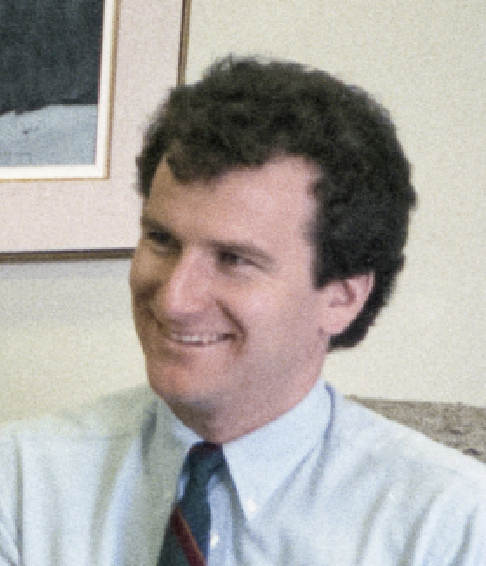
George Yuri Adam Laura Bruce
Locke Chumak Bobker Macdonald Stratton
Notes:
Co-authors are special. You have to do a mind-meld like a Vulcan.
And I did with Locke, Chumak, Bobker, Macdonald and Stratt-Un,

Slide 27




Notes:
[Aside] I taught a lot of courses on IP law at a lot of places.
I’m guessing 800-1000 students had to listen to me.
They say when one person teaches, two people learn.
Thanks to teaching them,
I had to think about things a lot
and doing that, I think I learned a lot.
O if you’ve ever read something I edited,
or read something I wrote,
Or if you ever heard, something I spoke,
Thank you for letting me into your brain,
To have your brain some new thoughts evoke.

Slide 28

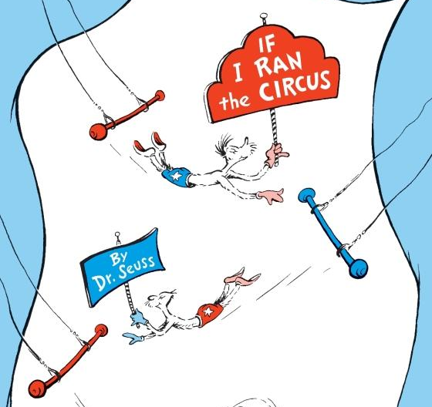
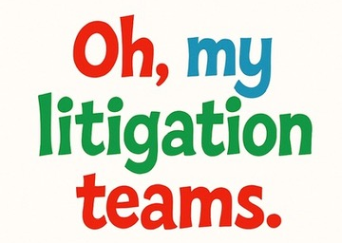
Notes:
My favourite kind of team was the litigation team,
That kind of team often worked like a dream.
When one puts out a hand, one gets what one needs.
Like the people who fly on the flying trapeze.
It’s all based on trust. Having trust is a must.
Who are the people in whom I’ve had such great trust?

Slide 29
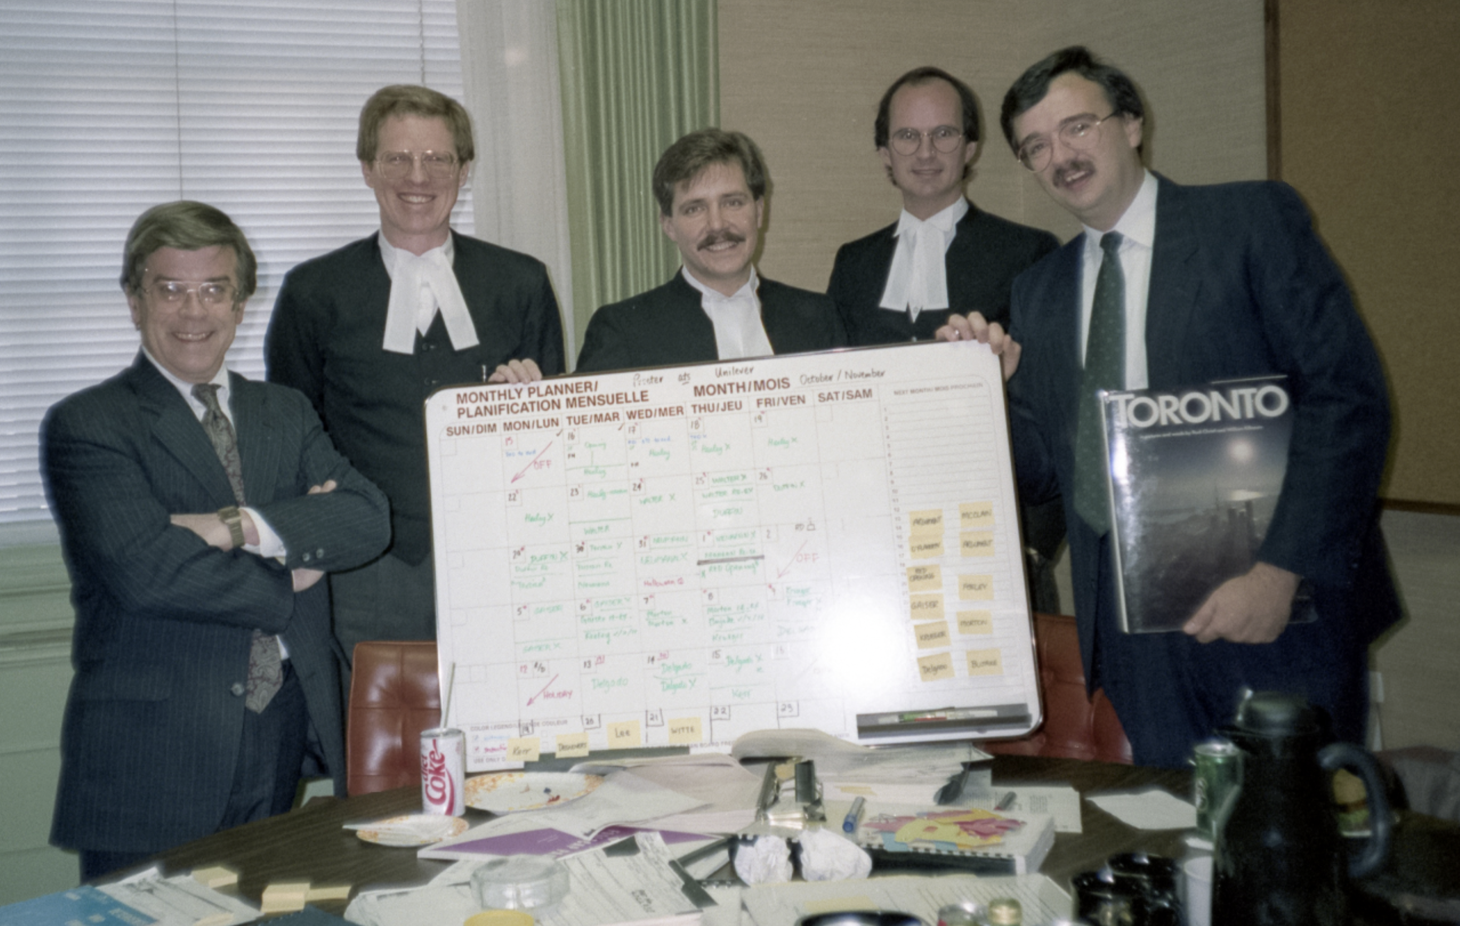
Art Renaud
Scott MacKendrick
Bruce Stratton
Notes:
first: Art Renaud, Scott MacKendrick and Bruce Stratton

Slide 30
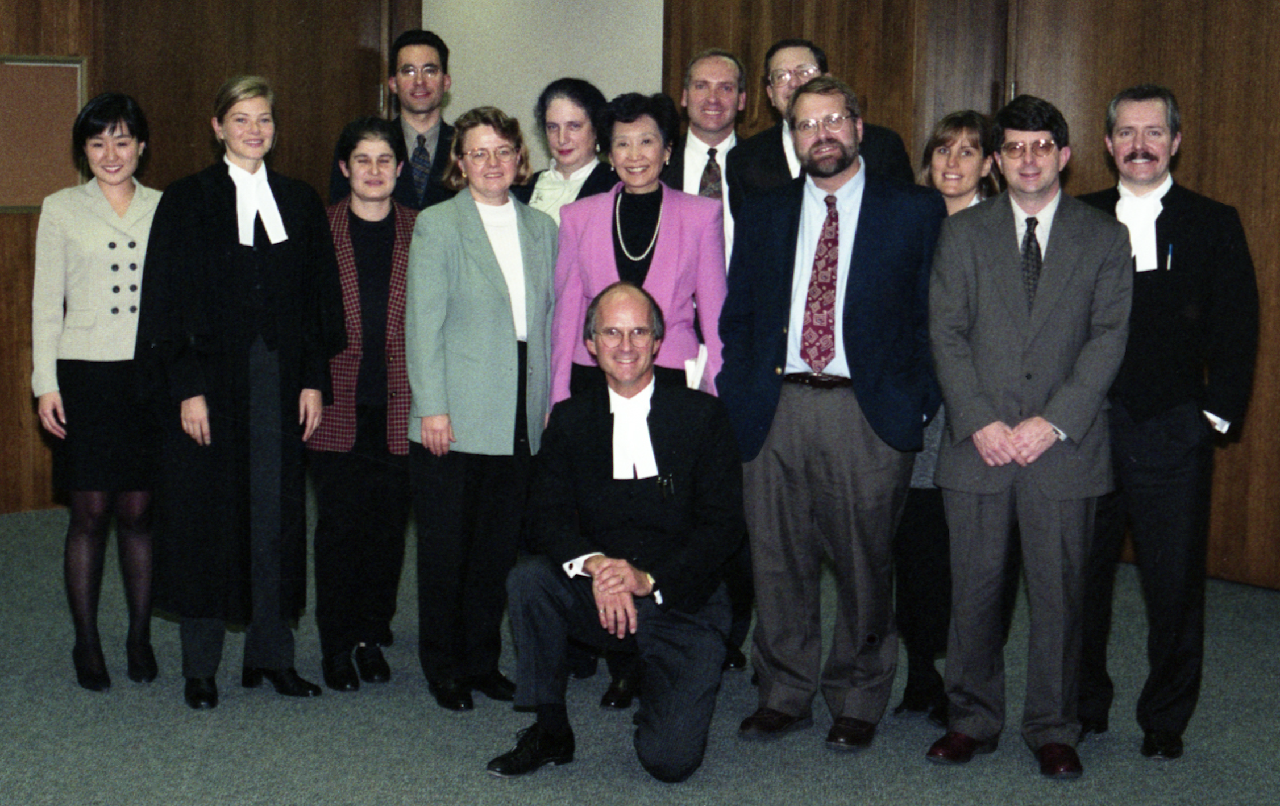
Allyson Whyte
’’ ‘’
Nowak
Bill Chan
Jane Caskey
Jason Markwell
Notes:
Allyson Whyte and then Whyte Nowak, all people I could count on.
Bill Chan, Jane Caskey and Jason Markwell,

Slide 31
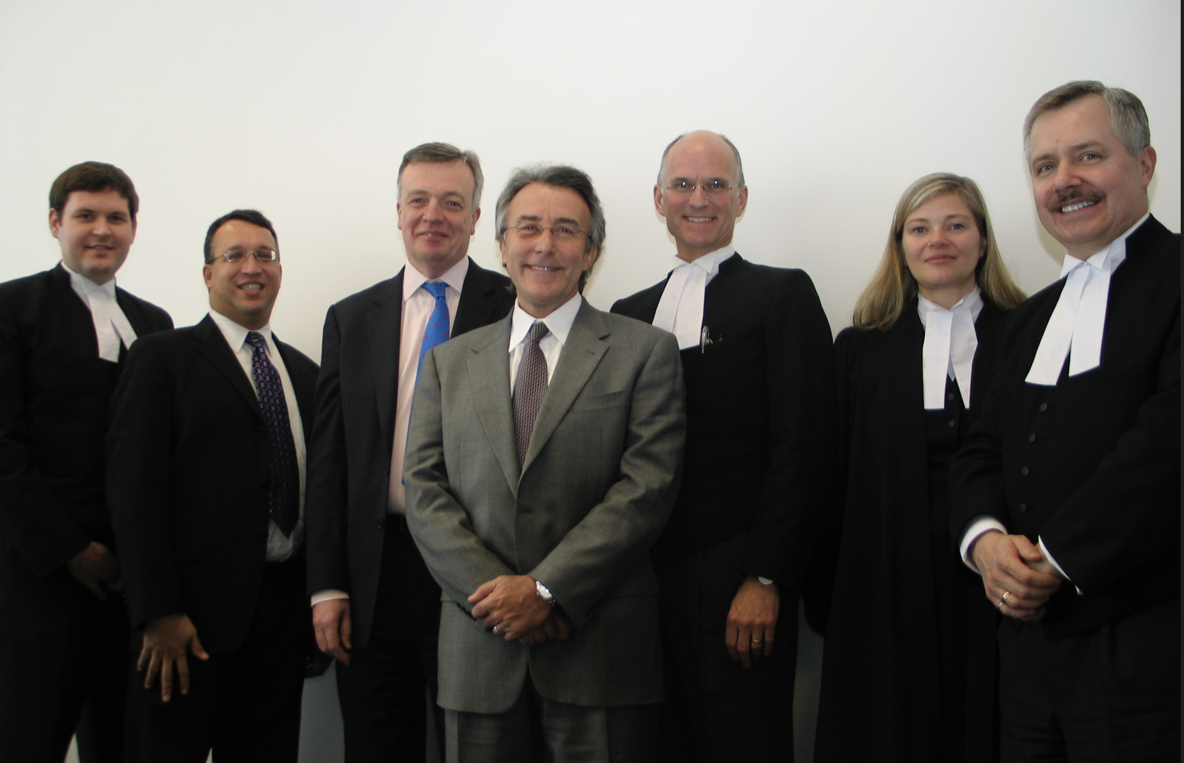
Yuri Chumak
Diane LaCalamita
Josee Gravelle
Christina Capone Settimi
Kristen Wall
Notes:
Yuri Chumak, Diane LaCalamita and Josee Gravelle,
Christina Capone Settimi and Kristen Wall.

Slide 32
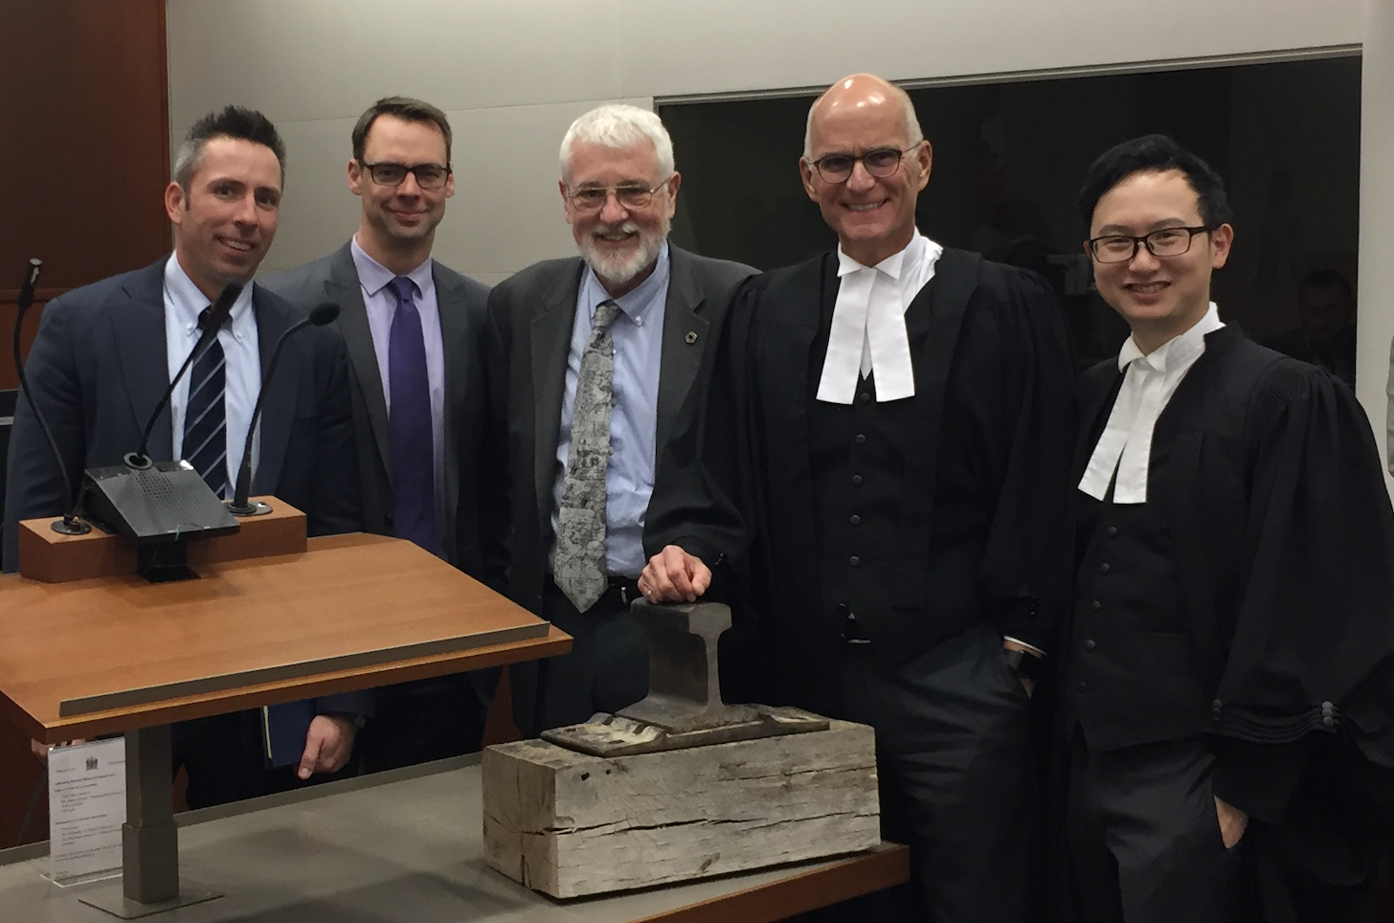
Chad Matheson
Brad Limpert
Michelle Nelles
Jerry Chen
Mark Robbins
Amrita Singh
Josh Spicer
Notes:
Some great women, some great fellas
like Chad Matheson, Brad Limpert and Michelle Nelles.
Jerry Chen, Mark Robbins, Amrita Singh, and Josh Spicer

Slide 33
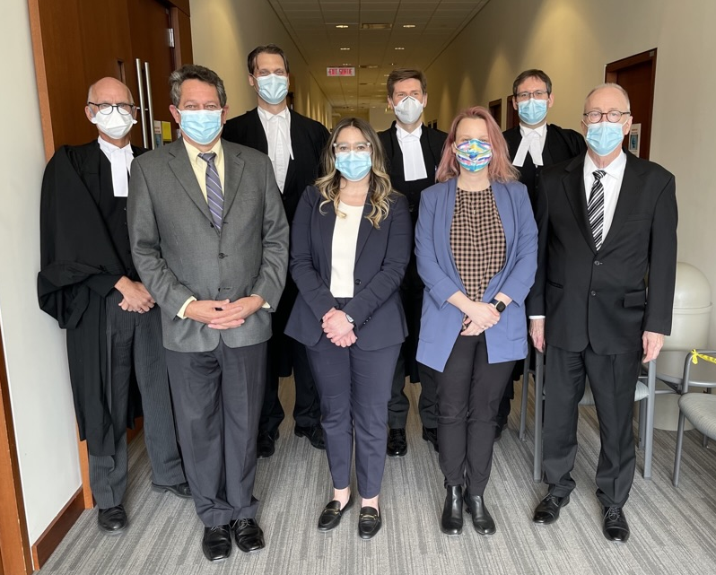
Martin Brandsma
Mike Burgess
Adam Bobker
Notes:
Martin Brandsma, Mike Burgess and Adam Bobker

Slide 34
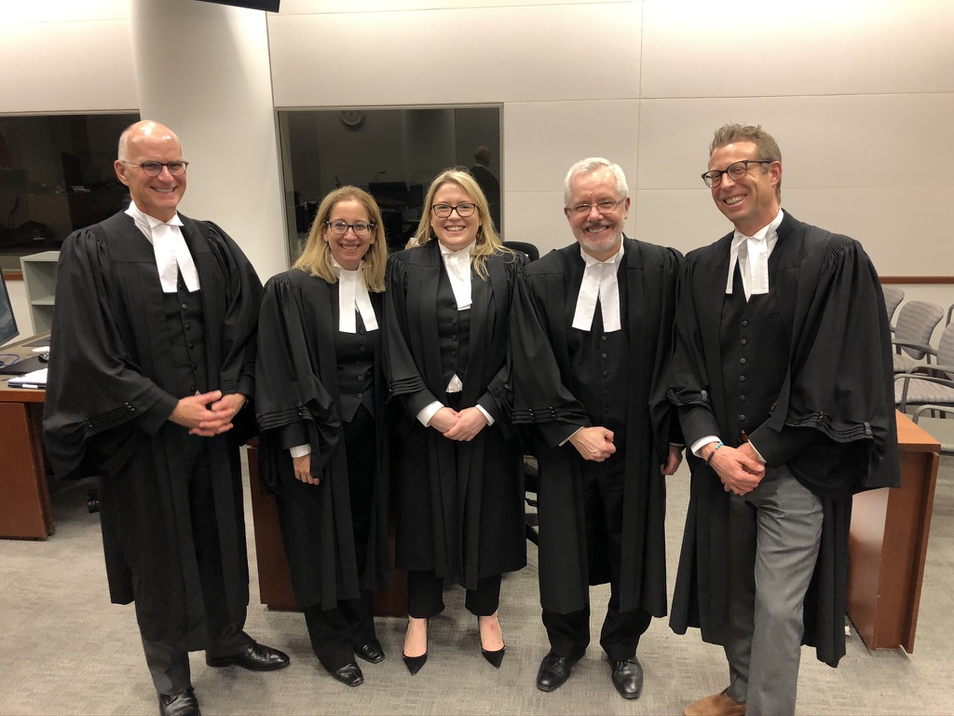
Melanie Szweras
Mike Fenwick
Laura Macdonald
Notes:
Melanie Szweras, Mike Fenwick, and Laura Macdonald
Some cases we lost; some cases we won.
Many cases we settled – thank goodness not every one.
For my litigation teammates, it’s so nice to see, how well they have all done.

Slide 35

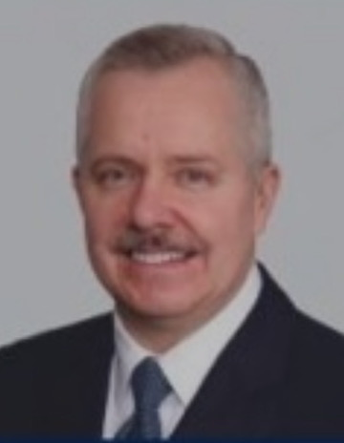
Notes:
And Scott, for 36 years, as my teammate, you’ve been the best.
Our brains put together, can out best the rest.
Likewise, our skills have complemented each other.
Thank you most of all for being my friend, like a brother.

Slide 36

Notes:
And, lastly,
my most important team of all: my family relations.
Thank you, Jane for supporting me, through work’s trials and tribulations.
And the job I’ve liked best being in:
Being Dad to our kids: Jamie, John and Caroline
And now with grand-children, I get to sit in a nook
And read to them, my favourite Dr. Seuss books.

Slide 37




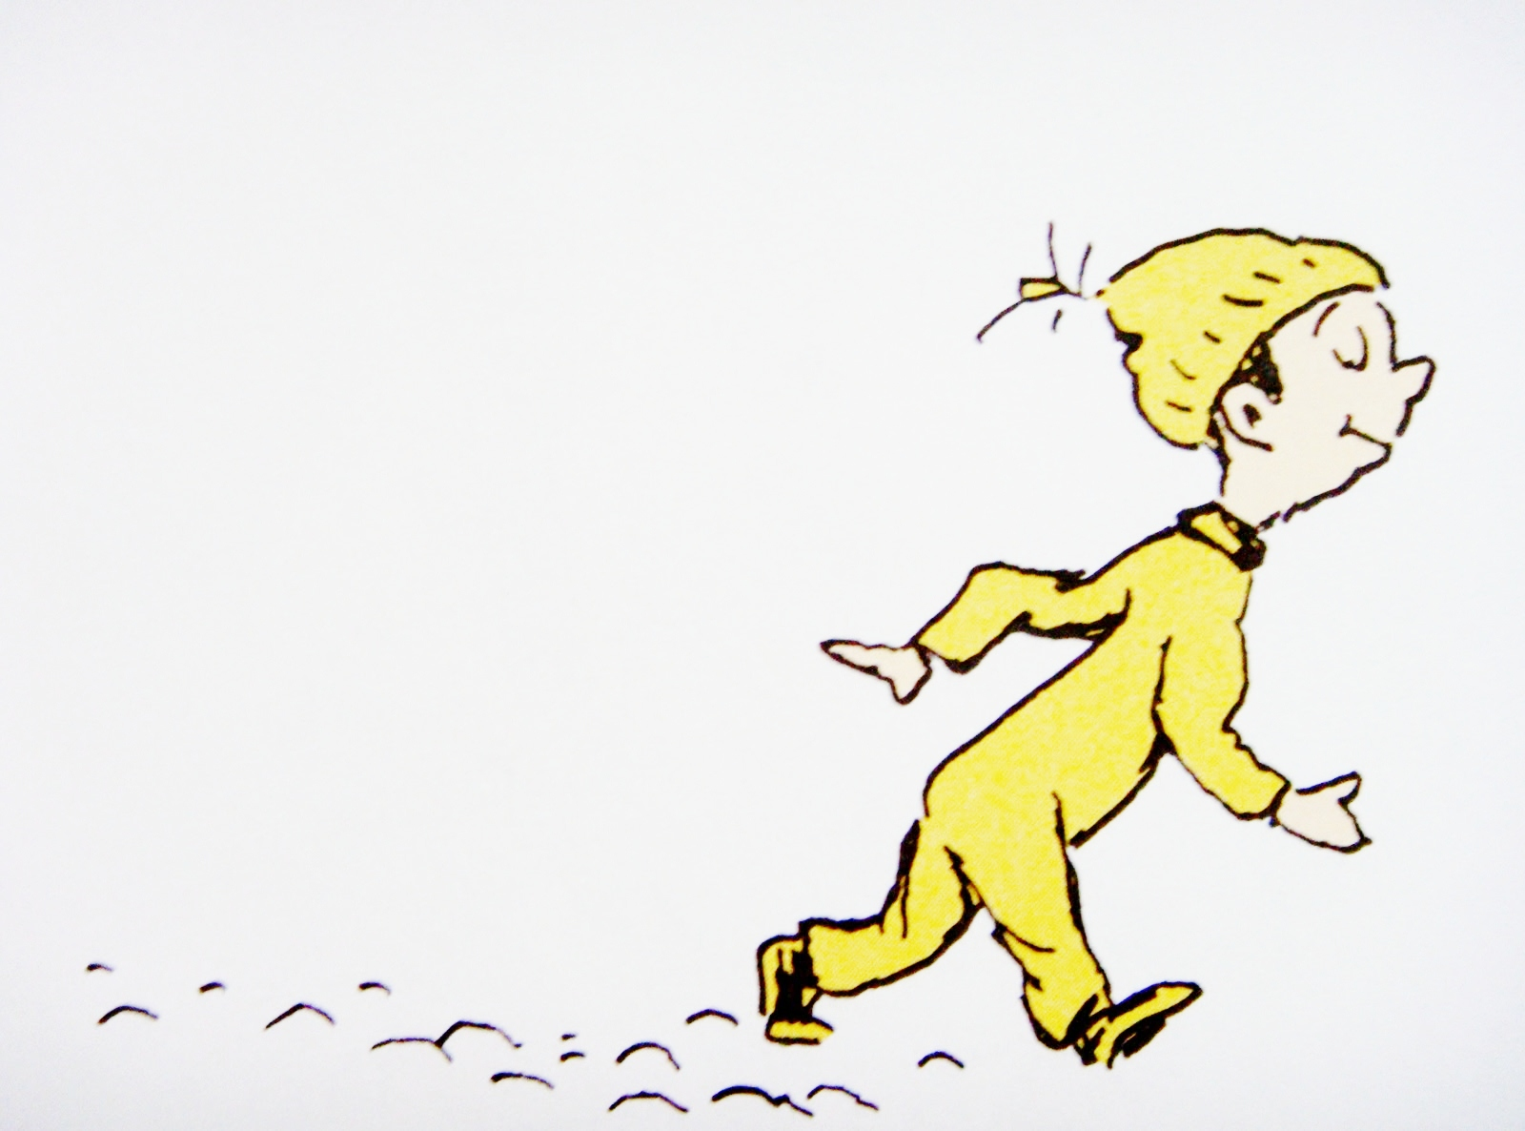
Notes:
So remember, it’s not the places you go,
Or the things that you learn
Or the things you know
It’s the PEOPLE you know.
If one of the people I mentioned tonight is you
please know, that MY career was helped along by YOU too.
My career in the law, was thanks to you all.
I hope too in some way, maybe big, maybe small,
I was of some help, at least a little help, to you all.
Well, I’ve run out of rhymes.
and I’ve used up my time.
Thank you, again, for this honour tonight.
And let me exclaim, as I retire out of sight,
to all, one and all, I wish you a good night.

